Slide 1
Fast Local Laplacian Filters: Theory and Applications
Mathieu Aubry (INRIA, ENPC),
Sylvain Paris (Adobe), Sam Hasinoff (Google),
Jan Kautz (UCL), and Frédo Durand (MIT)
Notes:
Today, I’m going to speak to you about LLFs. The first thing you may ask is why?

Slide 2
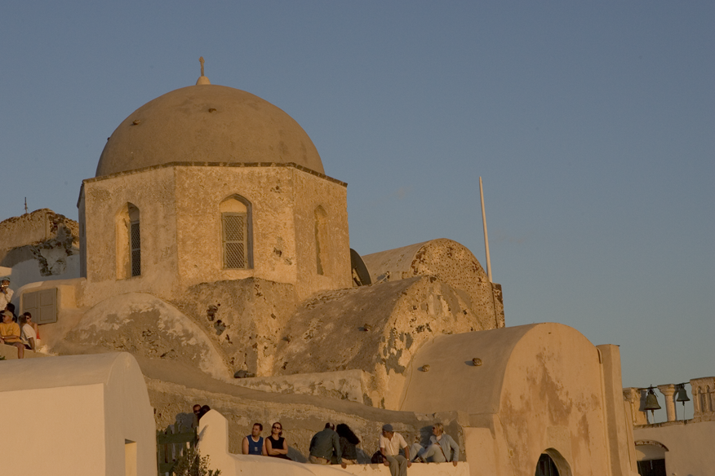
Input
Notes:
Well, here is a typical picture. It looks good, but also a bit flat. That’s why being able to do strong detail enhancement is important

Slide 3
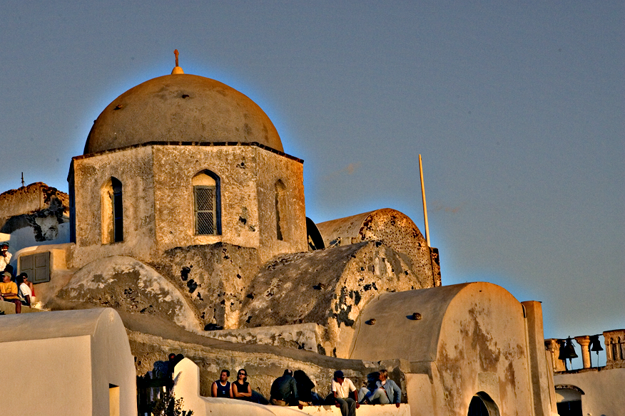
Unsharp Mask, not edge-aware ☹
Halo ☹
Notes:
Unfortunately, if you do it in a naïve way, a lot of problem appear, especially halos around strong edges

Slide 4
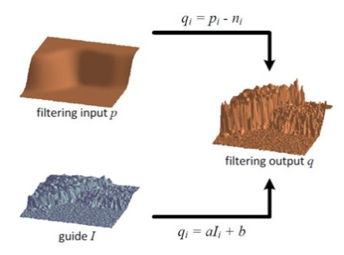
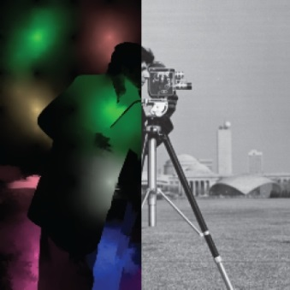
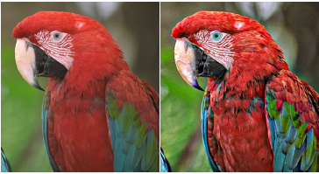
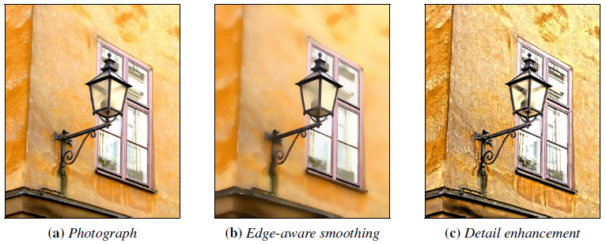
Edge-aware image processing
Bilateral Filter [Tomasi and Manduchi 1998]
$L_{0}$ Gradient Minimization [Xu et al. 2011]
Guided Image Filtering
[He et al. 2010]
Edge-aware wavelets
[Fattal 2009]
Adaptative Manifolds
[Gastal and Oliveira 2012]
See also [Fattal et al. 2002], [Farbman et al. 2008], [Subr et al. 2009], [Gastal and Oliveira 2011]…
Notes:
That’s why there has been a lot of work on edge-aware image processing for image editing.

Slide 5
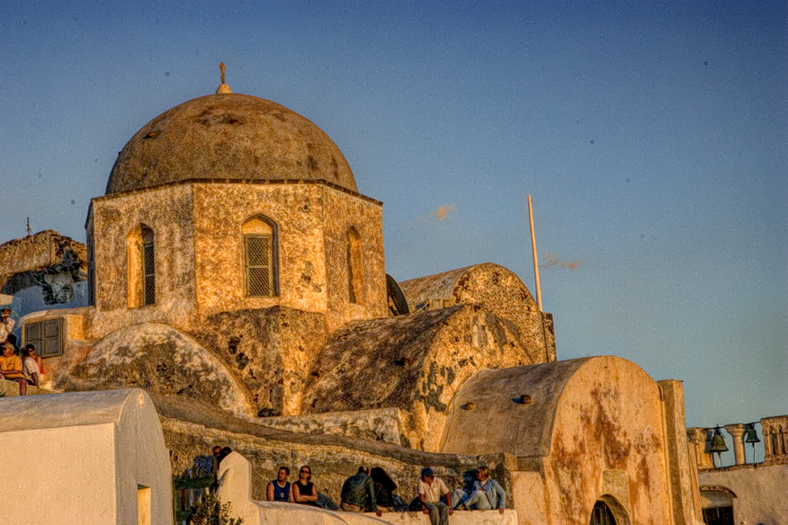
Local Laplacian Filter, edge-aware ☺
[Paris et al. 2011]
No halos or gradient inversion
Even for extreme edits
Notes:
Today I am going to focus on a set of Filters that was developed by some of my co-authors, Local Laplacian Filter. They have the specificity that they don’t create any artifacts like halos or gradient inversions, even for really extreme transformations like this one, and for this reason are very exciting.

Slide 6
Some limitations…
Too slow for interactive editing: 4s/Mpixel
Unknown relationship to other filters
Only detail manipulation and tone mapping
Notes:
So there is a lot to like about these filters, but they have also some limitations.
Right now, they are too slow,
we don’t fully understand their theory,
and they don’t have many applications yet.

Slide 7
Our contributions
Too slow for interactive editing: 4s/Mpixel
20x speed up
Unknown relationship to other filters
Formal analysis and relation to Bilateral Filter
Only detail manipulation and tone mapping
General gradient manipulations and style transfer
Notes:
In my talk, I will address those three points.
I will make them fast,
I will explain how they work,
and I will show how we can use them to transfer the gradient statistics from one image to another.
This three contributions will also be the structure of my talk,
but before going into them, I must first explain to you how LLF work.

Slide 8
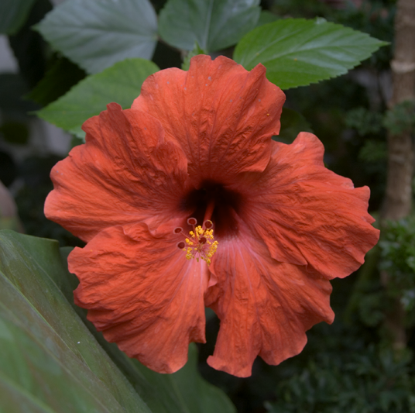
Background on Gaussian Pyramids
Resolution halved at each level using Gaussian kernel
level 3
(residual)
level 2
level 1
level 0
Notes:
Just to be sure we are on the same page, a GP is a set of images which divide by 2 the resolution at each level

Slide 9
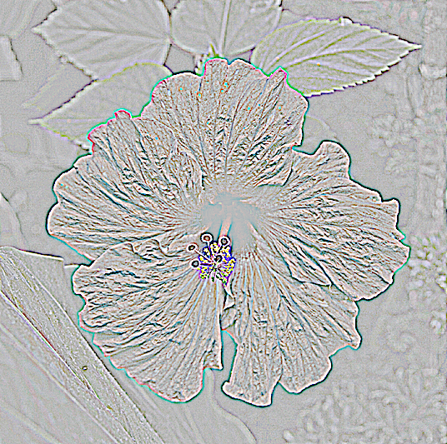
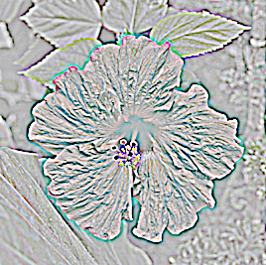
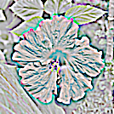
Background on Laplacian Pyramids
Difference between adjacent Gaussian levels
level 3
(residual)
level 2
level 2
level 1
level 0
Notes:
And a Laplacian Pyramid is the difference between the successive levels of the Gaussian pyramid.

Slide 10
Background on Local Laplacian Filters
level 2
level 1
level 0
input image
Output Laplacian pyramid
10
10
Notes:
The LLF algorithm defines an output image by defining its LP.

Slide 11
Background on Local Laplacian Filters
level 2
level 1
level 0
input image
Output Laplacian pyramid
input image
11
11
Notes:
Each coefficient depends of different region in the image

Slide 12
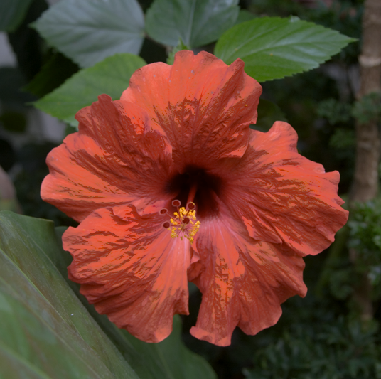
Background on Local Laplacian Filters
level 2
Local contrast
manipulation
level 1
level 0
input image
locally processed
image
Output Laplacian pyramid
12
12
Notes:
So the idea of LLF is to define for each region a locally processed image, relying on a simple intensity remapping

Slide 13
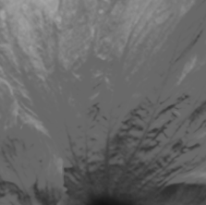
Background on Local Laplacian Filters
Output
intensity
Input
Output
Input
intensity
average
Notes:
How is this remapping defined? Well, we begin by considering the average of the input region. This average will be the reference for our remapping. Around it, we use for example a function that locally decrease the contrast. Look how this curve flatten the intensities around the average. We apply this remapping to the full region, resulting in a smoother image. The pixels which intensity in the input image was close to the average have an almost constant value in the output. On the contrary the rest of the image is almost unchanged.
Note that this remapping really depends on the average value and thus will be different for each region.

Slide 14
Background on Local Laplacian Filters
level 2
level 1
level 0
input image
locally processed
image
Output Laplacian pyramid
locally processed
image
14
14
Notes:
So now we know how to process the image locally in a given region,

Slide 15
Background on Local Laplacian Filters
level 2
level 1
level 0
input image
locally processed
image
partial pyramid
Output Laplacian pyramid
locally processed
image
15
15
Notes:
and we can compute the LP corresponding to this processed region

Slide 16
Background on Local Laplacian Filters
Background on Local Laplacian Filters
copy
level 2
level 1
level 0
input image
locally processed
image
partial pyramid
Output Laplacian pyramid
locally processed
image
16
16
Notes:
Then we just copy the corresponding value to the Output LP.

Slide 17
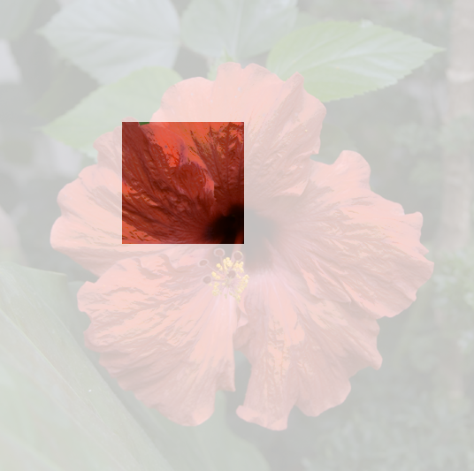
Background on Local Laplacian Filters
Background on Local Laplacian Filters
level 2
copy
level 1
level 0
input image
locally processed
image
partial pyramid
Output Laplacian pyramid
locally processed
image
17
17
Notes:
We repeat the same process for each coefficient in the pyramid, each coefficient defining a different region and thus a different remapping. Since one has to compute a remapped region and a pyramid per coefficient, that makes of course the LLF in their original version slow to compute.

Slide 18
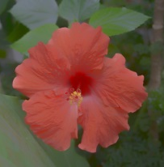
Background on Local Laplacian Filters
Background on Local Laplacian Filters
level 2
copy
level 1
level 0
input image
locally processed
image
partial pyramid
locally processed
image
18
18
Notes:
Finally, once each output coefficient has been computed, the LP is collapsed to get the output image

Slide 19
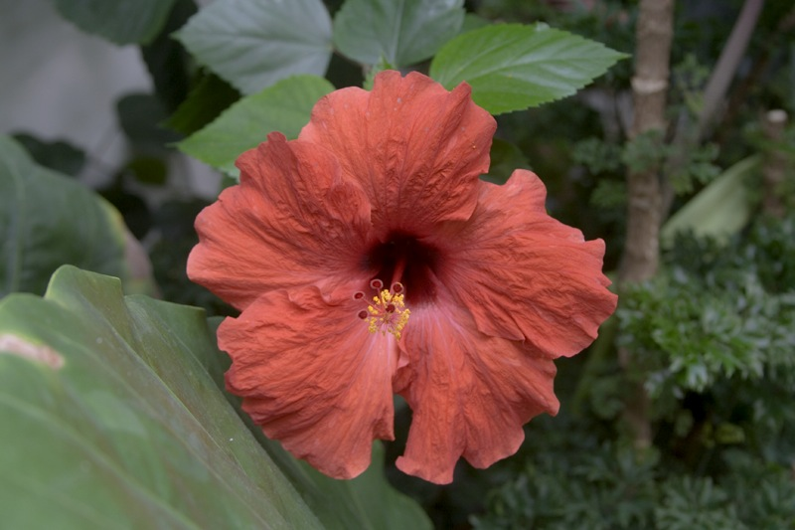
Input
Notes:
Let’s look at the final LLFs results. Here is an input image

Slide 20
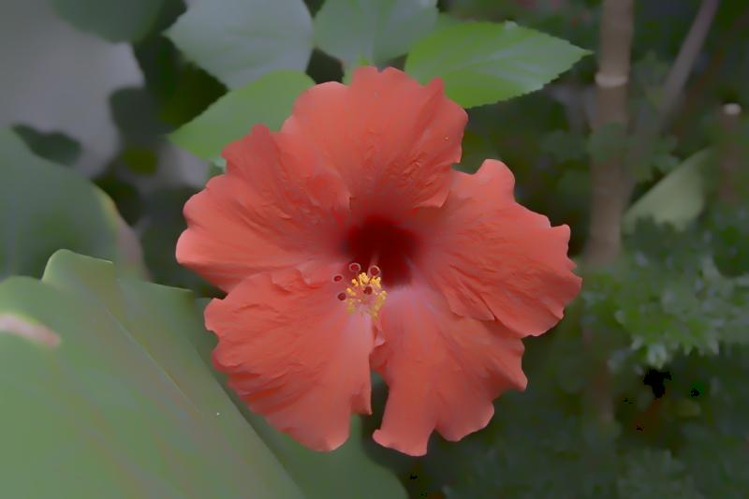
Smoothing
Notes:
And here the smoothed result of LLF using the contrast decreasing function shown on the top right to define the LLF

Slide 21
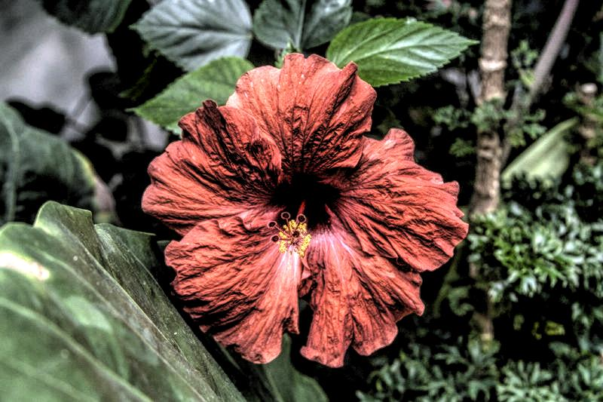
Enhancement
Notes:
If we use a contrast increasing function instead, shown in the top right corner again, the result will now be an artefact-free enhanced image, where we can really see the power of the LLFs. All of that was in the 2011 paper of my colleagues.

Slide 22
1. Speed up
Notes:
But as I mentioned earlier the LLFs were very slow to compute, and our first contribution, that I will present now, is to speed them up.

Slide 23
One-level Local Laplacian Filter
$$i→i−d(i−g)$$
$$I→I−G_{σ}∗I$$
level 1
copy
level 0
input image
locally processed
image
partial pyramid
STEP 1:
INTENSITY REMAPPING
STEP 2:
PYRAMID
23
23
23
Notes:
To do that, let’s begin by looking at a simplified version of the LLF, where only one level is processed. We can understand it as two main steps:
- First a non-linear intensity remapping. In the corresponding equation ‘g’ is the reference value for the remapping function.
- Second, the pyramid construction and processing which is linear.

Slide 24
One-level Local Laplacian Filter
$$i→i−d(i−g)$$
$$I→I−G_{σ}∗I$$
level 1
$O_{p}=I_{p}+\sum_{q}{G_{σ}\left(q−p\right)d(I_{q}−I_{p})}$
copy
Local
sum
level 0
input image
locally processed
image
partial pyramid
Output
image
Input
image
Gaussian
spatial weight
Influence from
intensity difference
STEP 1:
INTENSITY REMAPPING
STEP 2:
PYRAMID
24
24
24
Notes:
Using those equation and after some simplifications, for which I refer you to the paper, we obtain this equation for this simplified one level LLF. This is an important equation which give the value of the output image at a pixel ‘p’ as a perturbation over its value in the original image I_p. This perturbation is the sum on a local neighborhood of the influence of nearby image values. This influence is a function of the intensity differences with the neighbor pixels, and is weighted by a spatial Gaussian weight.
(pause)

Slide 25
Why is it slow?
$$i→i−d(i−g)$$
$$I→I−G_{σ}∗I$$
$O_{p}=I_{p}+\sum_{q}{G_{σ}\left(q−p\right)d(I_{q}−I_{p})}$
For each neighborhood
For each pixel
Computed #neighborhood x #pixels
Notes:
Now, using this equation, we can understand better why the LLF are slow to compute. They are slow because d is spatially varying, one must compute this remapping for each pixel and on its full neighborhood, so that the computational time is proportional to the product of the two.

Slide 26
Speed up
$$d(i−g)$$
Idea: if $g$ were constant, we would need to compute d only once per pixel
Compute d only for a small set of values
of $g$and interpolate
Compute d K x #pixels
Notes:
So to make LLF fast, everything is about computing d efficiently
If the reference “g” to consider were constant, we would need to compute the remapping only once, and everything would be fast. So we developed this very simple idea and show in the paper that one can approximate the results well by computing the remapping only for a small set of reference values and interpolating.
This allows to compute the remapping only a constant number of time for each pixel, which means approximately 2 orders of magnitude less than before.

Slide 27
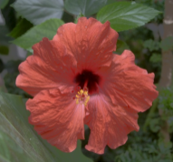
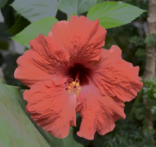
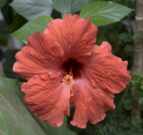
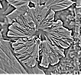
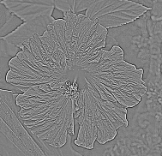
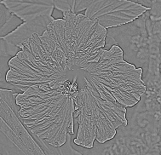
In practice
…
g=0.3
…
…
g=0.7
…
output
g=0.5
Remapped
images
Laplacian
pyramids
Notes:
So in practice, one begins by sampling reference values. Each reference value is associated to a different remapping function. Using those remapping functions, we compute remappings of the full image and for each processed image we compute a Laplacian pyramid.
Then we compute the output LP by interpolating all those pyramids, and finally, the output LP is collapsed to get the output image.

Slide 28
Performance
 | [Paris 2011] | Our method | Speed up
1Mpixel CPU | 15 s | 350 ms | 50x
4Mpixel GPU | 1 s | 49 ms | 20x
Suitable for interactive editing
implemented in Lightroom/Photoshop
Notes:
This allows a speed up of approximately 50 times on CPU and 20 times on GPU compared to the approximation introduced in the 2011 paper, leading to computation times below ½ a second per megapixel on CPU. This is fast enough for interactive editing, and thus the LLF are now used in several Adobe products with our new algorithm.

Slide 29
Input Image
Notes:
Let’s now look at what those results mean concretely. Here is an again our flower example

Slide 30
Ground truth enhancement
Notes:
Which details are enhanced with the LLF.

Slide 31
Our method with 20 values
Notes:
If we approximate it using 20 reference values for the remapping function, we get an image on which we can see no visible differences

Slide 32
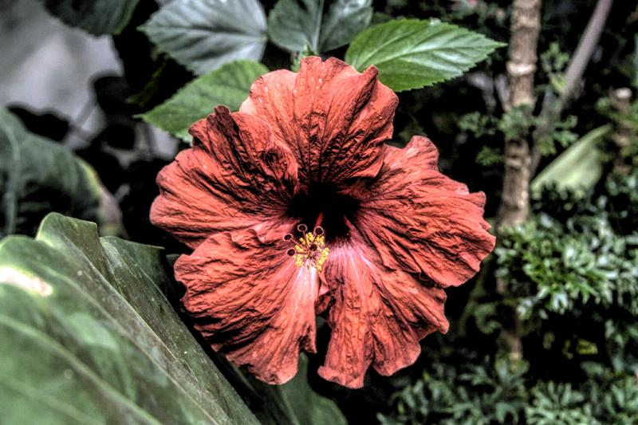
Our method with 10 values
Notes:
If we use 10 values we can see small differences but the image is still very satisfactory.

Slide 33
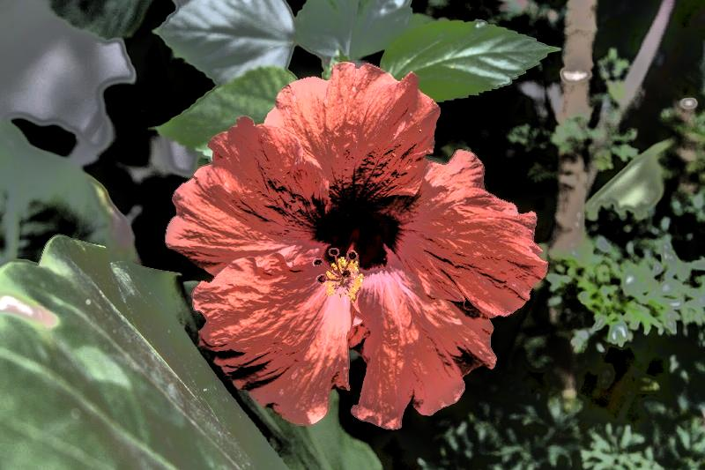
Our method with 5 values
Notes:
Eventually it breaks down, and we show in the paper that we can predict when using the bandwidth of the remapping function
(pause)

Slide 34
2. Relation to Bilateral Filter
Notes:
Let’s now move to our second key contribution: making the link between LLF and better known filters, in particular the BF

Slide 35
Interpretation
Bilateral Filter
One-level Local Laplacian Filter
Spatial weight
Weighted intensities
Spatial weight
from pyramid
Remapping
function
Notes:
Let’s look at the equation for the Bilateral filter. Its results is an average with a Gaussian spatial weight, of the input intensities weighted by a Gaussian over the intensity differences. This equation has a lot of similarities with the equation we have obtained for the one level LLF. It had also a spatial Gaussian weight that came from the LP, and the remapping function was depending on intensity differences.

Slide 36
Interpretation
Bilateral Filter
One-level Local Laplacian Filter
Spatial weight
Weighted intensities
Spatial weight
from pyramid
Remapping
function
Notes:
We can make those equations even more similar if we define a remapping function with a Gaussian.
Even if this function is different from the one introduced in the original paper which was defined by power functions, it is very similar,

Slide 37
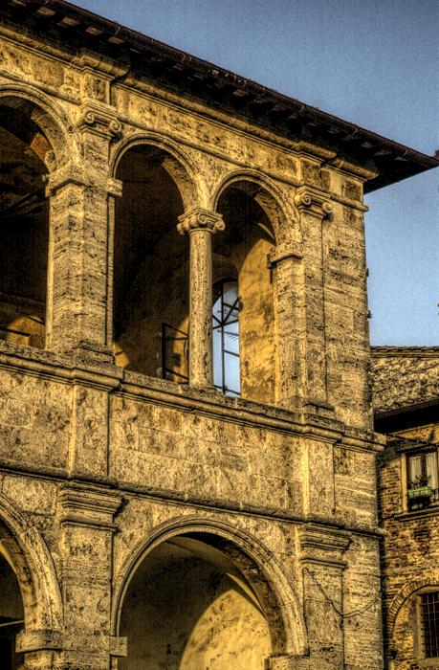
Power function
Gaussian
Notes:
and can give visually similar results, as you can see here

Slide 38
Interpretation
Bilateral Filter
One-level Local Laplacian Filter
Spatial weight
Weighted intensities
Spatial weight
from pyramid
Remapping
function
Notes:
The equation are still difficult to compare because of this term I_p in the equation of the one level LLF.

Slide 39
Rewriting the bilateral filter
Weights sum to 1
Bilateral Filter
Notes:
However, one can rewrite the BF to get a more similar form. Indeed, since the sum in the BF is normalized, one can add and remove the image value to make the BF appear as a perturbation

Slide 40
Interpretation
Bilateral Filter
One-level Local Laplacian Filter
Spatial weight
Weighted intensities
Original
image
Spatial weight
from pyramid
Remapping
function
Notes:
Now, we have very similar equations for both filters. Both appear as a perturbation over the initial image, both have a similar spatial weight and the intensity of the neighbor pixels has a similar influence.
The major difference that remains is that the BF sum is normalized, and not the one of the one level LLF. That has an important influence especially on edges, and I encourage you to look in a paper for a more detailed analysis on this point.
There is also another major difference between the BF and the LLF that I have discarded for the moment: the LLF are multiscale.

Slide 41
Multi-scale effect: input
Notes:
Let’ s look at what this multi-scale aspect means visually. Here is an input image

Slide 42
Multi-scale effect: 1 scale
Notes:
And here the same image with details enhanced only by the first level of the LLFs. You can see that only the very fine scale details are increased.

Slide 43
Multi-scale effect: 2 scales
Notes:
If we add second level in the LLF we obtain this image

Slide 44
Multi-scale effect: 4 scales
Notes:
And here we go until 4 levels. You can see that gradually more scales are increased.

Slide 45
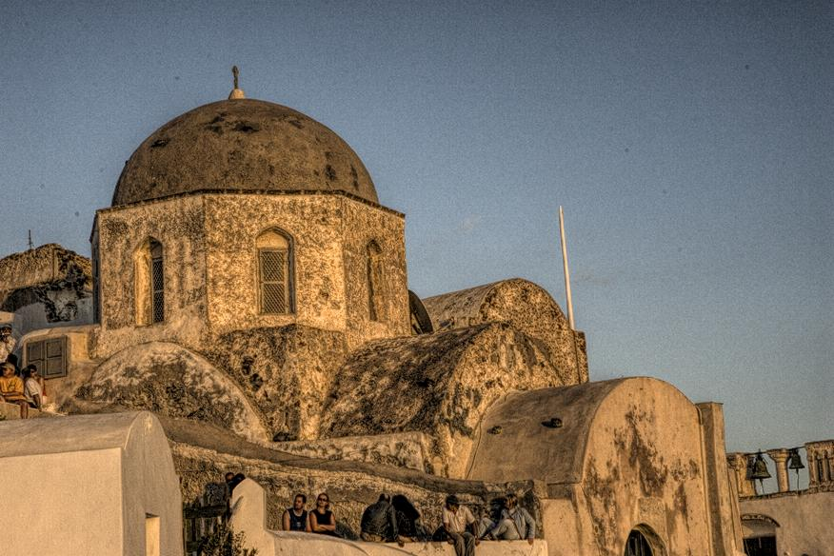
Multi-scale effect: 8 scales
Notes:
And if you go until 8 levels, which is almost the full LLF, you can obtain this image, which increase the image content at all scales
(pause)

Slide 46
3. Style transfer
Notes:
Now that we understand better the LLF, I will explain to you how we can use them to perform style transfer.

Slide 47
Local statistics manipulation
Interpret the remapping function as a remapping of pixel differences
intensities
Single-neighbor case
Notes:
For that, you can think of LLF as remapping of pixels differences. Let’s begin by looking what the simplified one level LLF does to a pixel ‘p’ in the ideal case where it has a single neighbor ‘q’ with which it has an intensity difference I_p - I_q . What it does is that it changes it into a value O_p which has an intensity difference h(I_p –I_q) with I_q. We show in the paper that h is a function that has a very simple relationship with the remapping function used for the LLF. I encourage you to read the paper for more details about it.

Slide 48
Local statistics manipulation
Many neighboors case
Can be interpreted as averaging target differences
intensities
Notes:
The question is now what happens in the real case where there are several neighbors. In this case all neighbors influence the value of p toward their target value defined by ‘h’, and the resulting output value is an average of all those target values.

Slide 49
Local statistics manipulation
h controls how the gradients are remapped
Use histogram transfer function to define h
Notes:
So in fact, in this one level LLF, h controls how the gradients are changed, from their original value ‘I_p-I_q’ to h(I_p –I_q) . That gives the idea of using the histogram transfer function between gradient histograms in an input image and a model image to define the positive part of h. Since we need to define h for negative values as well, we mirror it so that we treat positive and negative gradients the same way. Now, by defining this single function, we can define the LLF that will perform style transfer

Slide 50
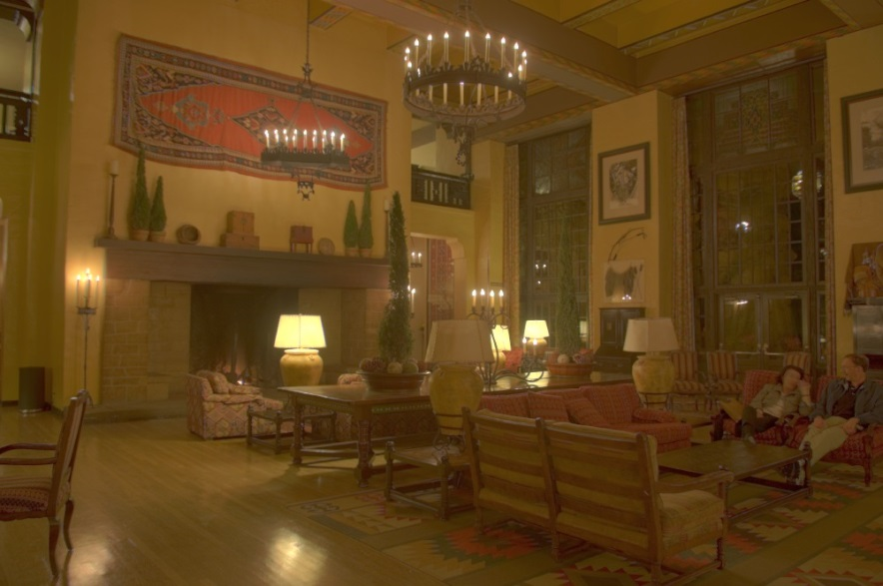
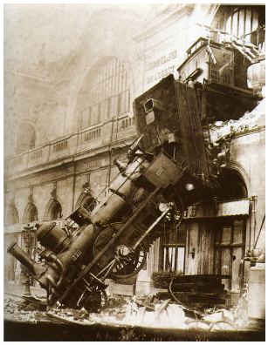
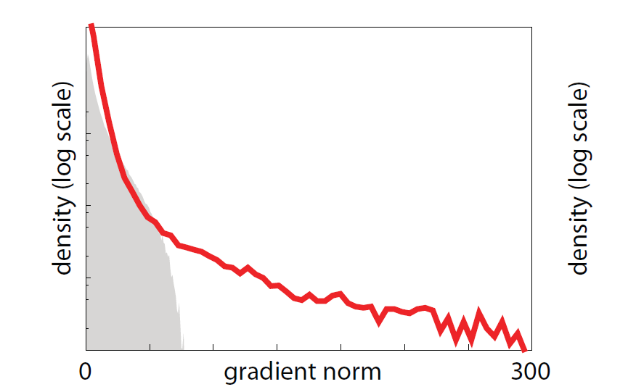
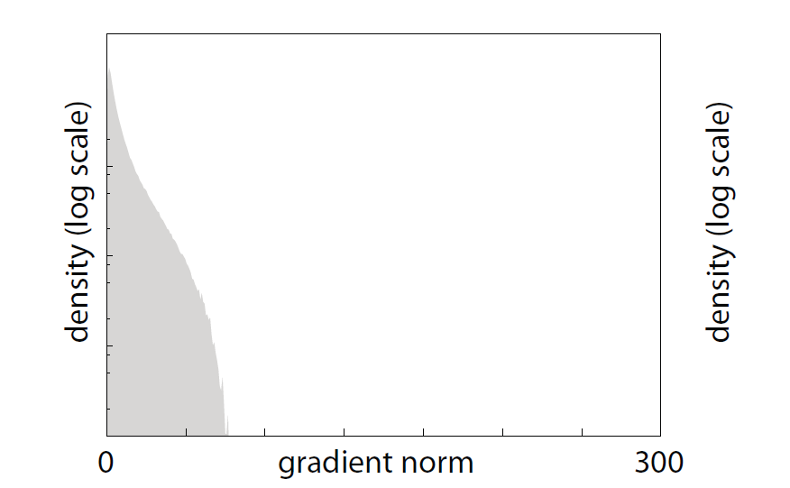
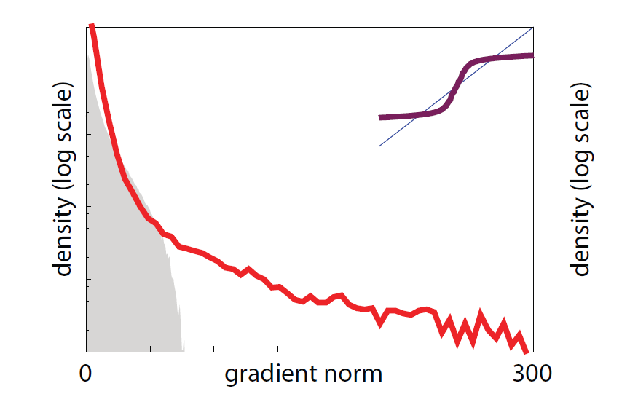
Example:
Notes:
Let’s look at what results it produces. Here is a well known photograph we take as model style. We can compute its gradients distribution, shown here. Here is an HDR photograph that we would like to map to a similar style. Since it is HDR, Its gradients are in a completely different range than the model photograph. If we now use the two gradient histograms to define a transfer function, we obtain this function, that corresponds to our intuition since it compress the intensity values
HDR->robust
So histogram smaller

Slide 51
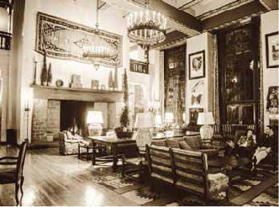
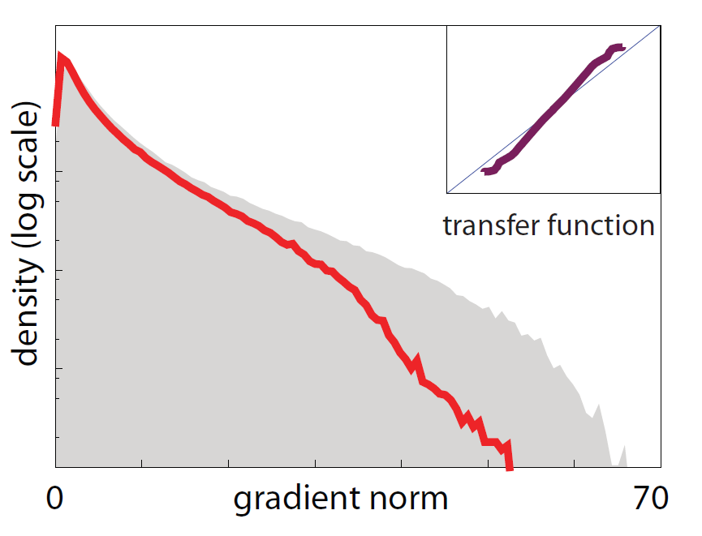
Example: iteration 1
Notes:
Applying the LLF with this function, we obtain this result. Notice the horizontal axis scale in the histograms has changed and the histograms are now in a similar range. The images also have a very similar style, and there is just some fine tuning to do.

Slide 52
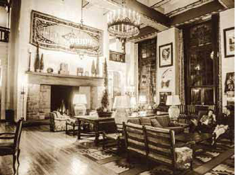
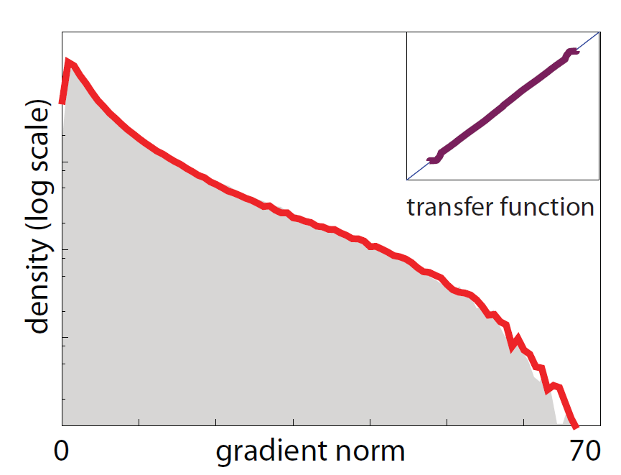
Example: iteration 2
Notes:
Repeating the process leads to this results. Visually that’s only small changes, but if you look at the gradient histograms they are now almost exactly the same.

Slide 53
Notes:
Here are some results in higher resolution. Here is our input image

Slide 54
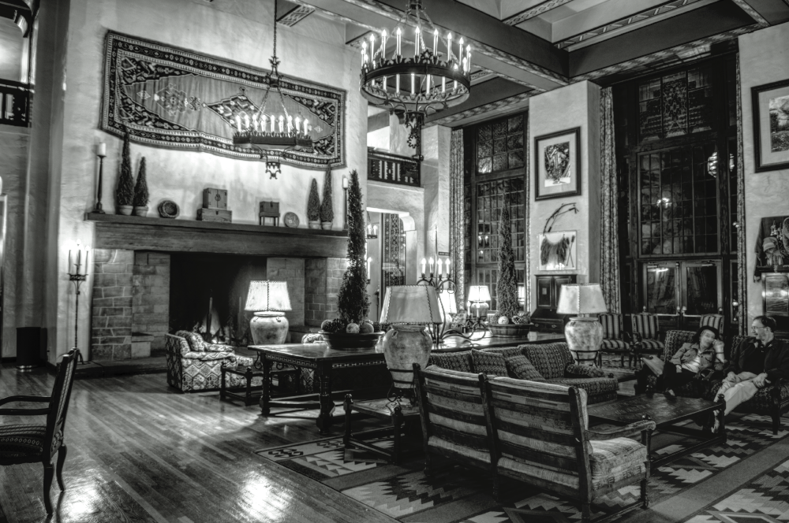
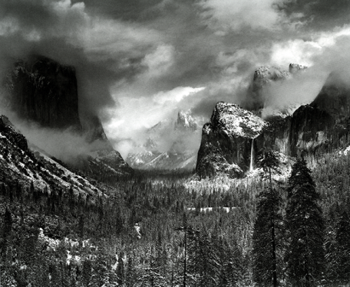
Notes:
And here the result when transferring the style of the image in the top right.

Slide 55
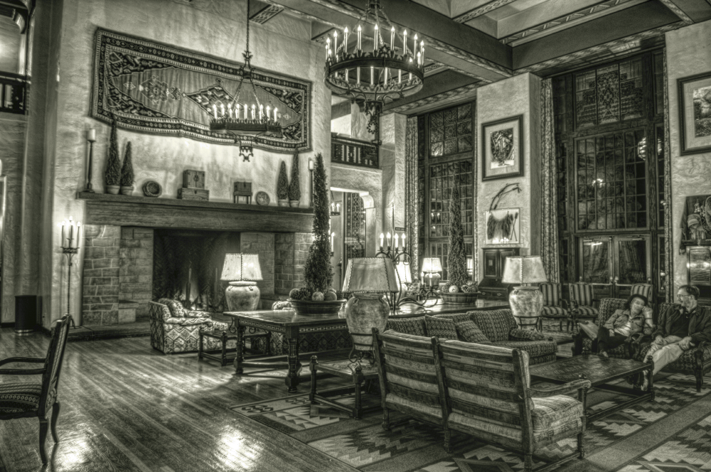
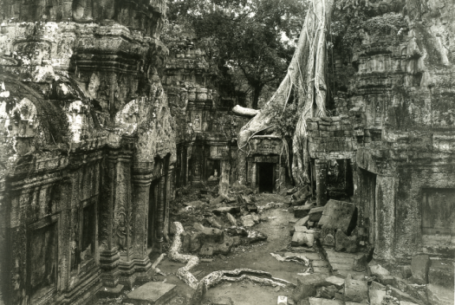
Notes:
Here the same input image but with a different model, which has strong gradients and a high level of details everywhere.

Slide 56
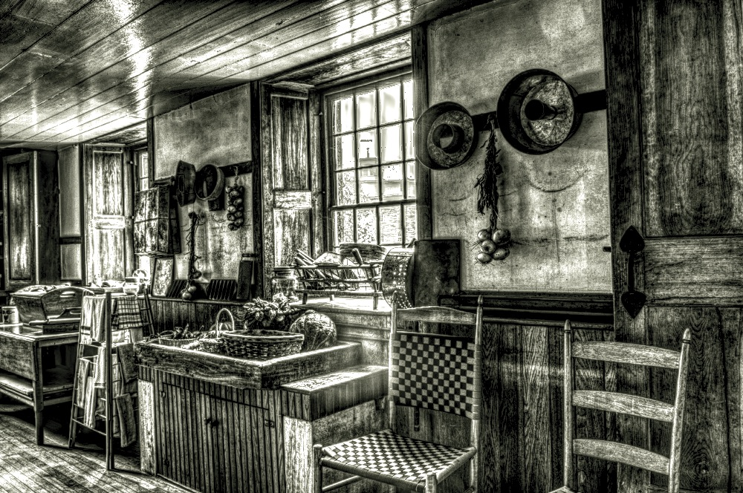
Notes:
Here the same input image but with a different model, which has strong gradients and a high level of details everywhere.

Slide 57
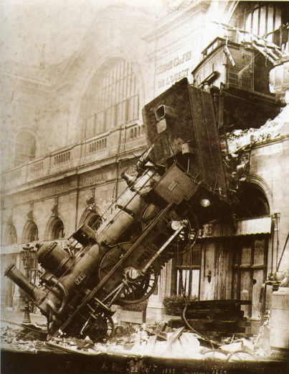
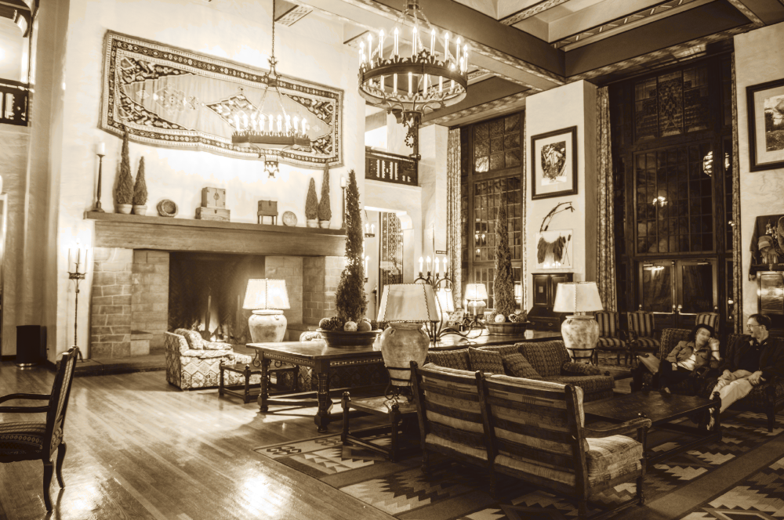
Notes:
And here the same model as before.

Slide 58
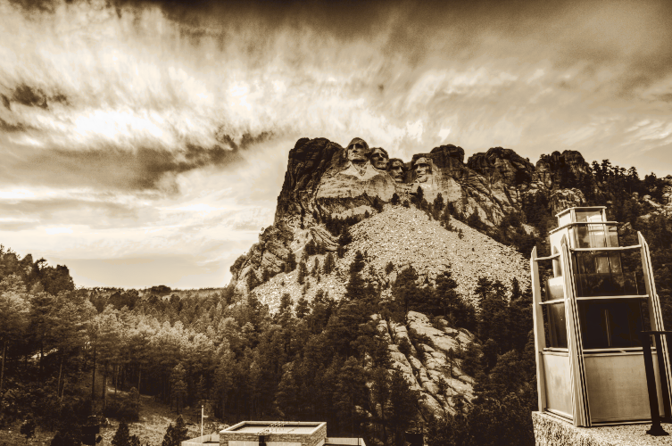
Notes:
Here the same model again with a different input

Slide 59
Also in the paper
Link with PDEs / Anisotropic diffusion
Introduction of Un-normalized Bilateral Filter
Discussion of effect on edges
More results and comparisons
Quantitative evaluations of transfer
Notes:
I encourage you to look at the paper where you can find a lot more analysis and results

Slide 60
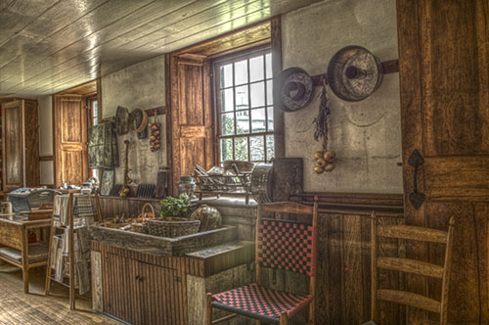
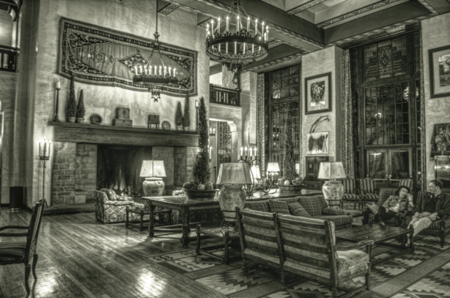
Conclusion
20x to 50x speed-up
in Lightroom and Photoshop
Relationship with BF and PDE
Gradient histogram transfer
Photographic style transfer
Matlab code and more results:
http://www.di.ens.fr/~aubry/llf.html
Notes:
To conclude, I have shown how to speed up the LLFs, to make them fast enough for interactive editing
I have shown how they relate to the BF
And I have explained how they can be used to transfer the gradient statistics from one image to another, performing photographic style transfer.
You can find the matlab code for fast LLF and style transfer on our project webpage.

Slide 61
We would like to thank…
Mark Fairchild for his HDR survey
The anonymous reviewers for their constructive comments
Adobe for its gifts to Jan Kautz, Sam Hasinoff and Frédo Durand
Notes:
Before finishing we would like to thank people who helped us

Slide 62
Conclusion
Relationship with BF and PDE
20x to 50x speed-up
in Lightroom and Photoshop
Gradient histogram transfer
Photographic style transfer
Matlab code and more results:
http://www.di.ens.fr/~aubry/llf.html
Notes:
Thanks for your attention

