Slide 1
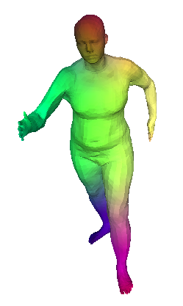
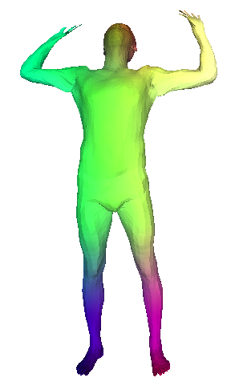
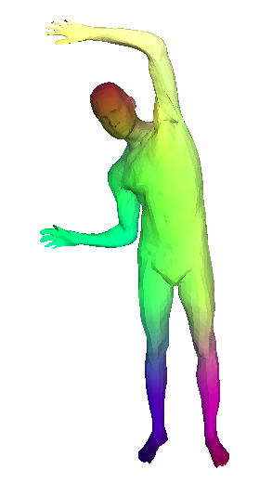
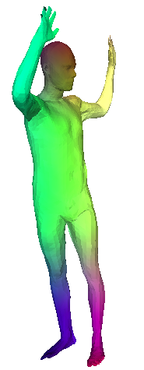
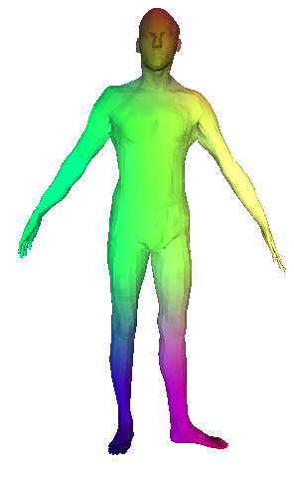
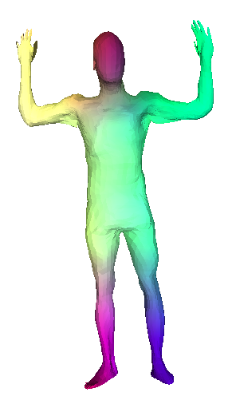
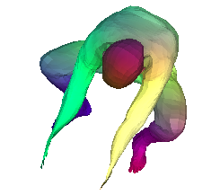
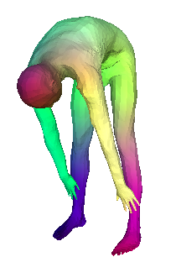
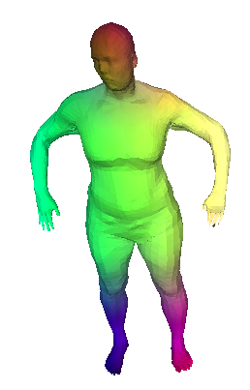
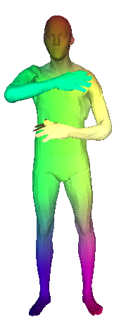
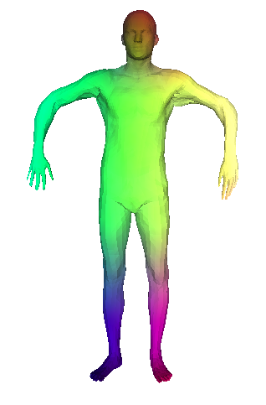
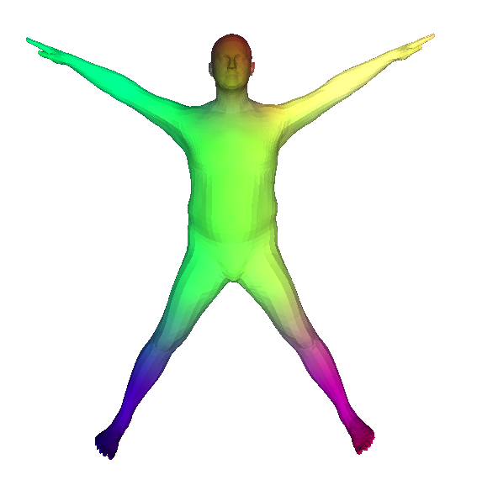
Parametric estimation of 3D surfaces and correspondences
Thibault Groueix (Ecole Nationale des Ponts et Chaussées)
Notes:
BEST VIEWED IN PRESENTER MODE.

Slide 2
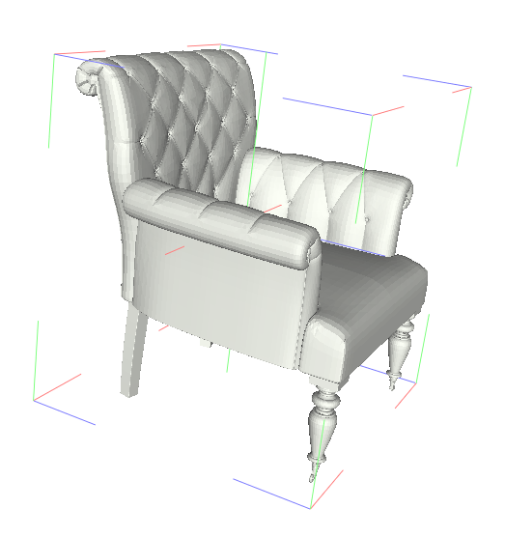
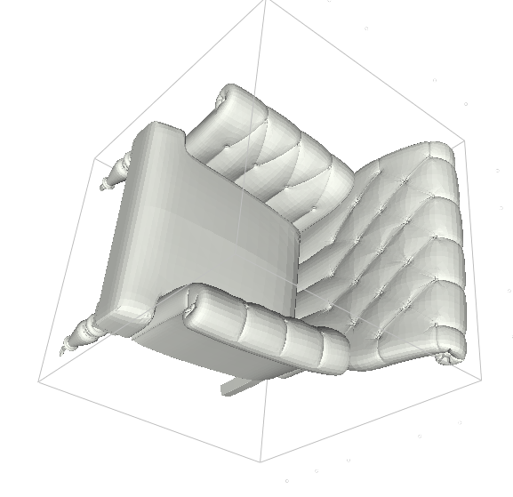
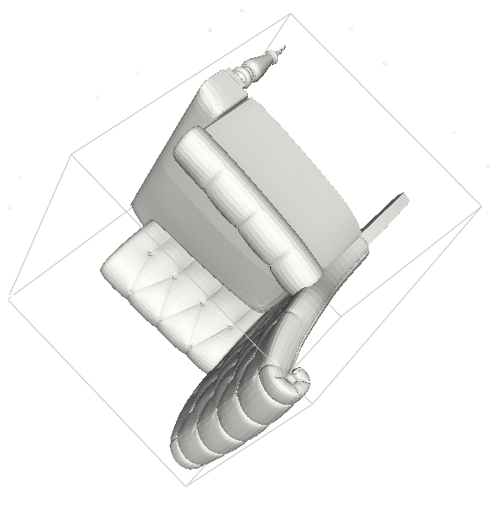
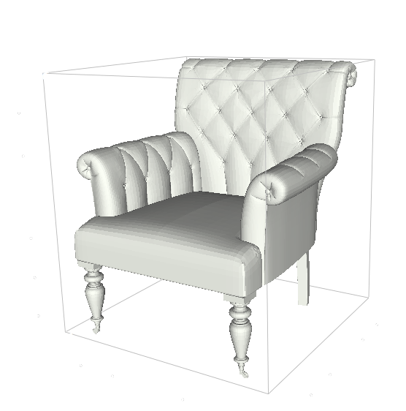
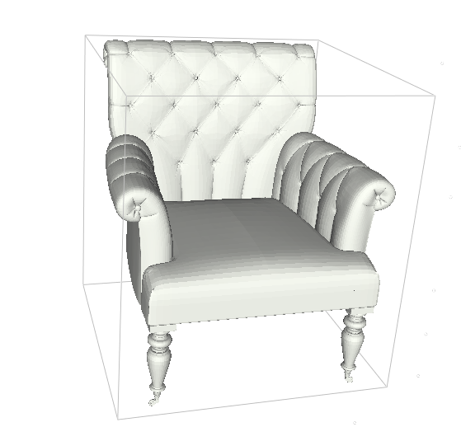
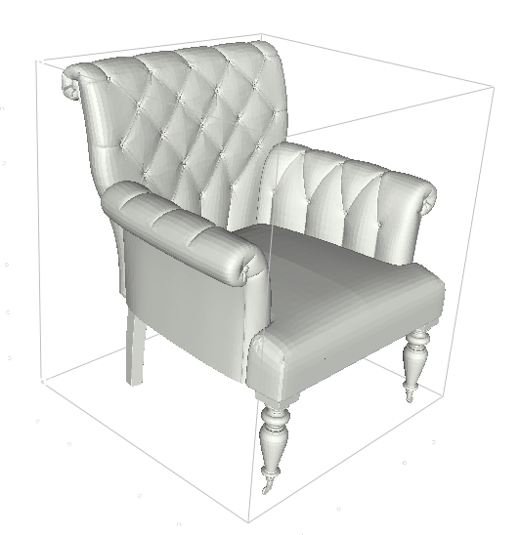
6D Object poses (rotation/translation) of a single object [Tan2017]
6D Object Pose Estimation with Depth Images: A Seamless Approach for Robotic Interaction and Augmented Reality, Tan et al. , ICCV 2017
Notes:
Imagine a rigid object, pose estimation with 6 degrees of freedom is well defined given a rigid object. It's the estimation of 3 parameters for translation, and 3 parameters for rotation.

Slide 3
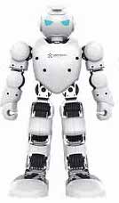
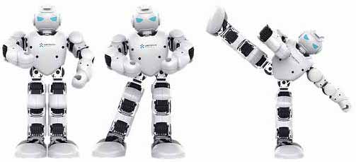

6 degrees of freedom is not enough for non-rigid objects, spanned from a template object.
Notes:
What happens when the object is not rigid ? For example, in the case of an articulated object such as a robot.
In addition to global rotation and translation, the robot have an additional degree of freedom for each of his joint.
Those are additional intrinsic parameters that we also have to estimate.
In this case, it is easy to manually design a parametrization with N degree of freedom, when each parameters naturally encodes the angle of a given joint.
In this particular setting, the problem of pose estimation becomes to estimate those intrinsic parameters, as well as rotation/translation.

Slide 4
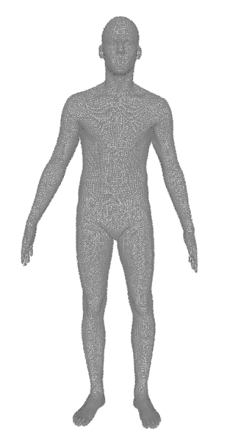
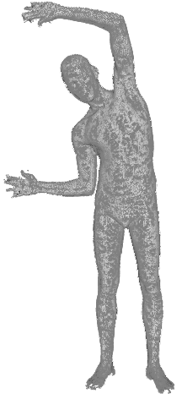
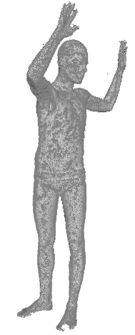
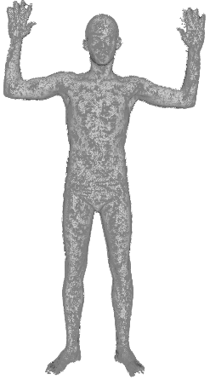
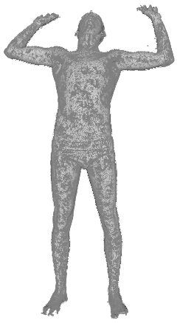
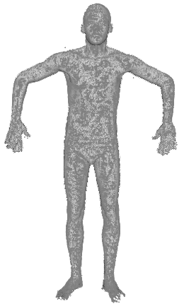
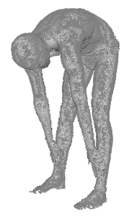
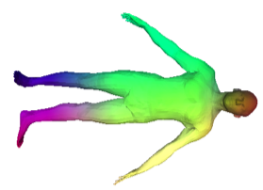
6 degrees of freedom is not enough for non-rigid objects.
6 degrees for translation/rotation + N degrees object pose
6 degrees for translation/rotation + no clear parameterization
Notes:
A broader class of shapes are deformable objects such as humans. Humans can make different movements using their muscles, similar to a robot but much harder to parameterized.
To make things worse, the category of human is diverse. Some are tall, slim, fat or short. We need additional parameters for all of this.
Pose estimation is not well define anymore in this context because there are no more natural parameterization as we had for robots. - > either manually design it or We have to learn it.
The first I want to discuss today is how to learn a parametrization for such deformable objects.

Slide 5
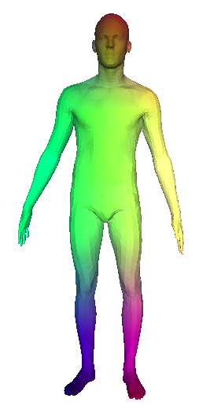
Approach: 3D parametrizaton by template deformation
template pointcloud
Input pointcloud
Input: 3D
pointcloud
Output: deformed template
Parameters
Notes:
To learn a parametrization, we want to be able to find the parameters of an input shape S.
input : point cloud S (list of 3D points),
Parameters : Epsilon (S).
to reconstruct the input pointcloud S from Epsilon (S)
We leverage the prior on deformable shapes that they come from the deformation of a neutral example that we call template.
It will be easier to learn a deformation on the template, because a lot of information is already there, rather than reconstruct a human from scratch.
You'll know already that eyebrows are above the eye, a head is on the shoulders, and , even more fancy stuff like the fact that the ration between the tip of your finger to your elbow, and your wrist to your elbow is the golden number.

Slide 6
Auto-Encoder
Reconstructed Shape
Template
Input Shape
Decoder
Parameters
Encoder
Notes:
To learn a parameterization, we are going to use neural networks and a structure of type autoencoder.
The encoder Epsilon maps the input pointcloud S to the parameter space and outputs Epsilon (S)
The Decoder take the template A and the parameters Epsilon (S) as input, and reconstruct the input S.
The parameterization is the mapping between parameters space to pointcloud space.
By learning the decoder, we're learning the parametrization.
At test time, we can estimate the parameters associated to this parametrization using the encoder.
Let's see how we can learn such an architecture. I first want to explain how to design a simple encoder on pointcloud data, then we'll see how to use this encoding to deform the template and reconstruct the input.

Slide 7





Encoder
(x₁, x₂,…, x_{n} ) = γ( g( h( x₁ ), …, h( x_{n} ) ) )
h
$$x_{1}=$$
(1,2,3)
MLP
Input
pointcloud
g
$$x_{2}=$$
(1,1,1)
γ
MLP
MLP
=
${(x}_{1},x_{2, }…,x_{n}$)
max
$$x_{…}=$$
(2,3,2)
MLP
…
$$x_{n}=$$
(2,3,4)
MLP
Credit : PointNet: Deep Learning on Point Sets for 3D Classification and Segmentation, Qi et al. CVPR (2017)
Notes:
The input of the encoder is a list of 3D points S. The key aspect of designing an encoder is to make sure it is invariant to a permutation of the input points
A simple and well-performing way to achieve this, introduced by PointNet, is to
- first embed each point x1, x2, ..., xN independently to a higher dimensional space with an MLP h,
- then apply a maxpooling. The result becomes invariant to permutation of x1, ... xN, precisely because the max operation is completely impervious to the order of the points x1, ..., xN.
- Then we further encode the resulting feature vector with an MLP in the parameter Epsilon of S

Slide 8
Auto-Encoder
Reconstructed Shape
Template
Input Shape
Decoder
Parameters
Encoder

Slide 9
Auto-Encoder
Reconstructed Shape
Template
Input Shape
Decoder
Parameters
Encoder

Slide 10
x
Key idea 1: deform a surface
Parameters
Generate
a point q
Decoder
x
y
y
MLP
z
z
Sample
a point p
Notes:
Let's take it from the decoder. The decoder encodes input shape S into a set of parameters Epsilon (S), from which we aim at reconstructing S, by deforming the template.
To achieve this, the decoder works at the point level.
A point p is sampled from the template and concatenated with the parameters
The resulting vector is fed the decoder, an simple MLP, which output a 3 dimensional vector : one point.
We can repeat this process for other points from the template.
As we do this for all the points in the template, we transform the template pointcloud in another pointcloud with the same number of points.

Slide 11
x
Key idea 1: deform a surface
Parameters
Generate
a point q
Decoder
x
y
y
MLP
z
z
Sample
a point p
Notes:
Furthermore, since the decoder only works one point at a time, we have a mapping between each point p of the template, and its reconstruction q.

Slide 12
Auto-Encoder
Reconstructed Shape
Template
Input Shape
Decoder
Parameters
Encoder
Notes:
If you missed how the encoder and the decoder works, that’s fine, we’re now going to see how we can train this structure. How do make sure that reconstructed pointcloud matches the input pointcloud ?

Slide 13
Supervised Loss
point p
Reconstructed Shape
Template
Input Shape
Decoder
Point r
Parameters
Encoder
point q
Notes:
What we know is that every point p on the template is mapped to a point q in the generated pointcloud.
What we want is that q is on S, and is specifically on the shoulder.
Hence what we need to make this connection is the last arrow. we need correspondence annotations in the dataset between every shape and the template. That is to say, we need to know for every point of every training example, where it maps on the template.
As we know this, we can make sure that a point going through our decoder is generated in the right place, and this for every point. In practice, we penalize the Euclidean distance between a generated point, and the place where it should have been generated according to the correspondence supervision. It is nothing more than an L2 distance between the generated list of points and the input points.

Slide 14
Challenges:
Expensive/impossible annotations
Notes:
Unfortunatly we made a big assumption, that we could gather a dataset of 3D shapes with correspondence annotations.
1000 3D shape with 10 000 points makes About 10 millions annotations.

Slide 15
Unsupervised Loss
point p
Reconstructed Shape
Template
Input Shape
Decoder
Point r
Parameters
Encoder
point q
Notes:
If we loose supervision, we loose the mapping between the template and the training example, and we can't map the generated points with the input points anymore.

Slide 16
Unsupervised Loss
point p
Reconstructed Shape
Template
Input Shape
Decoder
Parameters
Encoder
Point r
point q
Chamfer Distance
Notes:
We'll solve this in two steps, because in fact we want two things.
First we'll make sure that the set of generated points maps the input and worry about the semantics later.
We use the chamfer-distance, a nearest- neighbors loss to get an approximate mapping and replace the l2 loss.
For every generated points, we find the closest GT point and attract it. And the reverse, for every GT point, we find the closest generated point and attract it. At the end of the optimisation, the generated pointcloud aligns with the GT point cloud.
But that only work at the scale of the pointcloud. If you zoom in at the point level, nothing prevent a point sampled on the shoulder of the template to be mapped to the toe of the reconstructed shape. The chamfer distance only enforces globally that the generated pointcloud is close to the input point cloud. We could hope that the easiest and most efficient way to reconstruct the input would be by preserving the semantics, but in practice, we do observe good reconstruction with high distortion of the template, likely because of a bad local minimum.

Slide 17
Unsupervised Loss
point p
Reconstructed Shape
Template
Input Shape
Decoder
Parameters
Encoder
Point r
point q
Chamfer Distance + Regularization
Notes:
To make sure our parametrization maps a hand to a hand and a toe to a toe, and a shoulder to a shoulder we need additional regularization.
We have two regularization methods that complete one another.

Slide 18
Unsupervised case:
: Chamfer distance (nearest neighbors based reconstruction loss) between deformed template and target shape.
: Edge ratio loss (regularization). Preserve local neighbourhood of the template by encouraging each edge in the deformed template to keep the same length.
: Laplacian loss (regularization). Preserve local neighbourhood of the template by encouraging the laplacian of the deformed template to remain constant.
Notes:
It relies on the connectivity of the template.
The basis idea is just to say that if two points are close in the template, they should remain close in the reconstruction. Hence we simply compute the ratio of the distance between two points of the template and their reconstruction.
Similarly, if a group of points form a curvy region such a the tip of a finger, their reconstruction should have the same curvature. This makes sure the tip of a finger can't map to a torso. The curvature is easily computed with the Laplacian matrix of the template, and we use it make sure it is preserved by the deformation.

Slide 19
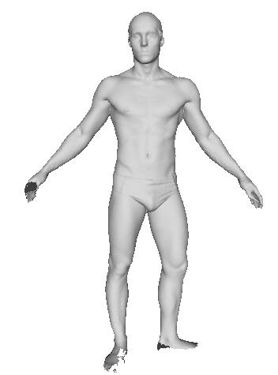
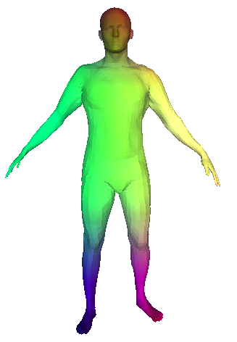
Results (Supervised)
Reconstructed Shape
Input Shape
Template
Decoder
Parameters
Encoder
Notes:
So all the ingredients are now in the soup, and we can look at some results. How well is this autoencoder architecture we designed performing ?

Slide 20
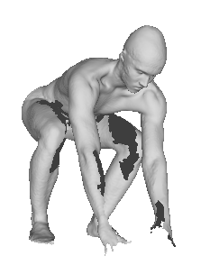
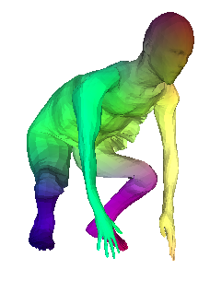
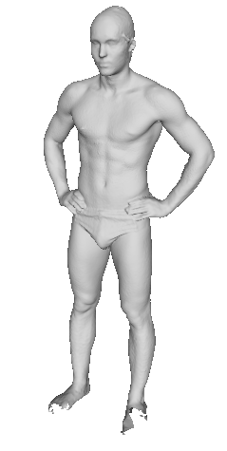
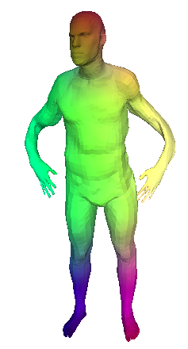
Results (Supervised)
Input Shape
Reconstructed Shape
Template
Decoder
Parameters
Encoder
Notes:
1st shape ok, good reconstruction.
2nd / 3rd shape Check out the skinny arms, the weird arms.
Given a parametrization (the decoder), the encoder gives a fair estimate of the parameters. Can we find better ones ?

Slide 21
Key idea 2: Parameter optimization
Input Shape
Reconstructed Shape
Template
Features
Minimize
Chamfer distance
Notes:
At test time, To find better parameters, we do local optimization with gradient descent.
We explore the parameter space, by doing gradient descent on a variable x. We initialize with epsilon (S), arguing that the estimate given by the encoder is a good start for finding better ones.
The weights of Decoder D are fixed.
The optimization is run for each pointcloud, independently.

Slide 22
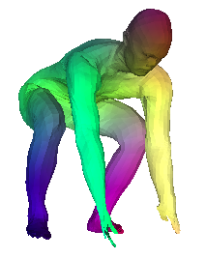
Input Shape
Deformed Template
Optimized reconstruction

Slide 23
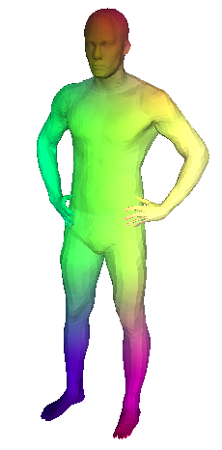
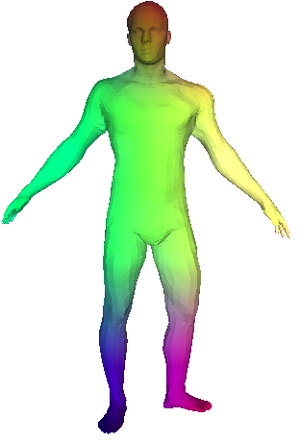
Input Shape
Deformed Template
Optimised reconstruction

Slide 24
Key idea 2: Parameter optimization
Input Shape
Reconstructed Shape
Template
Features
Minimize
Chamfer distance
Notes:
What does this mean for our parametrization ? We said the we wanted to encourage a parametrization that respects the semantics, maps a hand to a hand and a foot to a foot.​
We enforce that during training. But as we optimize away from the initial parameters obtained by the encoder, don't we loose this nice properties ?
It is an open question which we only answered by intuition. As the decoder has been trained to respect the semantics during training, it shouldn't matter whether or not the parameters comes from the encoder or not. If the decoder generalize well the property it has been trained to respect, it should respect the semantics for just any set of parameter.
So it is in fact a generalization issue.
It is true that feeding completely random parameters to the decoder, we would break the semantic property, and probably not even reconstruct a human
But as we only do local exploration from a point which work, that is to say, we stay close to training data, it is likely that the decoder would respect our desired property​.
It is also a new view on auto encoders. When you train an auto encoder so that the decoder reconstruct the input with an added property or constraint. If what you care about is the quality of your reconstruction, you should always perform local exploration of the parameter space, and the decoder will keep following the property it has been trained for.​

Slide 25
Evaluation: Finding 3D shape correspondences between 2 shapes
Nearest
Neighbor
Correspondence
via template
Nearest
Neighbor
Template
Notes:
Let's evaluate our learned parametrization with a proxy task of finding correspondences between any two pointcloud.
The task is to map each point from the left shape, to a point from the right shape, and this, for a bunch of shapes.
To do this, we simple reconstruct them with our autoencoder, and then we have everything we need.
The two reconstruction are in correspondences because they come from the deformation of the same template. And we've trained our AE to consistently respect the semantics.
We can thus use nearest neighbor to map r to q, switch shape though the template, and map back q to r.

Slide 26
Datasets: 230 000 synthetic human shapes
[1] Learning from synthetic humans, Varol et al. CVPR (2017)
[2] FAUST: Dataset and evaluation for 3D mesh registration, Bogo et al. CVPR (2014)

Slide 27
State-of-the-art quantitative results
Error in cm
Lower is Better
[2] FAUST: Dataset and evaluation for 3D mesh registration, Bogo et al. CVPR (2014)
[3] Robust nonrigid registration by convex optimization, Chen, Koltun, ICCV (2015)
[4] Deep functional maps: Structured prediction for dense shape correspondence, Litany et al. ICCV (2017)
[5] The stitched puppet: A graphical model of 3d human shape and pose, Zuffi et al. CVPR (2015)

Slide 28
Evaluation: Finding 3D shape correspondences between 2 shapes
Nearest
Neighbor
Correspondence
via template
Nearest
Neighbor
Template

Slide 29
State-of-the-art quantitative results
Error in cm
Lower is Better
[2] FAUST: Dataset and evaluation for 3D mesh registration, Bogo et al. CVPR (2014)
[3] Robust nonrigid registration by convex optimization, Chen, Koltun, ICCV (2015)
[4] Deep functional maps: Structured prediction for dense shape correspondence, Litany et al. ICCV (2017)
[5] The stitched puppet: A graphical model of 3d human shape and pose, Zuffi et al. CVPR (2015)

Slide 30
State-of-the-art quantitative results
Error in cm
Lower is Better
[2] FAUST: Dataset and evaluation for 3D mesh registration, Bogo et al. CVPR (2014)
[3] Robust nonrigid registration by convex optimization, Chen, Koltun, ICCV (2015)
[4] Deep functional maps: Structured prediction for dense shape correspondence, Litany et al. ICCV (2017)
[5] The stitched puppet: A graphical model of 3d human shape and pose, Zuffi et al. CVPR (2015)

Slide 31
Robustness to perturbations : noise, holes, sampling, topology, scaling
SCPA
SCAPE
TOSCA
[6] Scape: shape completion and animation of people, Anguelov et al. TOG (2005)
[7] Numerical geometry of non-rigid shapes, Bronstein et al. Springer Science & Business Media (2008)
Notes:
We also tested robustness to a lot of noise, and surprisingly our results was very robust to many types of perturbations;

Slide 32
Corres
Correspondences on other deformable shapes
Notes:
Our method is not just limited to humans.
As long as we have a deformable shape and training samples, we can do it.
What do we mean by deformable shape ? A category spawned by a template. A key aspect of the method was being able to find a template.

Slide 33
Corres
Correspondences on other deformable shapes
Notes:
Pause. Pause. Pause.

Slide 34
Contributions 1/2: A simple framework
Previous work
Manually designed template [5,2]
Manual Parameterization
Complex multiterm optimization
3D-CODED (ours)
any neutral shape
Learned Parameterization
L2 loss + SGD
[2] FAUST: Dataset and evaluation for 3D mesh registration, Bogo et al. CVPR (2014)
[5] The stitched puppet: A graphical model of 3d human shape and pose, Zuffi et al. CVPR (2015)

Slide 35
Contributions 2/2: Strong unsupervised results
Supervised
Per point correspondences
L2 Distance
Unsupervised
No annotation
Chamfer Distance

Slide 36

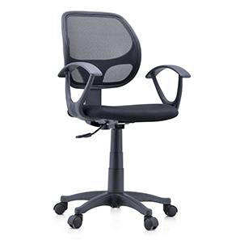
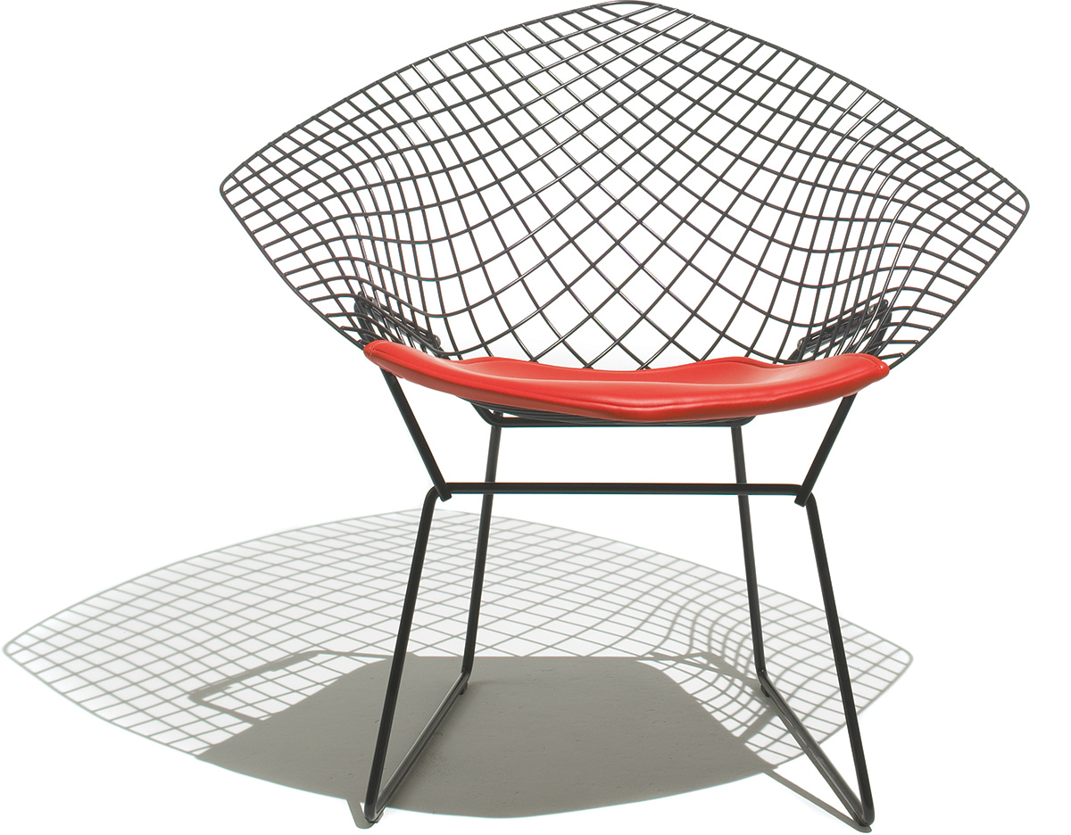
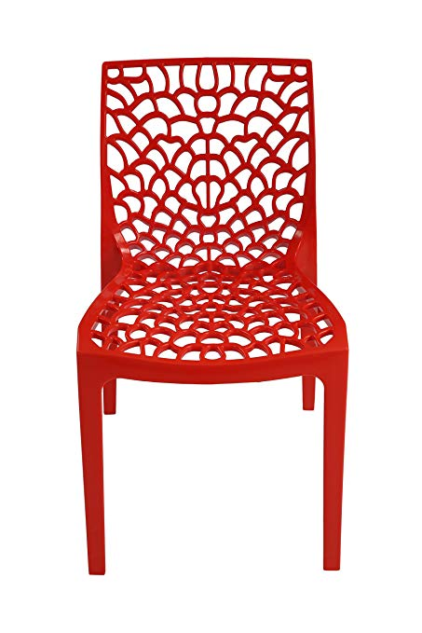
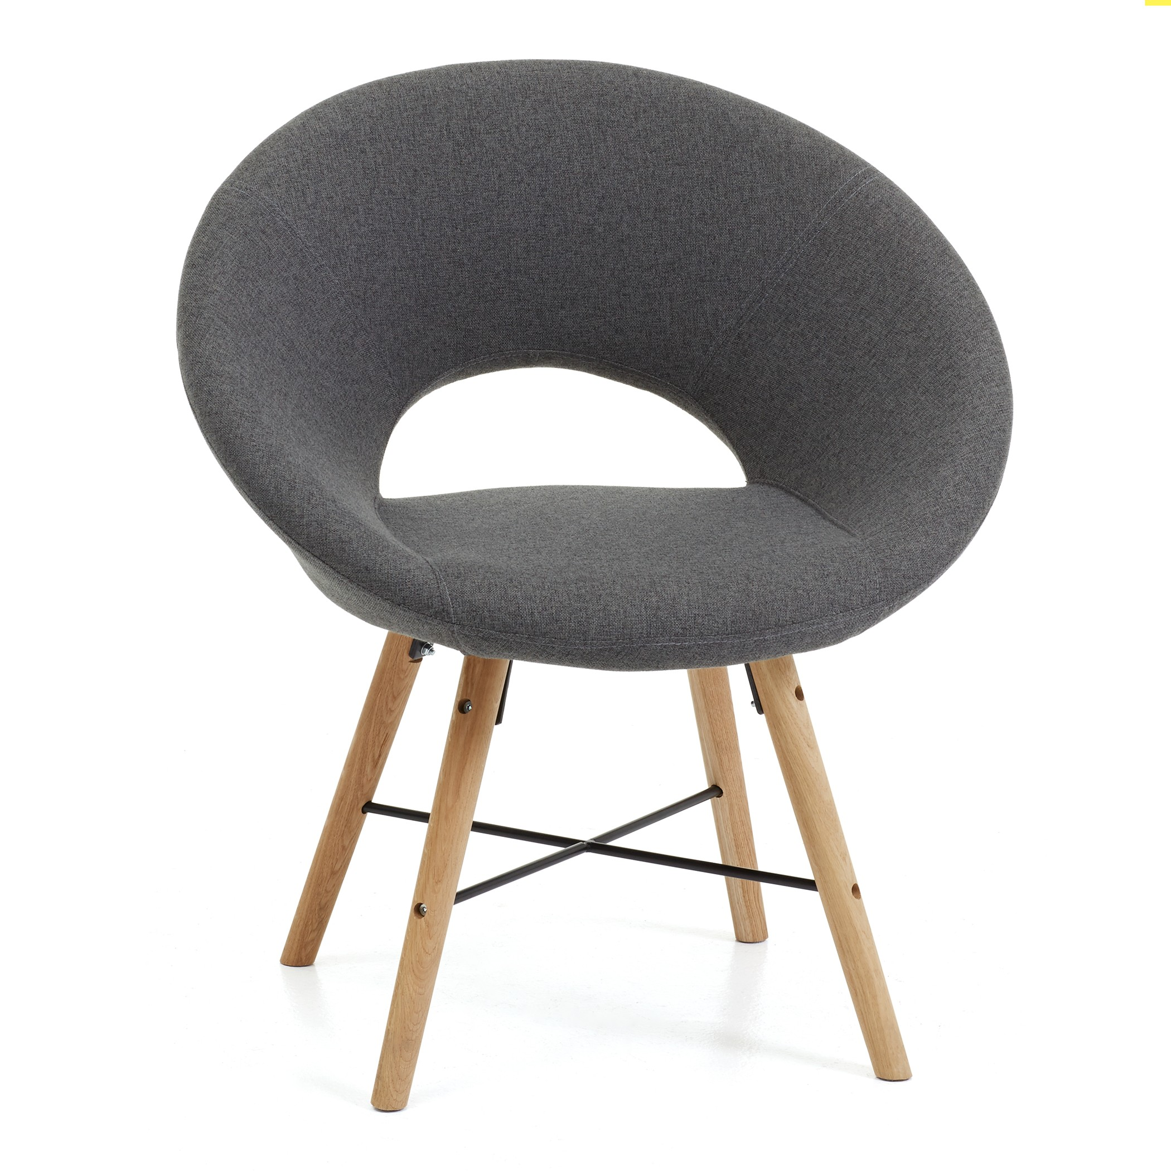
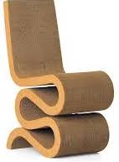





6 degrees for translation/rotation + N degrees object pose + no clear parameterization
6 degrees for translation/rotation + no clear parameterization + no template
Notes:
PAUSE
What I want to discuss in the last 5 minutes, is how we can extends those results to something that is more generic.
We designed a method to parametrized deformable shapes. It relied on the possibility of finding a good template. What happens beyond such cases, where no template make sense ? What is a template chair ?

Slide 37
Approach: 3D parametrizaton by template deformation
template
Input Shape
Output: Reconstructed input
Input: 3D
pointclouds
Parameters
Notes:
What can we deform to reconstruct the chair if no template is available?

Slide 38
Approach: 3D parametrizaton by template deformation
template
Input Shape
Output: Reconstructed input
Input: 3D
pointclouds
Parameters
Notes:
Well we experimented with universal shapes such as a simple sheet of paper.

Slide 39
Results
Reconstructed Shape
Input Shape
Template
Decoder
Parameters
Encoder
Notes:
So what i suggest is just to sample points from a sheet of paper instead of a human in the decoder.
I first want to show you what happens in the case of humans if you switch the template from a reference human to a sheet of paper, then i'll come back to my chair example.

Slide 40
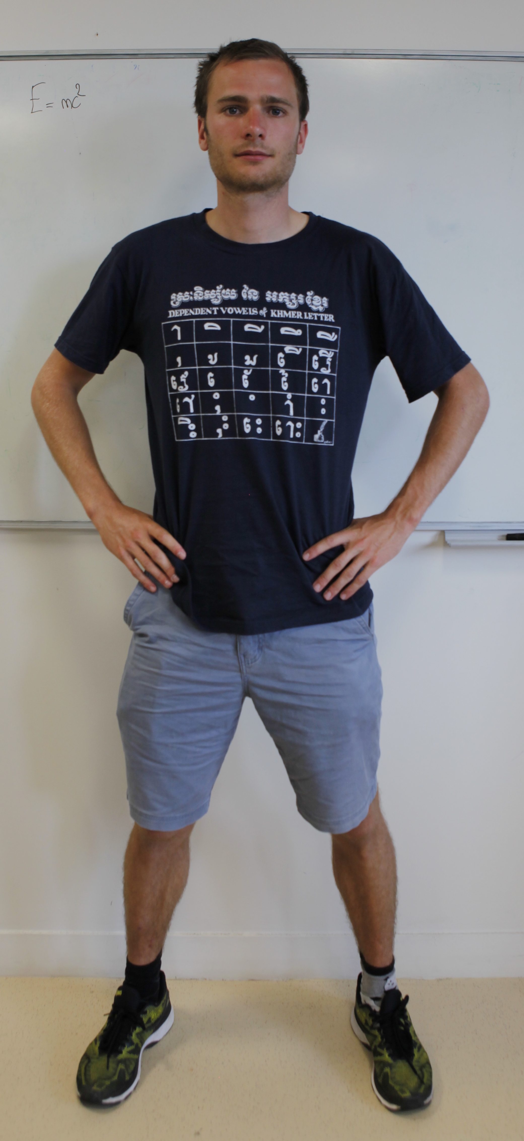
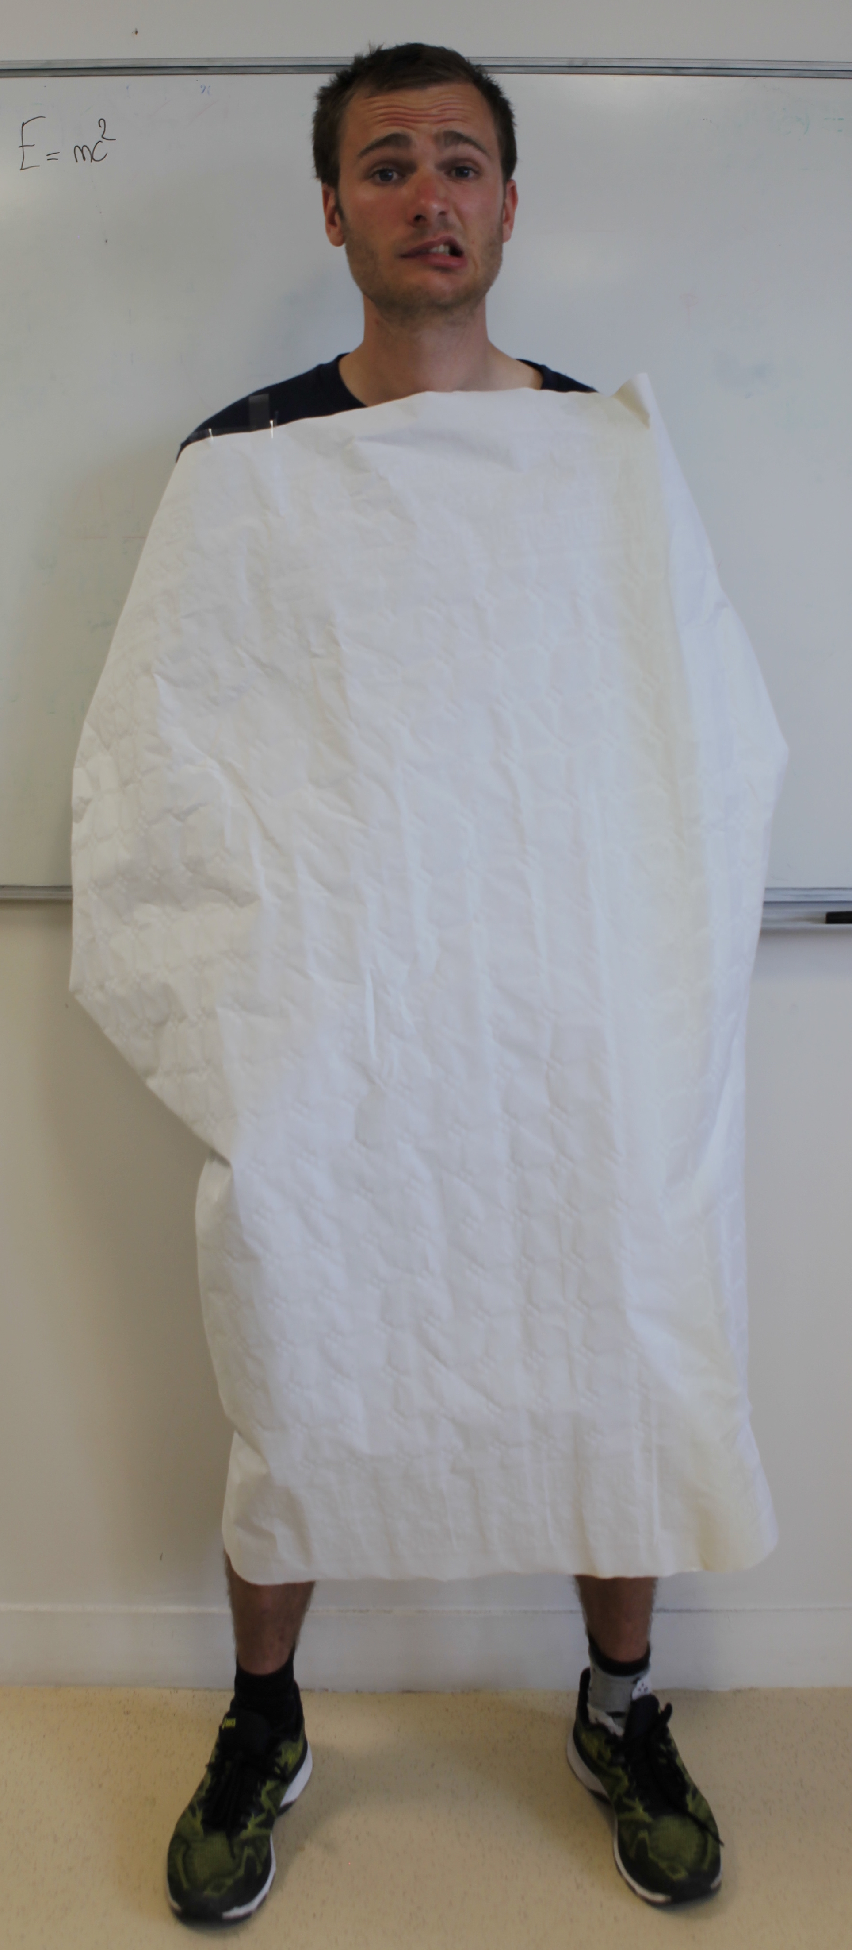
x
Key idea 1: deform a surface
Generated
3D point
Latent shape representation
MLP
y
Sampled
2D point
Notes:
The decoder is exactly the same, it takes a point as input and the parameter, and outputs a 3D point, placed of the input pointcloud.
However, with this approach reconstructing complex objects such as me is hard with a single deformed patch.

Slide 41

x
Key idea 2: learn an atlas
Generated
3D point
MLP 1
Latent shape representation
y
Sampled
2D point
Learnt simply by sampling many points and minimizing Chamfer distance
Notes:
To solve this issue, instead of learning a single deformation, we learn K deformations

Slide 42
x
Key idea 2: learn an atlas
Generated
3D point
MLP 1
Latent shape representation
MLP 2
y
MLP 3
Sampled
2D point
Learnt simply by sampling many points and minimizing Chamfer distance
Notes:
to cover the generated object.

Slide 43
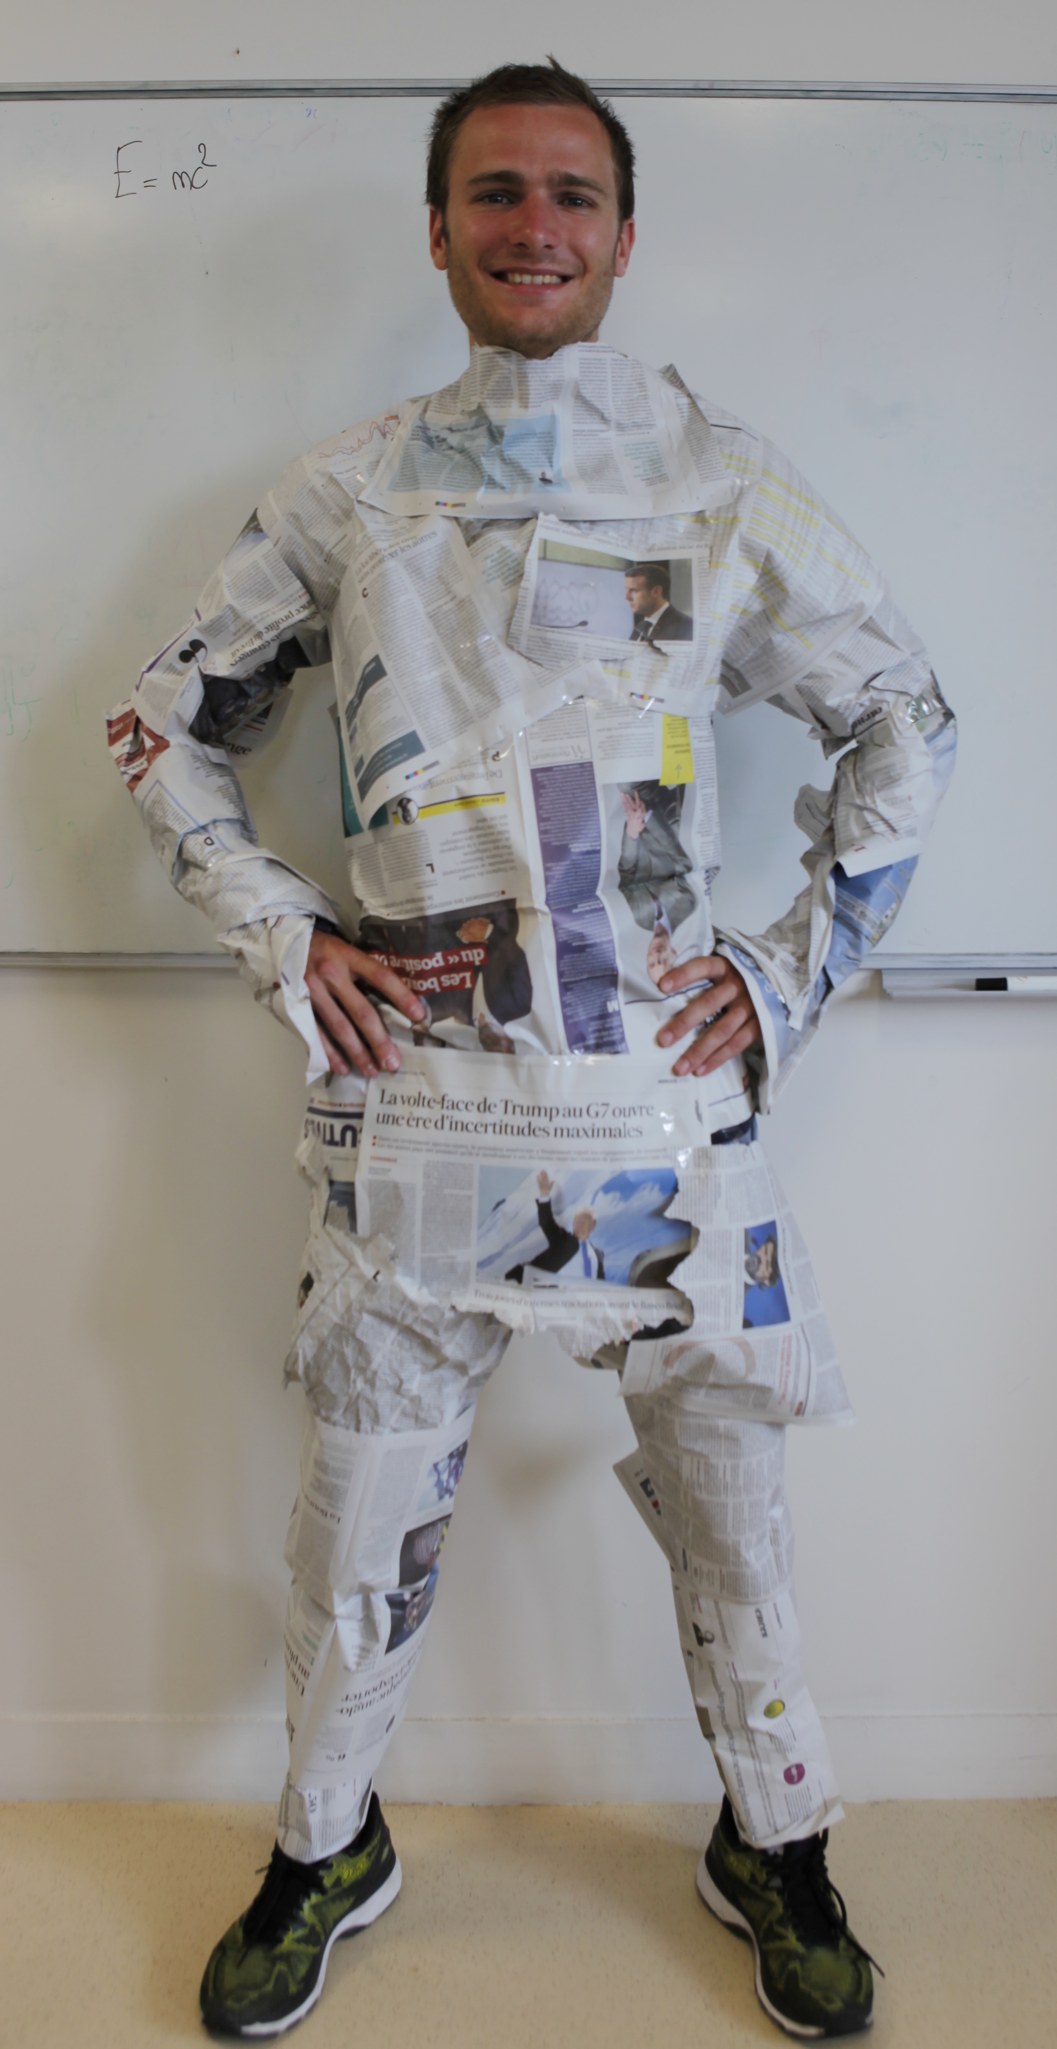
x
Key idea 2: learn an atlas
Generated
3D point
MLP 1
Latent shape representation
MLP 2
y
MLP 3
Sampled
2D point
Learnt simply by sampling many points and minimizing Chamfer distance
Notes:
And this works much better in practice. This type of parameterization is in fact called an atlas.
Now using this, we can train on more generic categories, for example we can train on ShapeNet. It's a dataset of about 30 thousand shapes coming from 13 categories, among which the chairs.
To evaluate our proposed parameterization, we evaluate the quality of the autoencoder.

Slide 44
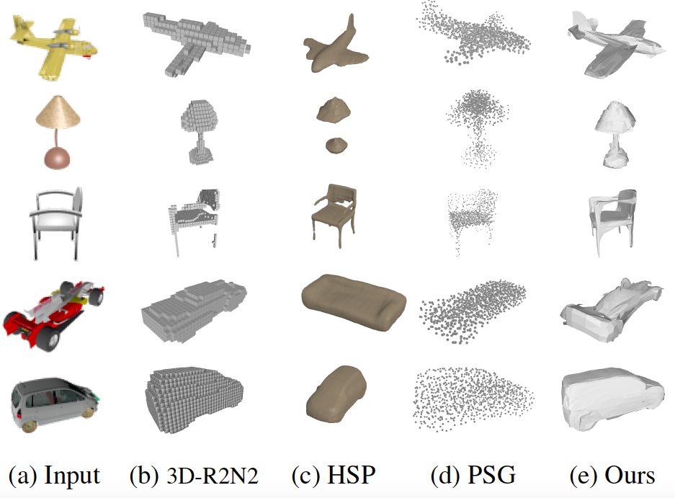
Notes:
We try to reconstruct the object on the left with our approach and compare with voxels, octrees and point cloud methods. Our results, on the right, outputs a surface representation. In the paper, we show quantitative comparisons but what’s important is the properties of the 3D representation.

Slide 45
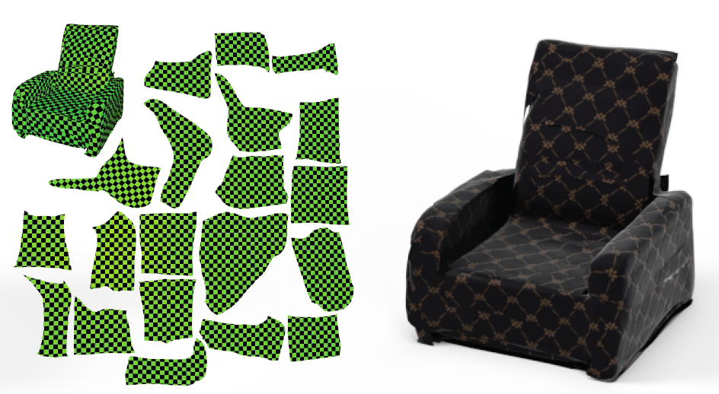
Other application: mesh parametrization
Notes:
Obtaining an Atlas is also useful for many applications.
For example, atlases are natural texture coordinates, and can be optimized by existing methods to apply new textures on 3D objects.

Slide 46

[ ---------------------------- ]
6 degrees for translation/rotation + N degrees object pose + no clear parameterization
6 degrees for translation/rotation + N degrees object pose + no clear parameterization + no template
[ ---------------------------- ]
Pose recovery beyond rigid objects
Learning parameterizations for 3D shapes
  Disclaimer : this has been done with « object-centered» 3D shapes.
Notes:
Before concluding, let me emphasize that we didn't actually estimated the translation rotation of the object, but we just learned a parametrization for those shapes.
In this presentation, we saw how we can extend the concept of pose estimation to non rigid objects.
And, the key point was to learn a parametrization.

Slide 47




AtlasNet: A Papier-Mâché Approach to Learning 3D Surface Generation, CVPR 2018
3D-CODED : 3D Correspondences by Deep Deformation, ECCV 2018
Matthew Fisher Vladimir Kim Bryan Russell
Adobe Research
Mathieu Aubry
École des Ponts ParisTech

Slide 48
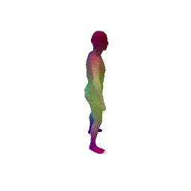
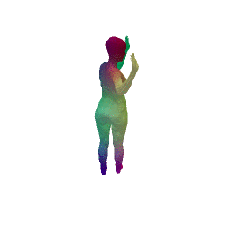









Code and data available : http://imagine.enpc.fr/~groueixt/atlasnet/
http://imagine.enpc.fr/~groueixt/3D-CODED/
Notes:
The code for all this is available.
You can stop by the poster tomorrow morning if you want to discuss the details more in depth.
Thank you for your attention.
Thibault Groueix 11 September 2018

