Slide 1





AtlasNet: A Papier-Mâché Approach to Learning 3D Surface Generation
Thibault Groueix
École des Ponts ParisTech
Matthew Fisher Vladimir Kim Bryan Russell
Adobe Research
Mathieu Aubry
École des Ponts ParisTech
Notes:
I am Thibault Groueix and I am presenting AtlasNet, a paper on 3D shape generation using a Papier Macher approach. It is joint work between Adobe Research, with Vova Kim, Mathew Fisher and Bryan Russel and the IMAGINE TEAM to which my PhD advisor Mathew Aubry, and I belong.

Slide 2
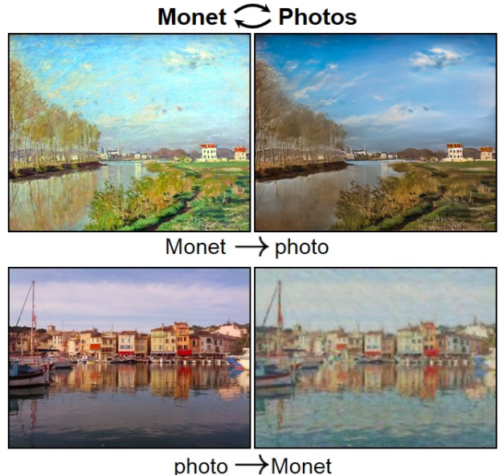
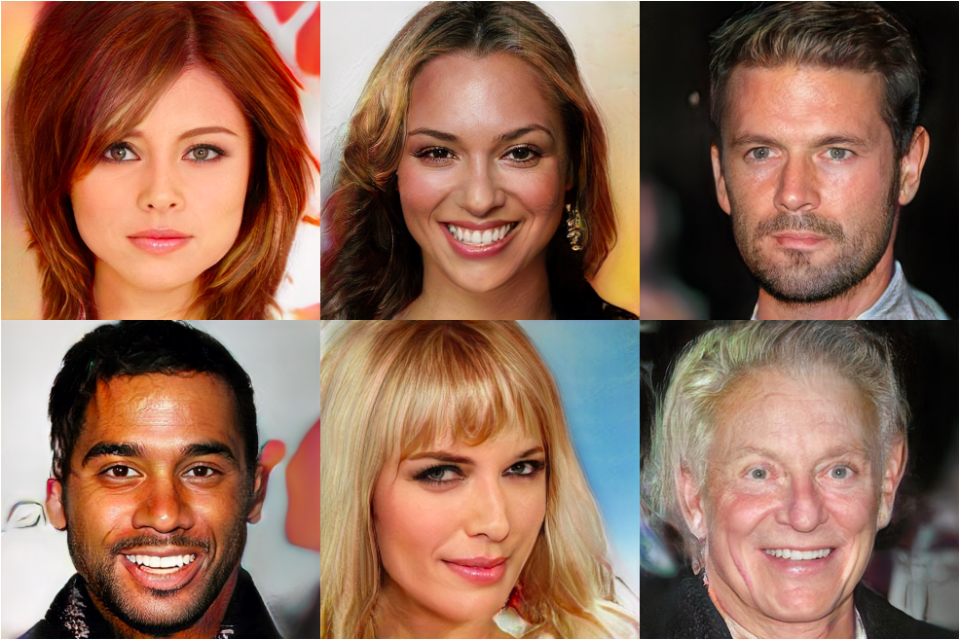
We are getting good at generating images!
Karras, T., Aila, T., Laine, S., & Lehtinen, J.
Progressive growing of GANs for improved quality, stability,
and variation. ICLR 2018
Zhu, J. Y., Park, T., Isola, P., & Efros, A.
Unpaired image-to-image translation using cycle-consistent
adversarial networks. ICCV 2017
Notes:
Recent work on image generation have shown impressive results in many tasks. One the reason for this is that it is now obvious how to represent 2D content : there’re 2D regular grids of pixel. For this particular type of structure, convolutions have proven to be a powerful kind of learnabe filters. We try to achieve similar results, but in 3D.

Slide 3
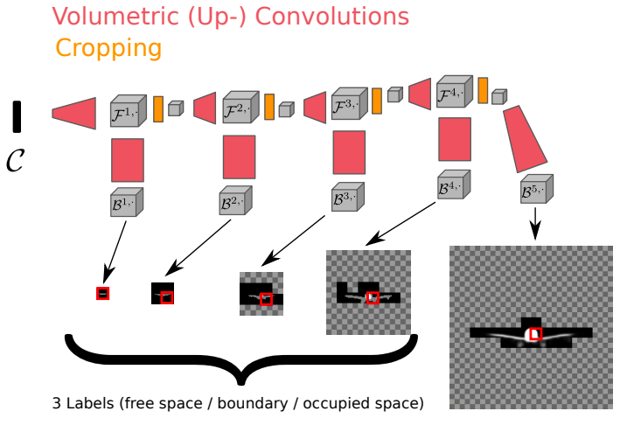
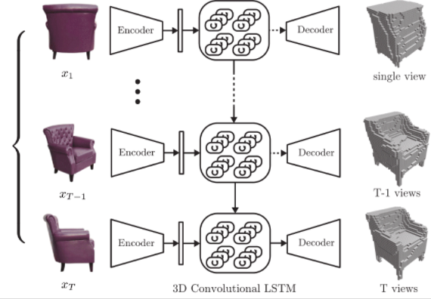
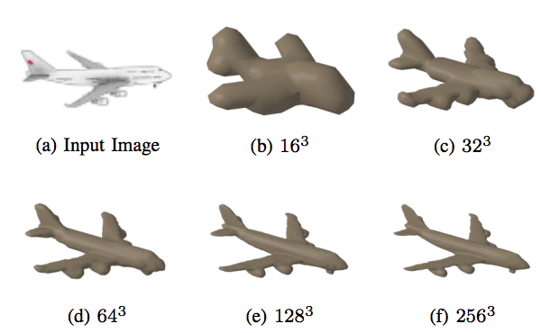


Generating voxels
Choy, C. B., Xu, D., Gwak, J., Chen, K., & Savarese, S.
3D-R2N2: A unified approach for single and multi-view
3D object reconstruction, ECCV 2016
Häne, C., Tulsiani, S., & Malik, J.
Hierarchical surface prediction for 3D object reconstruction.
3DV 2017
Natural, conceptually simple
Heavy or complicated
Notes:
The first challenge in 3D is to find an appropriate representation for data. Voxels are popular. They extend 2D regular grids to 3D. But They are typically memory intensive.

Slide 4
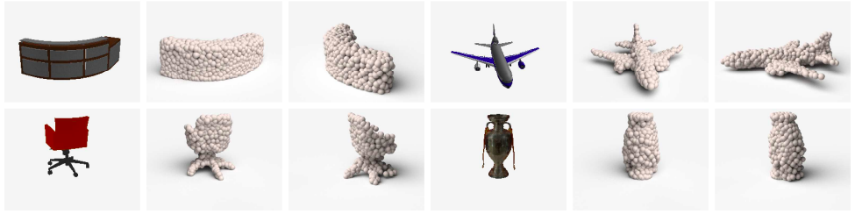
Generating points : PointSetGen
Fan, H., Su, H., & Guibas, L. A point set generation network for 3d object reconstruction from a single image. CVPR 2017
Simple
Unstructured point cloud
Notes:
Another approach is to sample points on the surface of the 3D shape and work with an unordered list of 3D points. PointSetGen, a work from Stanford group, introduced such a network last year.
Obviously there are lots of other approaches such as Surfnet but wouldn’t it be great if we could directly generate a mesh ?

Slide 5
Notes:
In fact, that’s our goal : generating a set of 3D points and the connectivity between those points.

Slide 6
Notes:
From an input object (on the left), we use existing methods to extract a latent vector, and try to design a decoder to generate a polygonal mesh. (on the right). The latent vector can be extracted from an image with a Resnet Encoder, or from a pointcloud with a pointnet encoder but we don’t really care about that for now. We focus on the decoder, that is to say how to recreate 3D content, in the form of a pointcloud, from the latent vector.

Slide 7
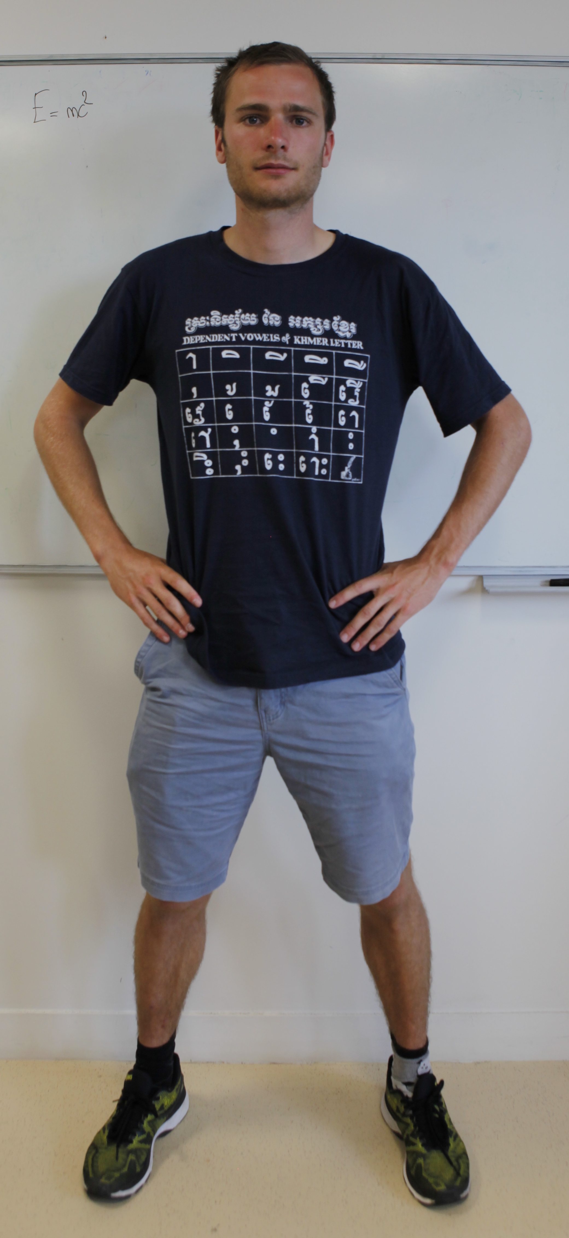
Test Shape
Notes:
Let’s try this on an arbitrary shape : me :)

Slide 8
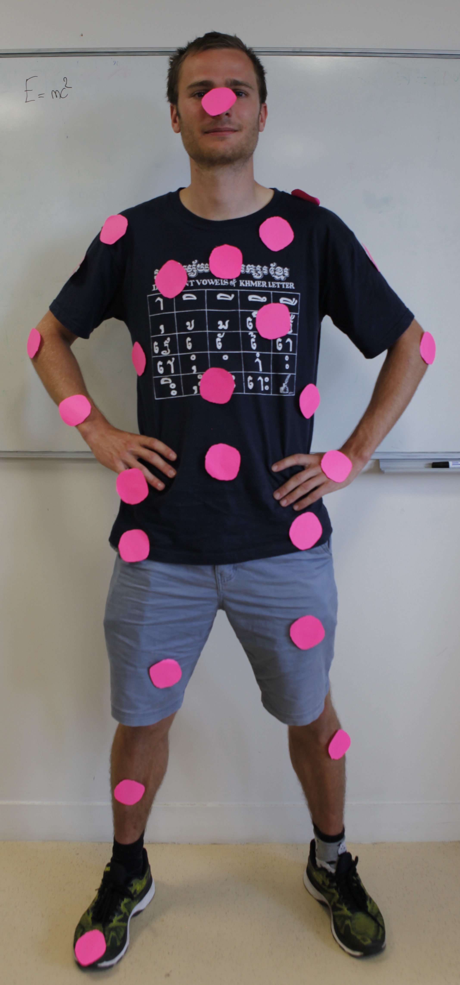
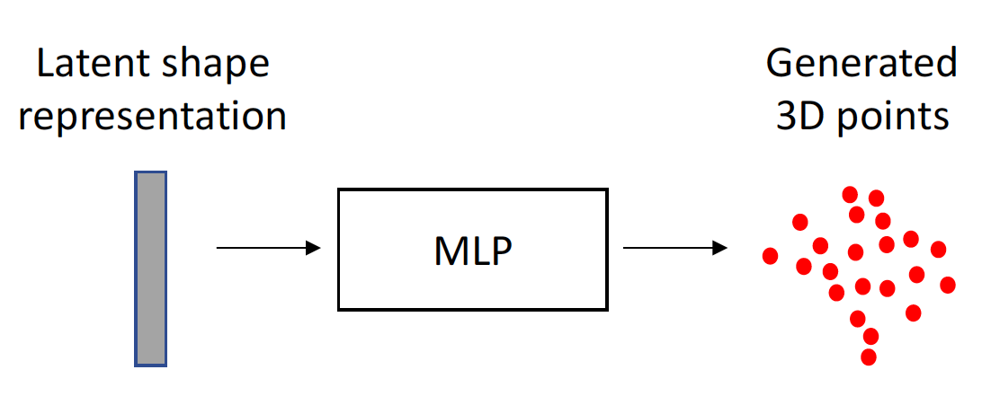
Generating points
Quite similar results
Issue: no idea of surface, thin structures
Notes:
We build on PointSetGen, and its point cloud representation.
In its simplest form, the latent vector is fed to an Multi Layer Perceptron that outputs a fixed number of 3D points scattered in 3D (on me).
It is optimized by minimizing a distance with the ground truth points, such as Chamfer or Earth Mover Distance. The chamfer distance is a nearest neighbors based loss. It is differentiable almost everywhere and it says something like : for every generated point, find the closest ground truth point and move towards it, for every ground truth point, find the closest generated point and attracts it. At the end of the optimisation, the generated point cloud aligns with the ground truth point cloud.
This works really well but there is a fundamental issue with this way of generating point clouds which is the fact that the generated points do not belong to an implicit surface. This comes from the fact that in the last layer of an MLP, the neurons are not correlated and there is no surface constraints on the generated points.

Slide 9
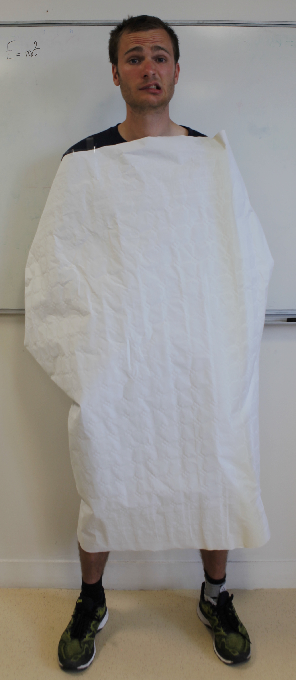
x
Key idea 1: deform a surface
Generated
3D point
Latent shape representation
MLP
y
Sampled
2D point
Learnt simply by sampling many points and minimizing Chamfer distance
Notes:
We observed that and build on this work by adding in the decoder architecture the prior that all points should belong to a surface. The simplest way to make sure we generate a surface is to deform one. To achieve this, we will learn a function that implicitly deform a surface, in a very simple way.
In addition to the latent shape representation, our MLP takes as input the coordinates of a single 2D point sampled from a 2D patch in R2, and outputs the 3D coordinates of a single point. And we’re mostly done.
Because, an MLP is a continuous function, it transforms the continuous input domain into another continuous domain, a deformed surface, while preserving manyfold properties.
Indeed, as we repeat NEXT 16- 85 (more points appear) this process for other 2D points in the patch, and all the generated 3D points belong to a implicit surface.
Furthermore, if we define a connectivity between samples in the patch, such as a triangulation of the points,- it can naturally be propagated to the 3D generated points and aligns with the generated surface.This type of decoder generates a mesh without further post processing.
Interestingly, at inference time, by sampling the 2D patch more or less densely, we can generate as many points as we want.
However, with this approach reconstructing objects with complex topology such as me is hard with a single deformed patch.

Slide 10
x
Key idea 2: learn an atlas
Generated
3D point
MLP 1
Latent shape representation
y
Sampled
2D point
Learnt simply by sampling many points and minimizing Chamfer distance
Notes:
To solve this issue, instead of learning a single deformation, we learn K deformations

Slide 11
x
Key idea 2: learn an atlas
Generated
3D point
MLP 1
Latent shape representation
MLP 2
y
MLP 3
Sampled
2D point
Learnt simply by sampling many points and minimizing Chamfer distance
Notes:
to cover the generated object.

Slide 12
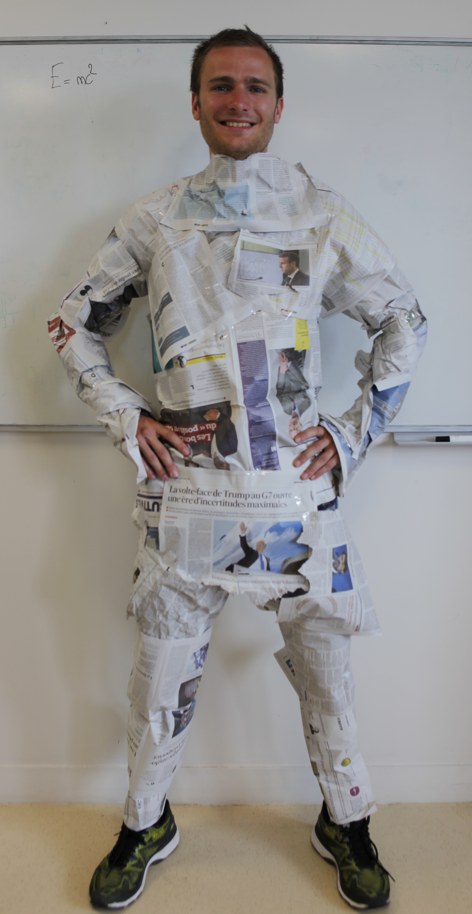
x
Key idea 2: learn an atlas
Generated
3D point
MLP 1
Latent shape representation
MLP 2
y
MLP 3
Sampled
2D point
Learnt simply by sampling many points and minimizing Chamfer distance
Notes:
And this works much better in practice.
This actually goes back to the topological definition of a surface, as being everywhere similar to a 2D patch (homeomorphic to R2). We show in the paper that in fact the representation we learn is similar to an atlas.
This is our final setup.
We show that this simple representation leads to better shape generation, improved generalization and several free applications.

Slide 13
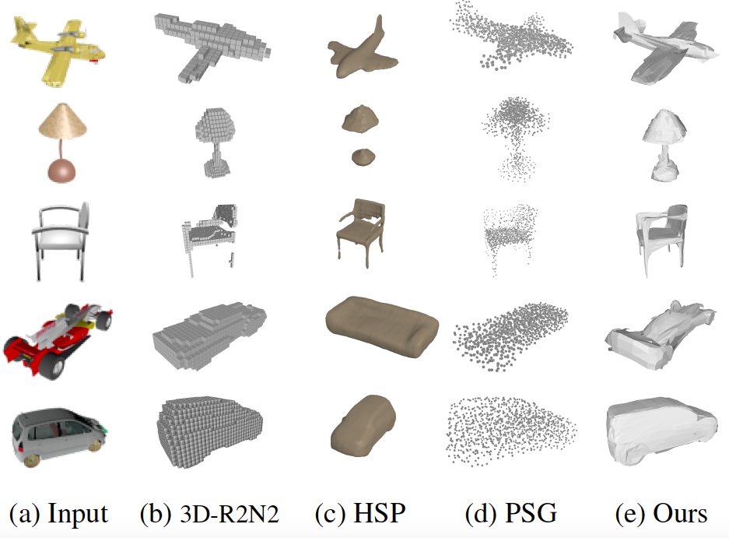
Notes:
such as single view reconstruction here.
From an single image, from left to right, we compare with voxels, octrees and point cloud methods. Our results, on the right, outputs a surface representation. In the paper, we show many quantitative comparisons as well as experiments on surface reconstruction given an input 3D point cloud.

Slide 14
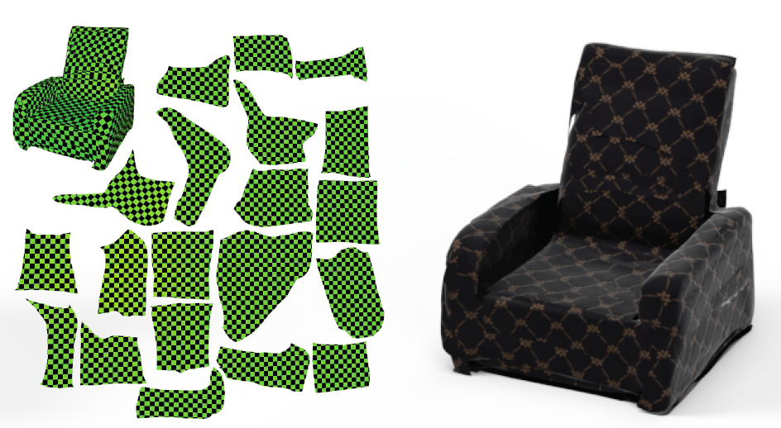
Direct application: mesh parametrization
Notes:
Obtaining an Atlas is also useful for many applications.
For example, atlases are natural texture coordinates, and can be optimized by existing methods to apply new textures on 3D objects.

Slide 15
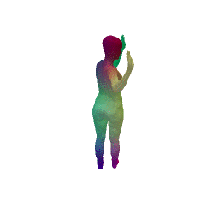
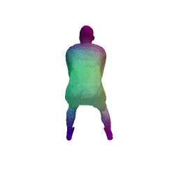
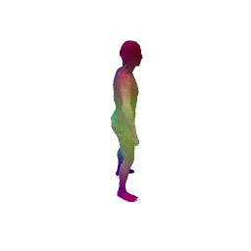
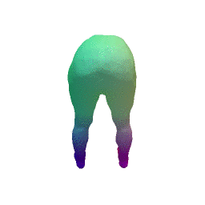
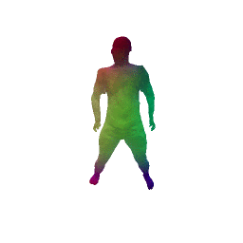
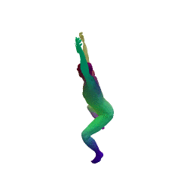
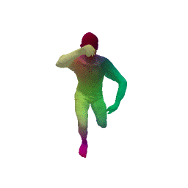
Follow-up paper on arxiv:
“3D-CODED: 3D Correspondences by Deep Deformation”
Notes:
We observed that each patch naturally specializes in a part of the object. We explored this idea further in a follow up paper and obtained state of the art results on human correspondences.

Slide 16
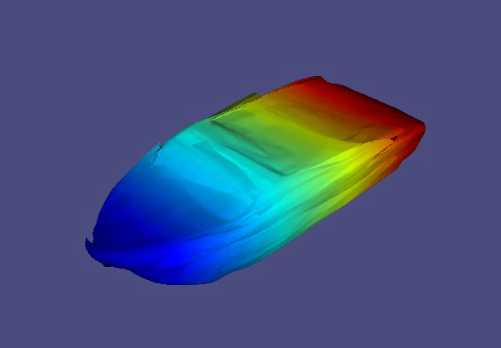
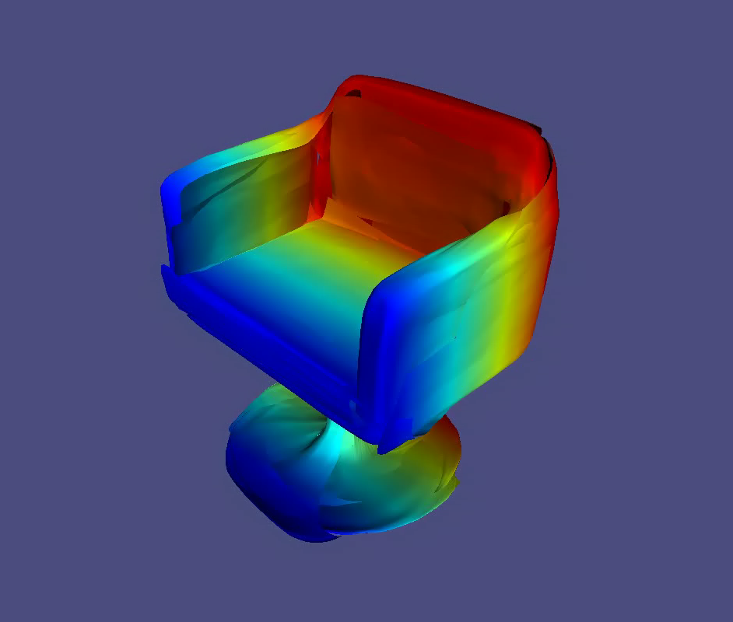
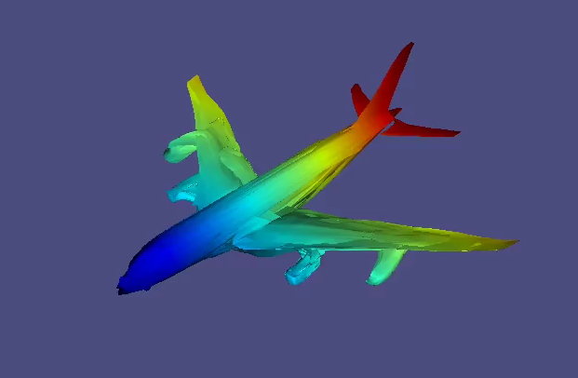
Code and data available : http://imagine.enpc.fr/~groueixt/atlasnet/
State-of-the-art results
Generate meshes
Many natural extensions.
Notes:
The code is available. Thank you for your attention and come visit us !!

