Slide 1
Interactive MC Ray-Tracing Upsampling
M. Boughida, T. Groueix, T. Boubekeur
LTCI, CNRS, Telecom ParisTech, Paris-Saclay University

Slide 2
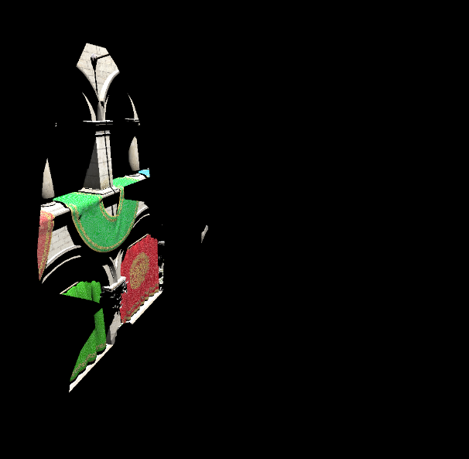
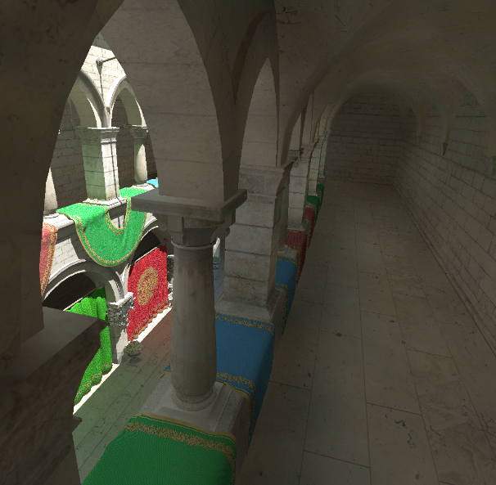
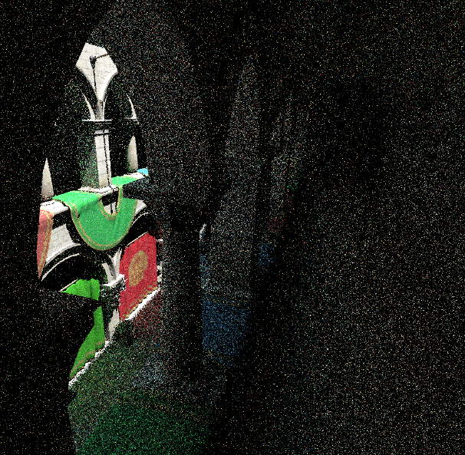
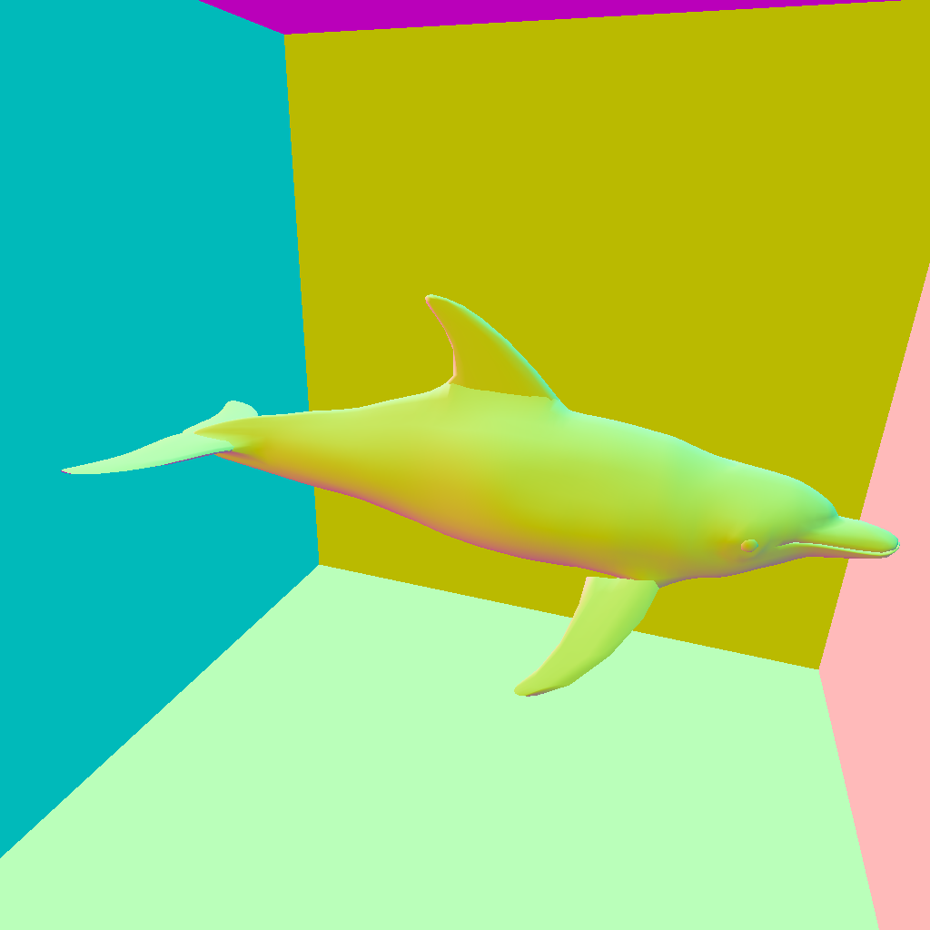
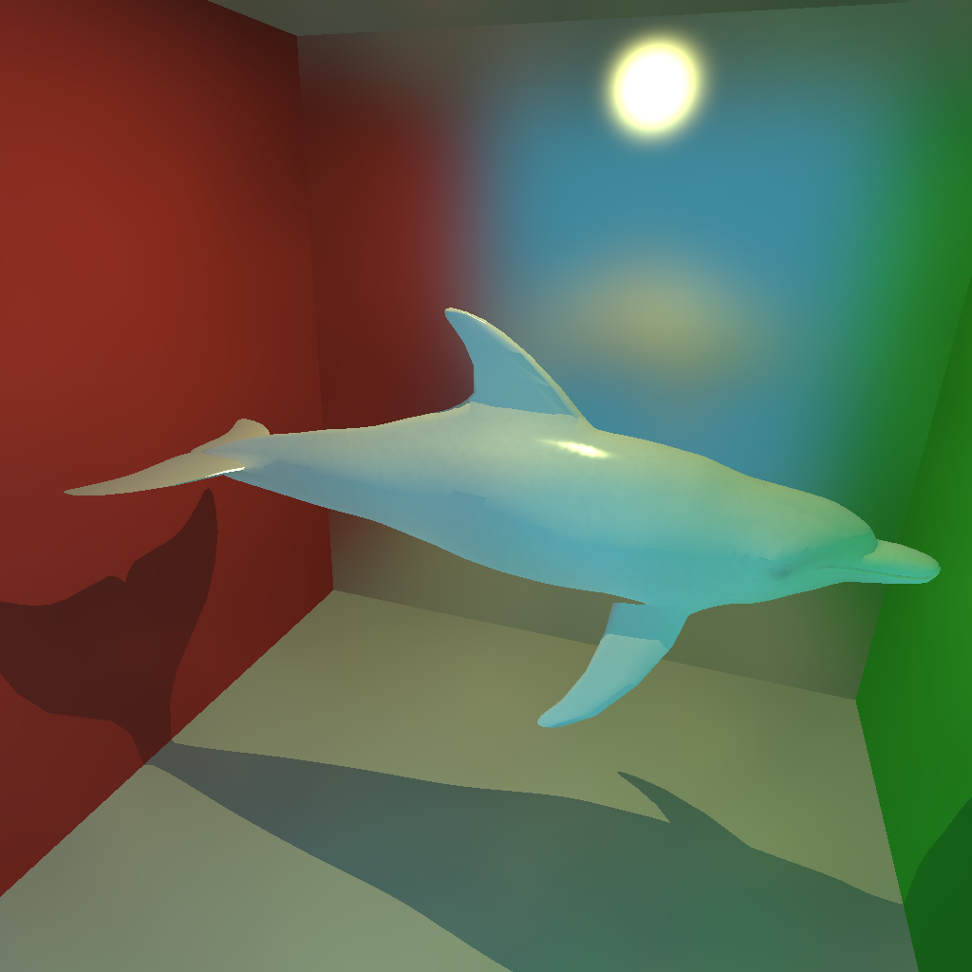
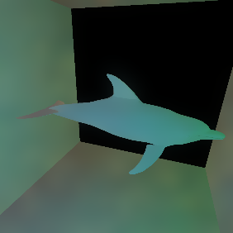
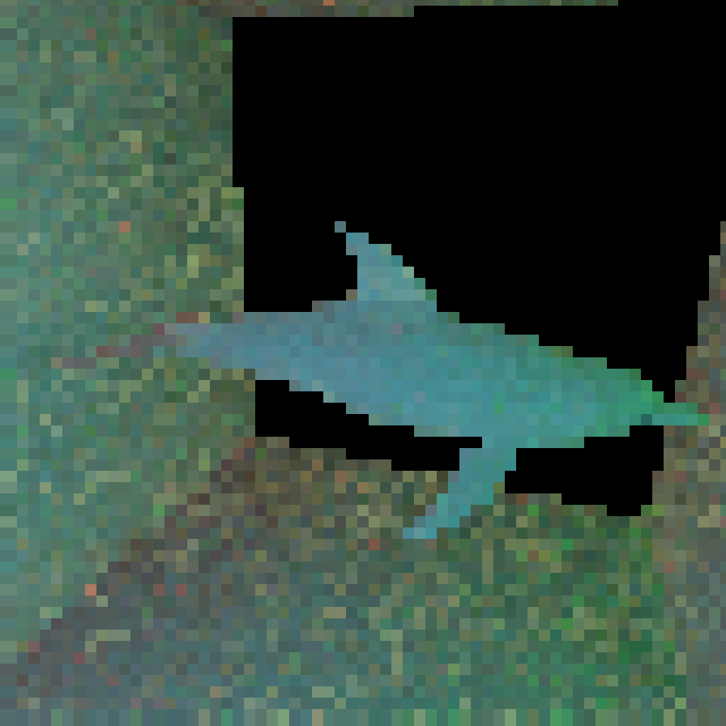
Interactive MC Ray-Tracing Upsampling
Context
Interactive framerate
Completely dynamic scene
Multiple-bounce GI
Indirect visibility
→ GPU-accelerated path-tracing
Direct only
Ours
Path-tracing
High-res GBuffer
Final render
Our method
Focus rays in low resolution
Joint Bilateral Upsampling
Easy to implement
Interactive preview
Textured lambertian and moderately glossy materials
Low-res
Indirect
Upsampled indirect

