Slide 1
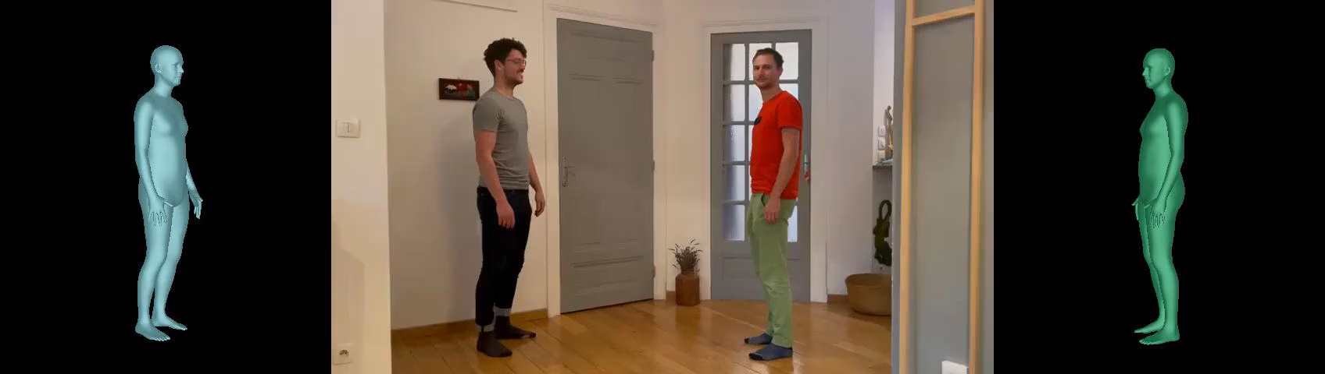




Leveraging MoCap Data for Human Mesh Recovery
3DV 2021
Fabien Baradel*
Thibaut Groueix*
Philippe Weinzaepfel
Romain Brégier
Yannis Kalantidis
Grégory Rogez
Notes:
Hi, the goal of this project is to turn any single-image human pose estimation model into a video-based model.

Slide 2
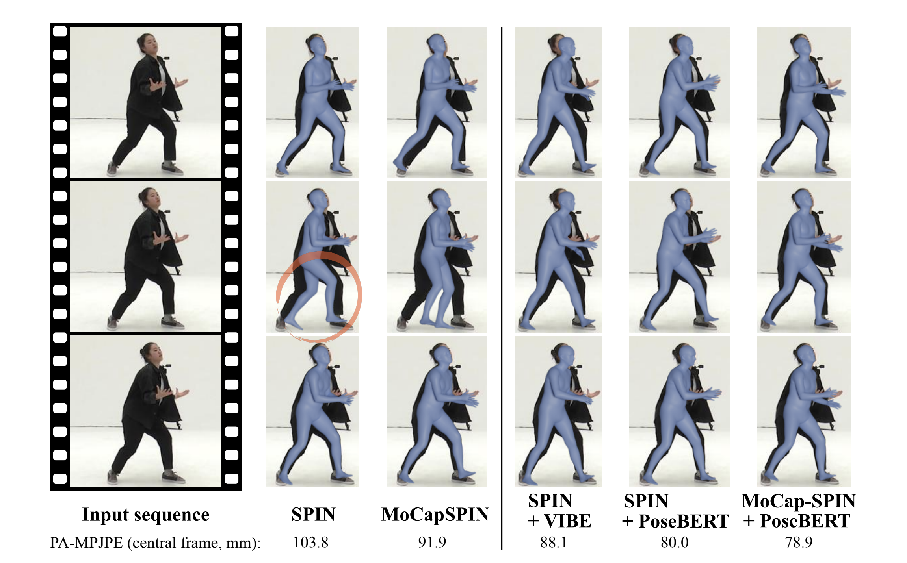
A video-based model
Motivations
Mesh recovery from a single RGB image is difficult (depth e.g. ambiguity, occlusion)
Missing information can be found using surrounding frames
Notes:
-Estimating the human mesh from a single RGB image is challenging due to depth ambiguity or occlusion.
For instance, if you take a look at the middle frame in this video, it’s challenging to tell wether the left and right leg should be in front. However, if you look at context from adjacent frames you can disambiguate this.
How do we do take a single-image model and add temporal context on top of it?
I must say I am glad that we were reminded by Dall-E 2 of the importance of data, because the interesting bit of this project was really to think about how can we leverage existing incomplete datasets to achieve such a goal.

Slide 3
Data
Size : small - big
Annotations : 2D – 3D keypoints – mesh
Annotations : pseudo ground truth – accurate
Camera parameters : none - yes
Setting : controlled -- In the wild
Input : single image – video
Person : single - multi
Occlusions : none - yes
Notes:
Ideally, the dataset would be big, has accurate mesh annotations with camera parameters, be in the wild, and contain multi-person frames with occlusion. O it needs to be videos as well.
You won’t be surprise if I tell you that such a thing does not exist yet given how hard it is to acquire accurate 3D annotations in the wild.

Slide 4
Data
Size : small - big
Annotations : 2D – 3D keypoints – mesh
Annotations : pseudo ground truth – accurate
Camera parameters : none - yes
Setting : controlled -- In the wild
Input : single image – video
Person : single - multi
Occlusions : none - yes
Observation
RGB video datasets with 3d annotations are scarce...
...but we have large amounts of MoCap data.
Notes:
However, we do have MoCap data dataset which are BIG – have sequences of meshes

Slide 5
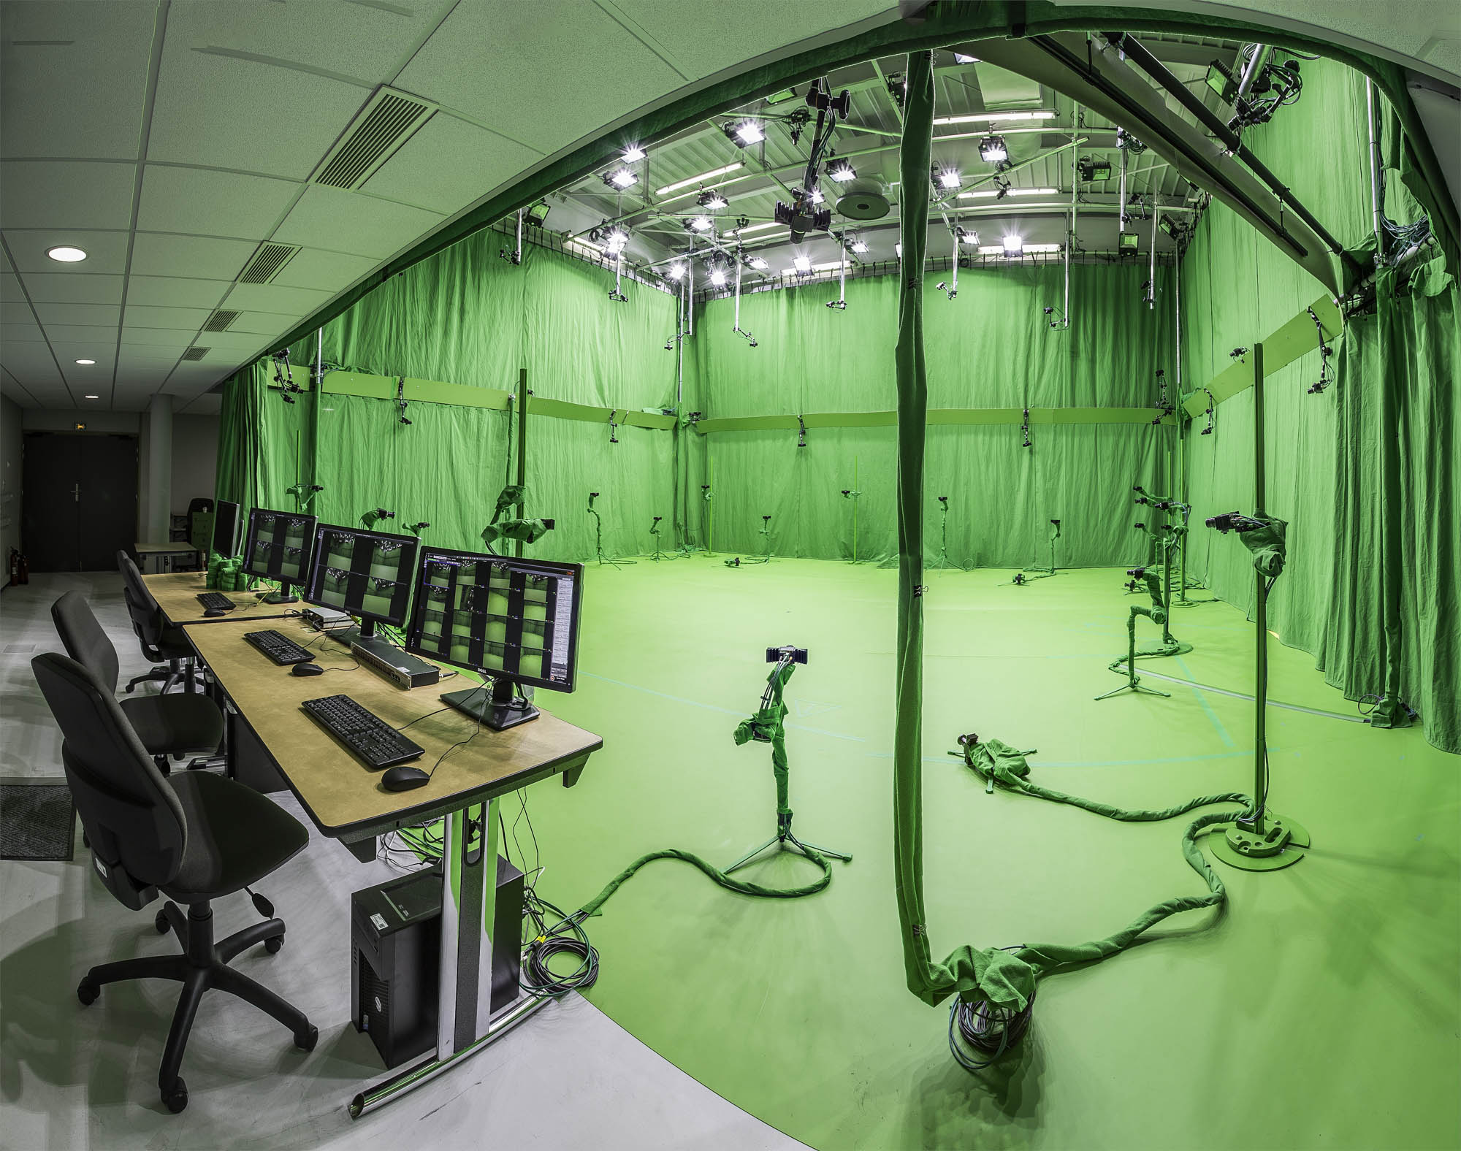
Amass
MoCap data, ICCV 2019
Indoor controlled settings
Example : Platform Kinovis, INRIA
“Here we combine 15 existing motion capture datasets into one large dataset: the Archive of Mocap as Surface Shapes (AMASS). AMASS has 40 hours of mocap, 344 subjects, and 11265 motions”.
Notes:
MoCap data or Motion Capture. People go in these rooms with green background, tons of sensors in the room, with markers on them and they perform actions. So what we get out of it are sequences of realistic 3D motions, with the corresponding meshes; but we don’t have in-the-wild input videos ot associate with these 3D motions.
And the interesting part is that we have a lot of them, in fact AMASS combined 15 previous such datasets into a big one.

Slide 6
PoseBERT: A transformer-based architecture
Key components
Input : sequence of noisy pose estimates
Output : refined sequence of poses
Notes:
So we propose to pipe the following two elements.
A of-the-shelf frame-based predictor, usually trained on in the wild images with 2D or 3D keypoints annotations.
And a seq2seq model, trained on Amass, that takes as input the sequence of noisy predictions from the frame-based model and learns to turn it into a coherent human motion.
Our proposed video-based method called PoseBERT is a transformer model.
It is trained mostly like the original BERT, by taking an AMASS sequence of 3D meshes; adding gaussian noise and random masking on the sequence and triying to reconstruct the original sequence.

Slide 7
What is the impact of PoseBERT?
 | 3DPW | MPI-INF | MUPOTS | AIST
SPIN | 59.6 | 68.0 | 83.0 | 76.2
+ PoseBERT | 57.3 ↓ 2.3 | 64.3 ↓ 3.7 | 80.9 ↓ 2.1 | 74.6 ↓ 1.6
VIBE | 56.5 | 65.4 | 83.4 | 76.0
+ PoseBERT | 54.9 ↓ 1.6 | 64.4 ↓ 1.0 | 81.0 ↓ 2.4 | 74.5 ↓ 1.5
MoCap-SPIN | 55.6 | 66.7 | 81.0 | 75.7
+ PoseBERT | 52.9 ↓ 2.7 | 63.8 ↓ 2.9 | 79.9 ↓ 1.1 | 74.1 ↓ 1.6
ROMP | 91.1 | - | - | -
+ PoseBERT | 90.2 ↓ 0.9 | - | - | -
LCRNET++ | 68.8 | - | - | -
+ PoseBERT | 58.5 ↓ 10.3 | - | - | -
Always improve performance
More robust estimation
Low computation overhead
The reported metric is the PA-MPJPE
Notes:
-We plug PoseBERT on top of recent image-based method and always observe a significant boost in performance

Slide 8
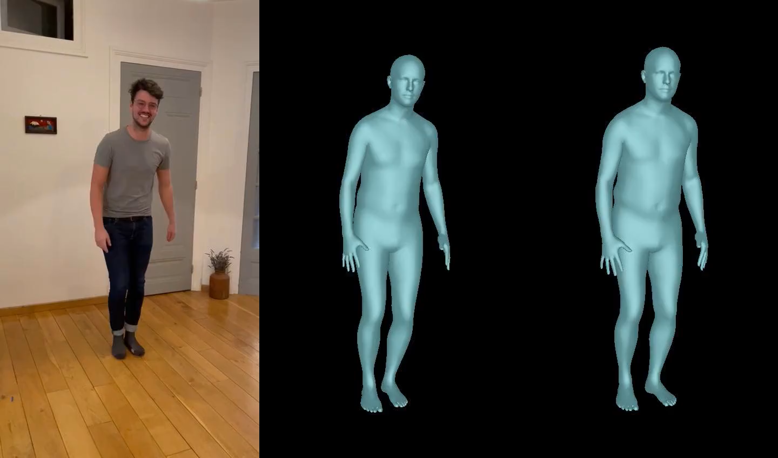
Qualitative results
MoCap-SPIN
MoCap-SPIN + PoseBERT
Notes:
These are the qualitative results, where you can see that the single frame model exhibit significant artifacts and plugging the transformer makes the results much smoother.
Thank you, and that’s my talk ☺

Slide 9
A video-based model
Motivations
Mesh recovery from a single RGB image is difficult (depth e.g. ambiguity, occlusion)
Missing information can be found using surrounding frames
Observation
RGB video datasets with 3d annotations are scarce...
...but we have large amounts of MoCap data.
Main Idea
Train a seq2seq model
Turn a noisy/incomplete sequence into a smooth and
coherent one
MoCap-SPIN
MoCap-SPIN + PoseBERT

