Slide 1

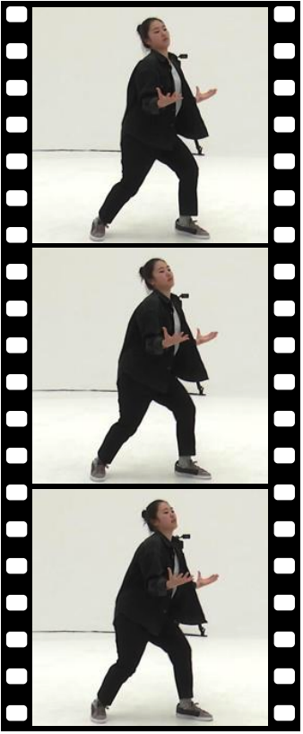
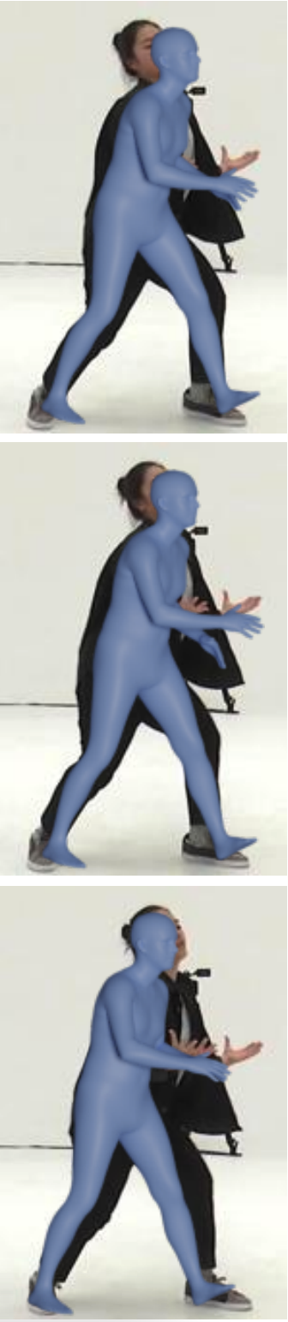
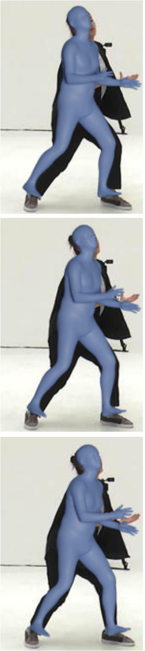
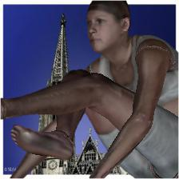
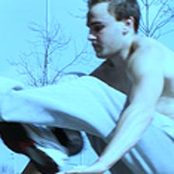
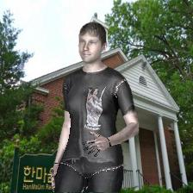
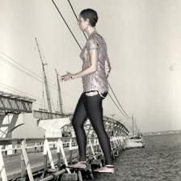
Leveraging MoCap Data for Human Mesh Recovery
3DV 2021 – #67
Fabien Baradel*, Thibaut Groueix*, Philippe Weinzaepfel, Romain Brégier, Yannis Kalantidis, Grégory Rogez
europe.naverlabs.com
Highlights
Goal: Body mesh estimation from image/video
Motivations
Difficult to acquire 3d annotations
Limited pose variety in current human mesh datasets
Large-scale MoCap dataset not used
Contributions
Leverage MoCap data
More robust image-based model
Plug-and-play video-based model
PoseBERT
Training from scratch a transformer on MoCap data only.
BERT-LIKE TRAINING
  Mask some chunks and predict them using the surrounding context,
  Input perturbation by injecting some gaussian noise,
  Iterative regression within the transformer after each block.
PLUG-AND-PLAY MODEL
  Can be added on top of any image-based model,
  Take a noisy estimation as input and update it with the context .
Results
The reported metric is the MPJPE.
HOW TO FINE-TUNE SPIN?
 | 3DPW | MPI-INF | MUPOTS | AIST
SPIN | 59.6 | 68.0 | 83.0 | 76.2
Fine-tune all params | 58.6 | 66.6 | 82.8 | 76.6
Fine-tune BN layers | 58.1 | 67.1 | 82.5 | 76.0
Using synthetic data
+ rendering of SPIN data | 58.6 | 67.4 | 82.1 | 76.0
+ renderings of MoCap data (MoCap-SPIN) | 55.6 | 66.7 | 81.0 | 75.7
Input sequence
SPIN + VIBE
MoCap-SPIN + PoseBERT
Finetune BN only,
Rendering MoCap data and pairs of augmented real images.
PA-MPJPE
88.1
78.9
MoCap-SPIN
Fine-tuning SPIN with synthetic renderings and pairs of augmented real images.
SPIN IS ROBUST ON SYNTHETIC RENDERING
  Good performance of SPIN on synthetic rendering w/ or w/o texture,
  Can we use render with different poses and improve SPIN?
ALL YOU NEED IS TO FINETUNE BATCH-NORM LAYERS
  Difficult to fine-tune the network without overfitting,
  Strange findings; we found that fine-tuning the BN only is optimal.
WHAT IS THE IMPACT OF POSEBERT?
 | 3DPW | MPI-INF | MUPOTS | AIST
SPIN | 59.6 | 68.0 | 83.0 | 76.2
+ PoseBERT | 57.3 ↓ 2.3 | 64.3 ↓ 3.7 | 80.9 ↓ 2.1 | 74.6 ↓ 1.6
VIBE | 56.5 | 65.4 | 83.4 | 76.0
+ PoseBERT | 54.9 ↓ 1.6 | 64.4 ↓ 1.0 | 81.0 ↓ 2.4 | 74.5 ↓ 1.5
MoCap-SPIN | 55.6 | 66.7 | 81.0 | 75.7
+ PoseBERT | 52.9 ↓ 2.7 | 63.8 ↓ 2.9 | 79.9 ↓ 1.1 | 74.1 ↓ 1.6
Training PoseBERT with masked modeling
Always improve performance,
↓ 2.0 in MPJPE in average.
AND WHAT ABOUT STATE-OF-THE-ART COMPARISONS?
Video | Method | 3DPW | MPI-INF | MUPOTS | AIST
 | SPIN | 59.2 | 67.5 | 83.0 | 76.2
 | MoCap-SPIN | 55.6 | 66.7 | 81.0 | 75.7
x | VIBE | 56.5 | 63.4 | 83.4 | 76.0
x | MoCap-SPIN + PoseBERT | 52.9 | 63.3 | 79.9 | 74.1
Pair of an augmented real image
Different possible renderings for a pose
State-of-the-art results of competitive results on 4 datasets.
References
SPIN, Kolotouros et al, ICCV 2019
VIBE, Kocabas et al, CVPR 2020
AMASS, Mahmood et al, ICCV 2019
The PoseBERT architecture
Regularizing image-based human mesh recovery model with synthetic data
© NAVER LABS Corp.

