Slide 1

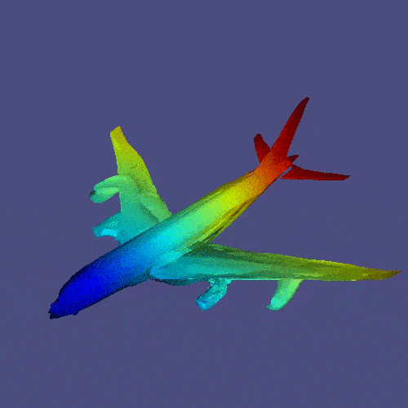
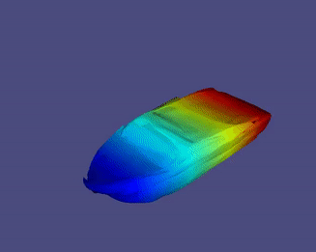
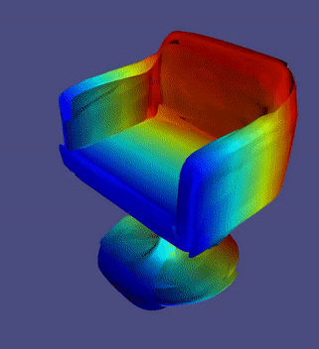

Representating 3D Surfaces by deformations
T. Deprelle B. Russell M. Fisher V. Kim M. Aubry
Thibault Groueix
Notes:
Hello everyone, I am very happy to share my work on surface-based representations of 3D shapes. This is joint work between ENPC with Theo Deprelle and Mathieu Aubry and Adobe Research with Bryan Russell, Mathew Fisher and Vova Kim.
There are several ways to represent 3D shapes, which is the motivation for this workshop. In this talk, I discuss a 3D representation based on surfaces. A surface representation can be used without post-processing to do rendering, to compute surface interactions, to penalize surface interpenetration, and as we’ll see in the talk compute shape correspondences.

Slide 2
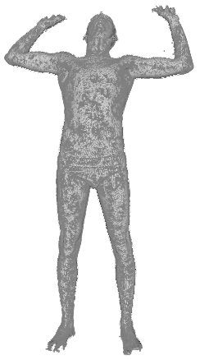
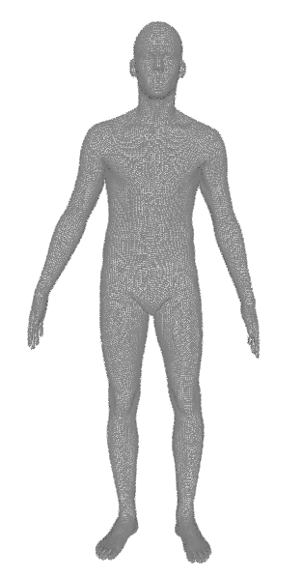
Key idea: deformation
Input
Point cloud
Generated
3D point
PointNet
Latent shape representation
MLP
x
y
z
Sampled
3D point
Template
Notes:
Our key idea is a new parameterization of 3D surfaces based on deformations. We parameterize a target 3D surface by the deformation from a template surface to the the target surface.
Of course, this requires a template. We are going to discuss several cases. The first case which is the simplest one, is shape categories with a clear shape template such as human body scans. We will discuss later harder categories which do not have a clear template.
Let’s see how we can parameterize these surface deformations in practice. We propose to model the deformation by a Multi Layered Perceptron (an MLP). This MLP is supposed to deform a common template into a target surface so it should be conditioned on the target shape, and the template.
More precisely we condition the MLP on the target shape embedding, obtained by a shape encoder such as PointNet, and a 3D surface point on the template such that the MLP, given the target shape embedding, acts as an R3 to R3 function: it takes a point on the template and outputs a 3D points on the reconstructed shape.

Slide 3
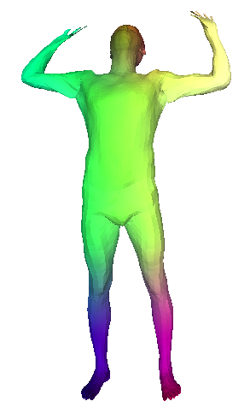
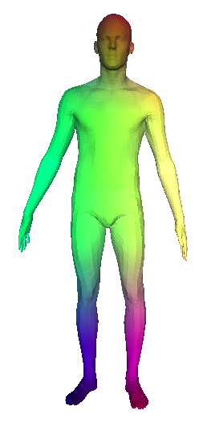
Key idea: deformation
The reconstructed shape is in dense correspondence with the template by design.
Generated
3D point
Latent shape representation
MLP
Sampled
3D point
MLP= learned family of parametric deformations
Notes:
This R3 to r3 function is run in parallel on all the template points which results in a reconstructed shape with the same number of points as the template.
Since the MLP deforms each template point independently, This means that there is a 1-1 correspondences between template points and its deformed version. We
say that the reconstruction is thus in dense correspondence with the template and visualize this with colors.
An important aspect of the method is that the MLP is conditioned on the embedding so that each transformation is specific to the current sample.
The key novelty here is to use MLPs as a family of parametric and continuous functions and use the embedding to predict which specific instance in that family we want to use for the current sample.

Slide 4
Training
2
Input
Point cloud
Generated
Point cloud
Input
Point cloud
Supervised
Loss
Unsupervised
Chamfer Distance
+ regularization
Generated
Point cloud
Notes:
These MLPs are trained on a large shape collection. There are two cases. Either we have correspondences annotation in the dataset, we can train these MLPs with a fully-supervised L2. Or we don’t and we use an unsupervised reconstruction loss like the chamfer distance, and couple it with regularization losses that penalize distorsion of the surface.

Slide 5
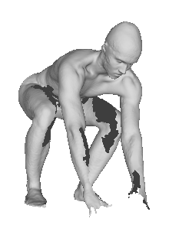
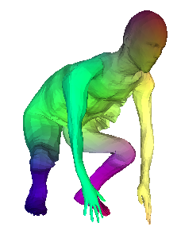
Test-time optimization
Input
Point cloud
Loss
PointNet
MLP
x
y
z
Notes:
Since our method has an fully unsupervised setting, regardless of how we trained the MLPs on the collection, we can always refine the learned deformation by a test-time optimization on a new test sample using our unsupervised losses. The variable that we optimize is the embedding of the test sample,

Slide 6
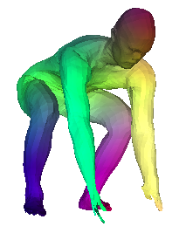
Test-time optimization
with gradient descent
Latent shape space
Loss
MLP
x
y
z
Notes:
and we initialize the optimization by the learned embedding. After optimizing the embedding, the quality of the reconstruction has improved.

Slide 7
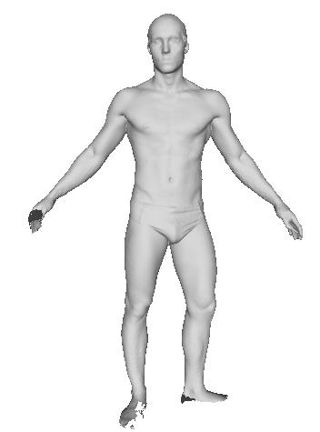
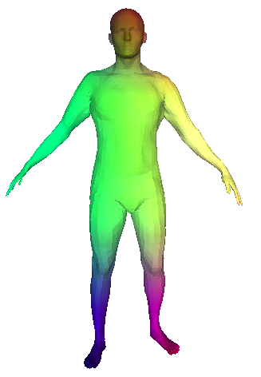
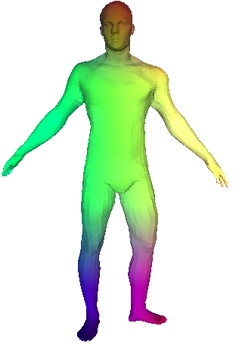
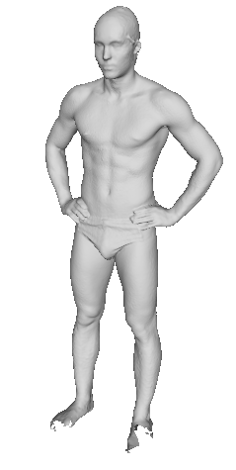
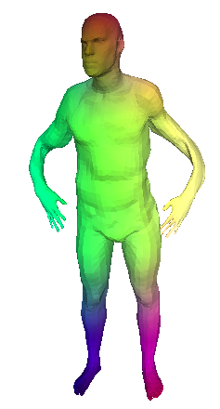
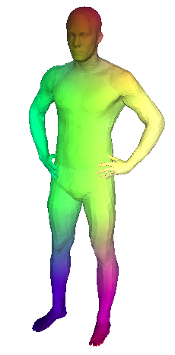
Input Shape
Before test-time optim
After test-time optim
Notes:
If the initial reconstruction is good enough, this test-time optimization doesn’t change much.
However it is critical if the initial has clear artifacts as you see on the arms.

Slide 8
Robustness to perturbations :
noise, holes, topology, sampling…
SCAPE
TOSCA
Scape: shape completion and animation of people, Anguelov et al. TOG (2005)
Numerical geometry of non-rigid shapes, Bronstein et al. Springer Science & Business Media (2008)
Notes:
This reconstruction approach by surface deformation is robust to noice, holes, partial scans, and generalize to difficult pose and shape

Slide 9
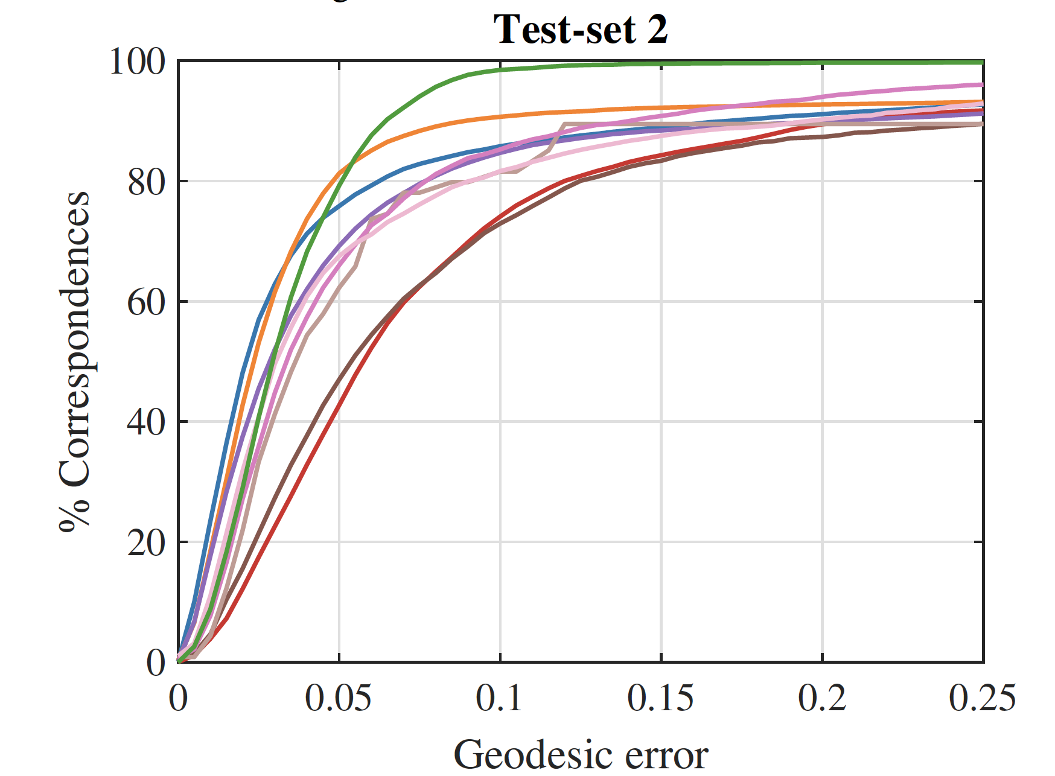
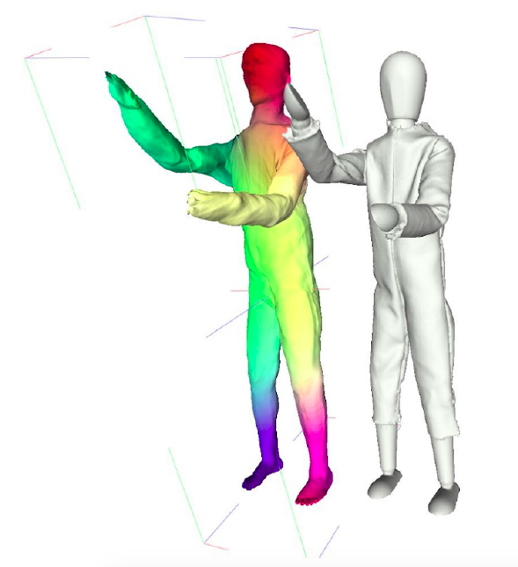
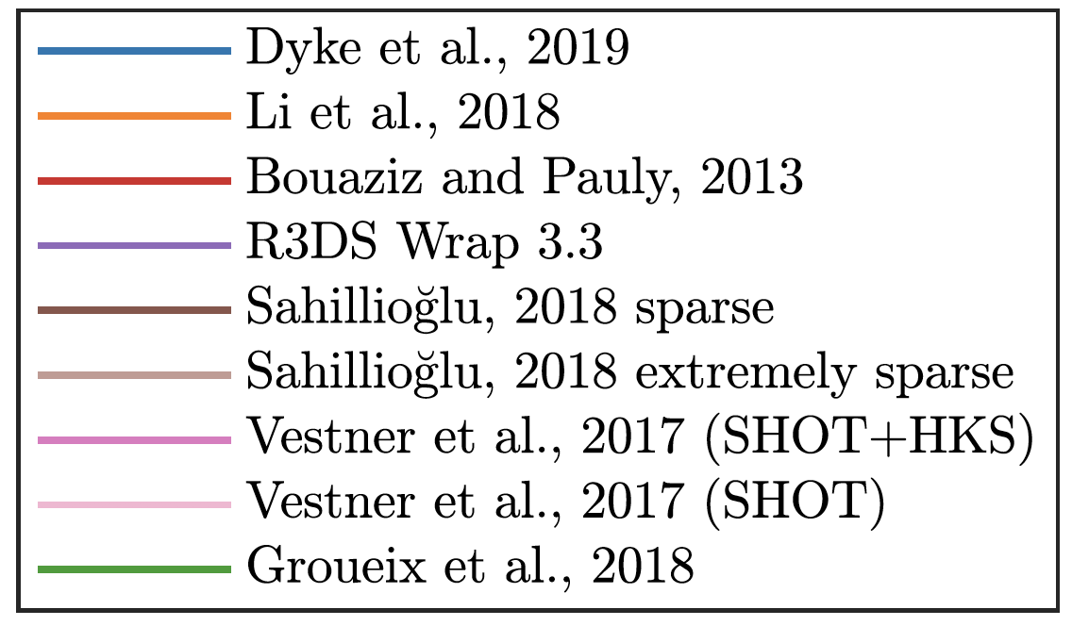
SHREC’19: Shape Correspondence with Isometric and Non-Isometric Deformations
Unsupervised cycle-consistent deformation for shape matching (SGP)
3D-CODED : 3D Correspondences by Deep Deformation (ECCV18)
Notes:
Because all the reconstructed shapes are, by design, in dense correspondences with the template, we we visualized with colors previously, it leads to a simple algorithm for shape matching that we called 3D-CODED, and that achieved the SOTA matching results on dataset of human scans and the SHREC19 competition.

Slide 10
w/o template + w/ cycle consistency
Unsupervised cycle-consistent deformation for shape matching (SGP19)
Notes:
We’ve seen how to deform surfaces for categories that have a clear template but most categories don’t have neither templates nor correspondence annotations. We now discuss two options to deal with those harder cases, like the chair category. In the absence of template and correpondences annotations, a first approach is to learn to deform any shape into any other which can be achieved by conditioning the deformation MLP on both target surface and source surface.
we can use cycle-consistency constraints to learn encourage those deformations to respect shape correspondences. Indeed, for any pair of shapes, the deformation of shape A should be the inverse of the deformation of shape B. Similarly for any triplet, if you compose deformations along a cycle, it should lead to the identity function of R3.
Since we don’t have access to a template, a key aspect of this approach is to design a selection criterion that tells, given a new test sample, which training shape should be the source surface.

Slide 11
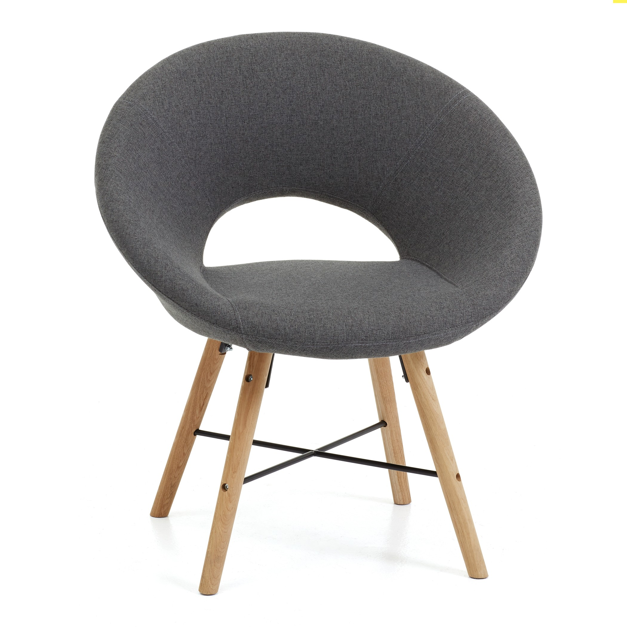

w/ universal template
Generated
Point cloud
Latent shape representation
MLP
x
y
z
AtlasNet: A Papier-Mâché Approach to Learning 3D Surface Generation (CVPR18)
Notes:
Another approach to handle categories without templates, is to deform a universal template such as a sphere or planar patches. This approach is called AtlasNet.

Slide 12

w/ universal template
Generated
Point cloud
Latent shape representation
MLP
x
y
z
Learning elementary shape structures (NeurIPS19)
Notes:
Our experiments with human body scans show that deforming a template specialized for the category leads to better reconstruction results that universal ones. For categories without clear shape template, we thus proposed to learn the template, which we call learning optimal elementary structures.

Slide 13
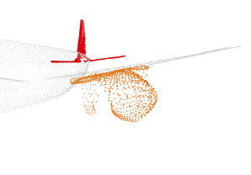
Learning elementary structures:
Point Learning
MLP 1
Latent shape representation
MLP 2
Notes:
To learn these optimal elementary structures, similarly to what we did before, we start from hand-crafted template as initialization, but this time, we make the points of the template learnable parameters of the model, and during training we backpropagate gradients all the way to the the spatial position of those template points.

Slide 14
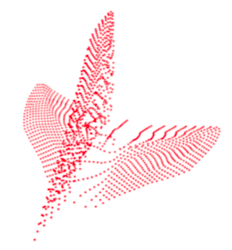
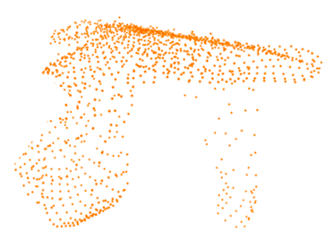
Learning elementary structures:
Point Learning
MLP 1
Latent shape representation
MLP 2
+ clear boost for reconstruction and correspondences
Notes:
After training, the templates has been specialized in order to best reconstruct to training data. Hence in the best cases, we can see semantic parts appearing like plane tail or reactor, without any prior annotation on parts, and simply by minimizing an unsupervised reconstruction objective. Beyond interpretable results, learning parts also give a clear boost for reconstruction and correspondences.

Slide 15
Summary.
Correspondences through surface deformation (AtlasNet+ 3D-CODED)
Parts through surface deformation (AtlasNetv2)
Clustering through surface deformation (DTI-Clustering) – New, not in this talk.
“Deep Transformation Invariant Clustering”, Arxiv 2020, T. Monnier, T. Groueix, M. Aubry
Notes:
It is time to wrap-up, we have seen how to parameterize the surface of 3D shapes with neural networks by their deformation from a template surface. And we have shown the strength of this approach in several applications doing analysis-by-synthesis.
In particular, we showed that surface deformations could be used for shape matching, learning parts, and just recently clustering on arxiv, check it out ☺ Thanks.

