Slide 1

Deep 3D Generation by Deformations
T. Groueix, M. Fisher, V. G. Kim, B. C. Russell, M. Aubry
AtlasNet: A papier-mâché approach to learning 3d surface generation, CVPR. 2018
3D-CODED 3D correspondences by deep deformation, ECCV 2018
Unsupervised cycle-consistent deformation for shape matching, SGP 2019
T. Deprelle, T. Groueix, M. Fisher, V. G. Kim, B. C. Russell, M. Aubry
Learning elementary structures for 3D shape generation and matching, Neurips 2019

Slide 2
A good 3D representation?
That make sense to us
We can use to reason about shapes
For Neural Networks
  Voxels (3D ConvNets, heavy)
  Rendered views/depth (great for recognition)
  Surface (2D ConvNets, tricky)
  …
  Points (PointNet, PointSetGen)

Slide 3
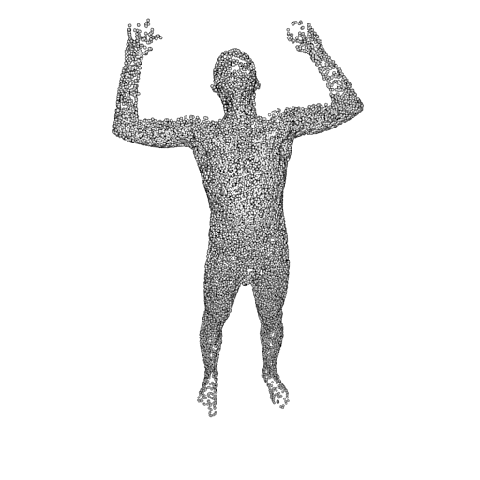
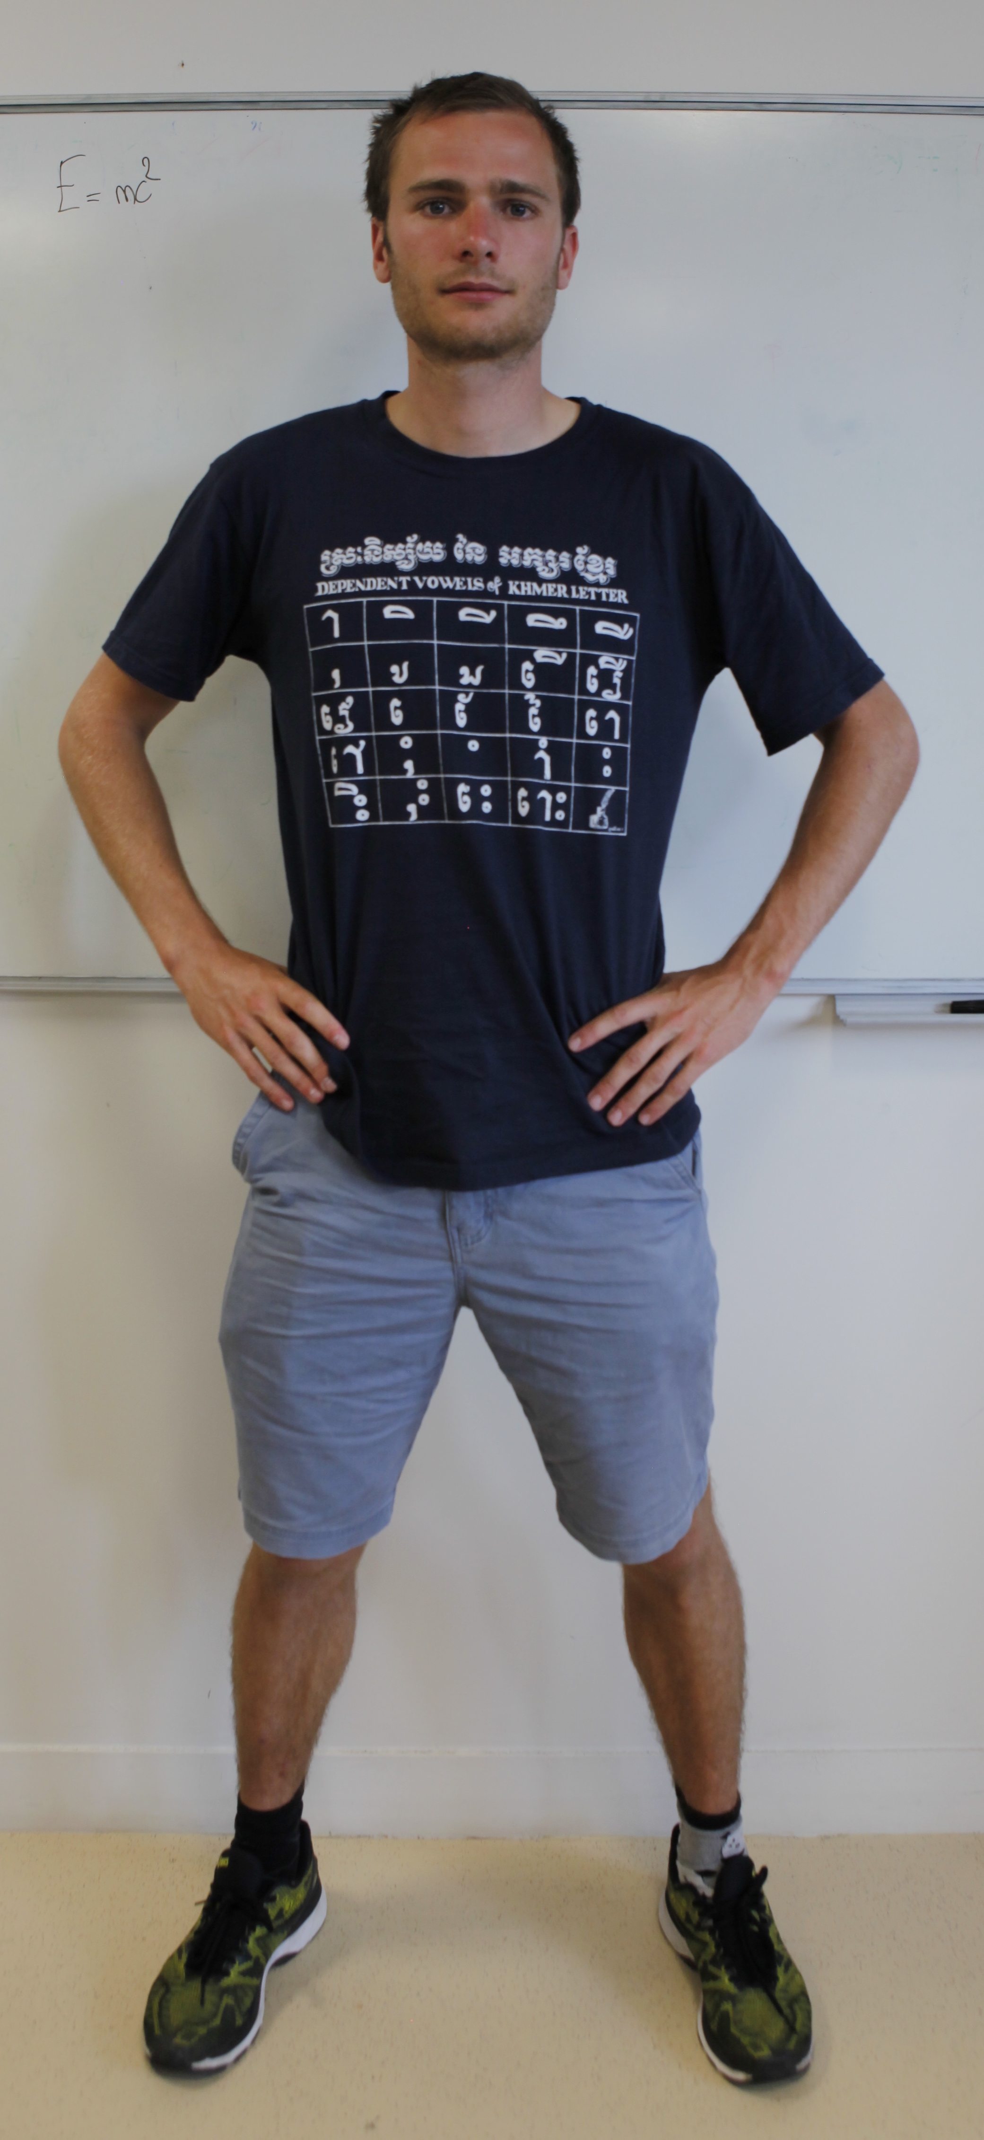
Points. PointSetGen
Input
Image
Generated
Point cloud
3D Deep Learning
Fan, H., Su, H., & Guibas, L. J. A point set generation network for 3d object reconstruction from a single image, CVPR 2017
Notes:
And this works much better in practice.
This actually goes back to the topological definition of a surface, as being everywhere similar to a 2D patch (homeomorphic to R2). We show in the paper that in fact the representation we learn is similar to an atlas.
This is our final setup.
We show that this simple representation leads to better shape generation, improved generalization and several free applications.

Slide 4
Points. PointSetGen
Input
Image
Generated
Point cloud
3D Deep Learning
CNN
Fan, H., Su, H., & Guibas, L. J. A point set generation network for 3d object reconstruction from a single image, CVPR 2017
Notes:
And this works much better in practice.
This actually goes back to the topological definition of a surface, as being everywhere similar to a 2D patch (homeomorphic to R2). We show in the paper that in fact the representation we learn is similar to an atlas.
This is our final setup.
We show that this simple representation leads to better shape generation, improved generalization and several free applications.

Slide 5
Points. PointSetGen
Input
Image
Generated
Point cloud
CNN
MLP
Fan, H., Su, H., & Guibas, L. J. A point set generation network for 3d object reconstruction from a single image, CVPR 2017
Notes:
And this works much better in practice.
This actually goes back to the topological definition of a surface, as being everywhere similar to a 2D patch (homeomorphic to R2). We show in the paper that in fact the representation we learn is similar to an atlas.
This is our final setup.
We show that this simple representation leads to better shape generation, improved generalization and several free applications.

Slide 6
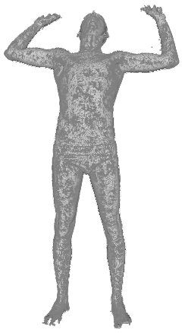
PointSetGen
Generated
Point cloud
Latent shape representation
MLP
Fan, H., Su, H., & Guibas, L. J. A point set generation network for 3d object reconstruction from a single image, CVPR 2017

Slide 7
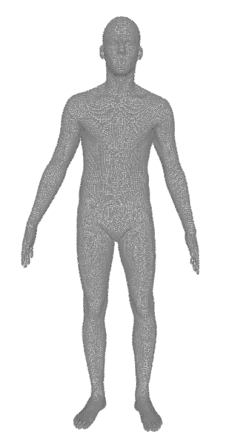
Key idea: deformation
Generated
3D point
Latent shape representation
MLP
x
y
z
Sampled
3D point
MLP= learned family of parametric deformations
Template

Slide 8
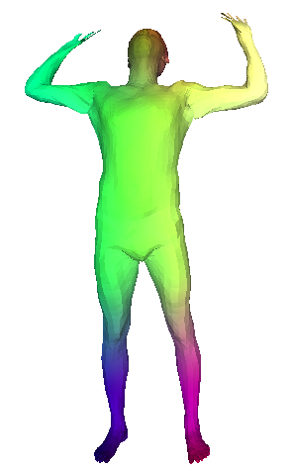
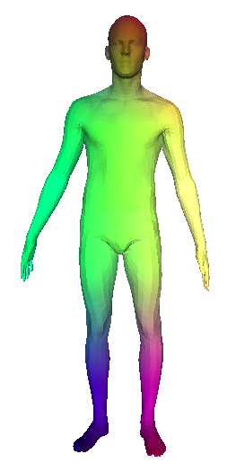
Key idea: deformation
The reconstructed shape is in dense correspondence with the template by design.
Generated
3D point
Latent shape representation
MLP
Sampled
3D point

Slide 9
Deformations are a flexible and intuitive way to represent shapes
  Preserve correspondences
  Infinite resolution
Generated
3D point
Latent shape representation
MLP
Sampled
3D point

Slide 10
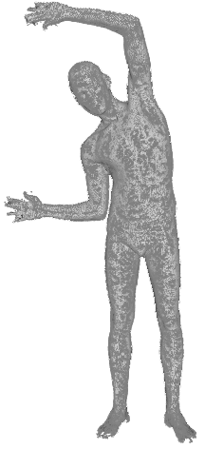
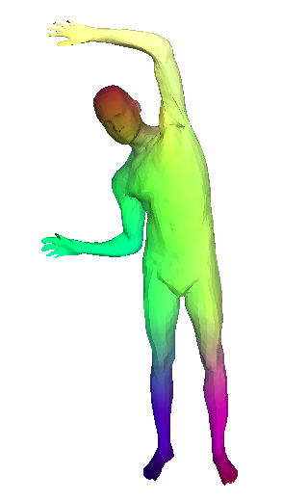
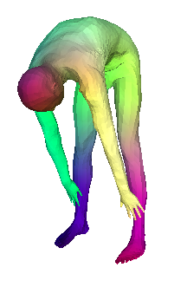
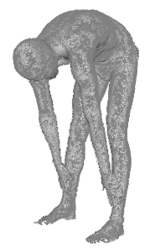
Evaluation: Finding 3D shape correspondences between 2 shapes
Template
Nearest
Neighbor
Correspondence
via template
Nearest
Neighbor

Slide 11
Results

Slide 12
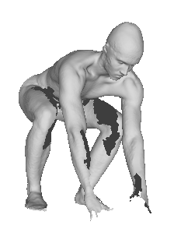
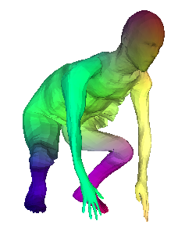
Results
The nearest neighbors are likely to be poor

Slide 13
Refinement.
Input
Point cloud
Loss
PointNet
MLP
x
y
z
MLP= learned family of parametric deformations

Slide 14
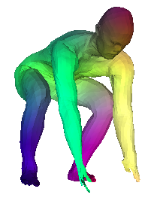
Refinement. Optimized with gradient descent
Latent shape space
Loss
MLP
x
y
z

Slide 15
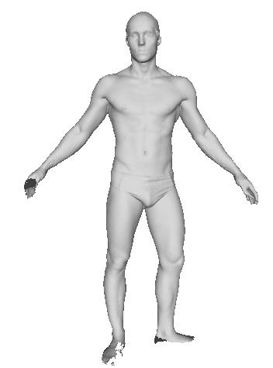
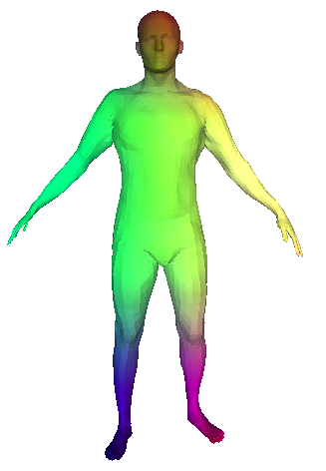
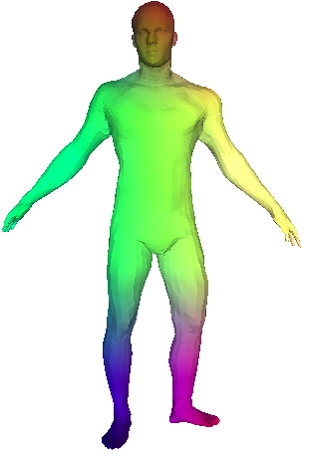
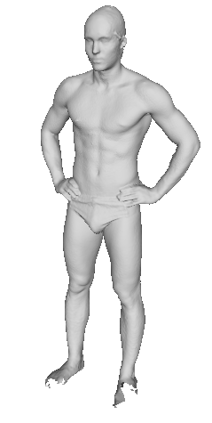
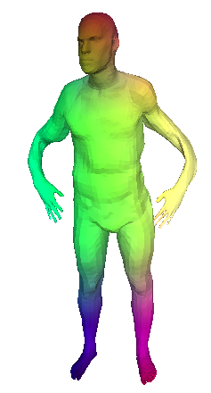
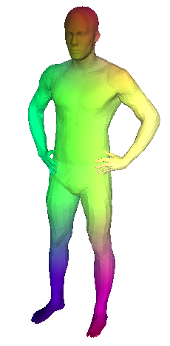
Input Shape
Deformed Template
Optimized reconstruction

Slide 16
Train Surreal^{[1]} + augmented bending poses ~ 230,000 synthetic poses
Test on FAUST^{[2]}
The first completely unsupervised correspondence learning approach for deformable 3D shapes.
[1] Learning from synthetic humans, Varol et al. CVPR (2017)
[2] FAUST: Dataset and evaluation for 3D mesh registration, Bogo et al. CVPR (2014)
[3] Robust nonrigid registration by convex optimization, Chen, Koltun, ICCV (2015)
[4] Deep functional maps: Structured prediction for dense shape correspondence, Litany et al. ICCV (2017)
[5] The stitched puppet: A graphical model of 3d human shape and pose, Zuffi et al. CVPR (2015)

Slide 17
Generalization. Credit: Zhongshi Jiang (PhD NYU)
Notes:
We also tested robustness to a lot of noise, and surprisingly our results was very robust to many types of perturbations;

Slide 18
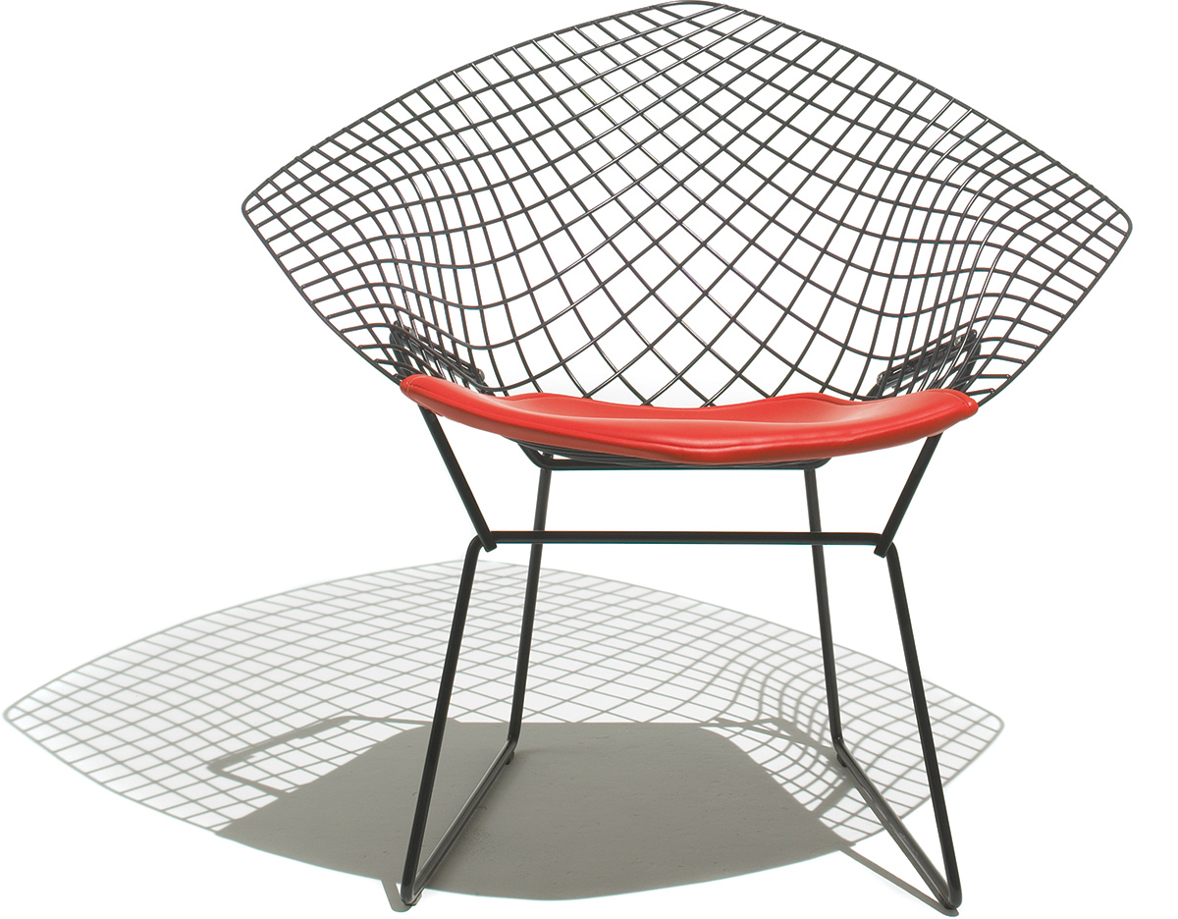
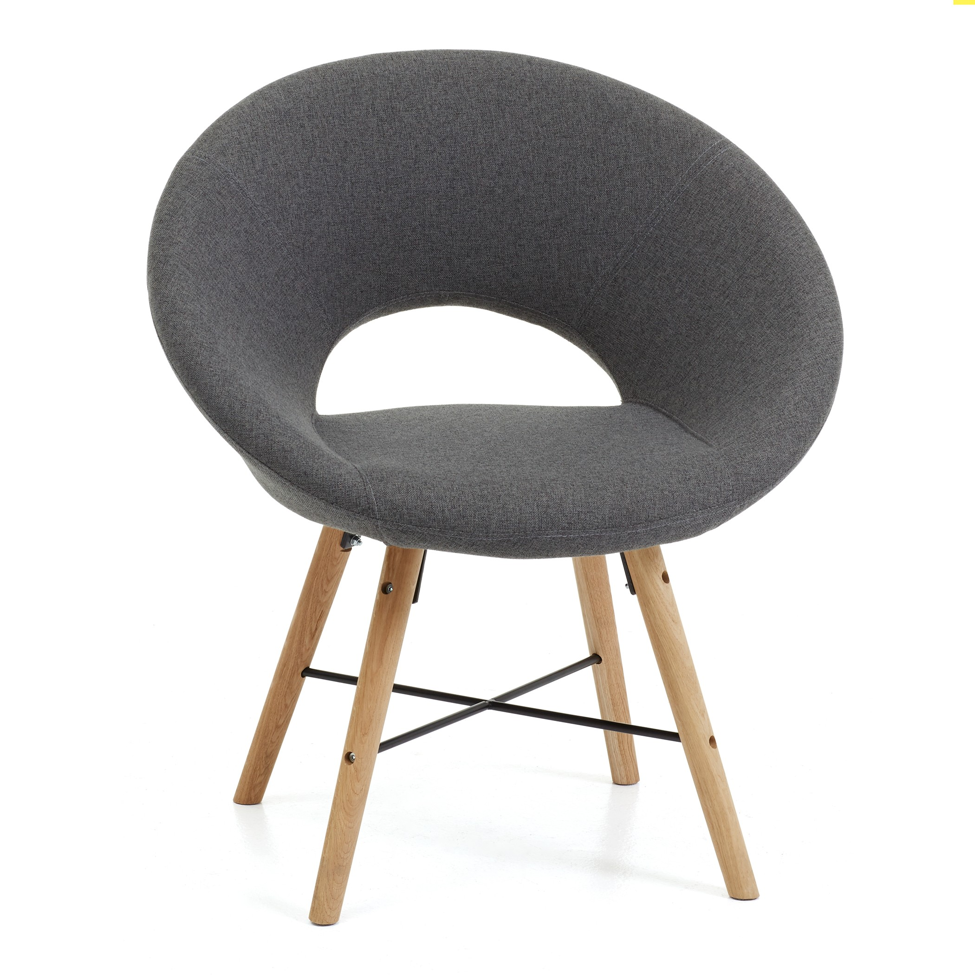
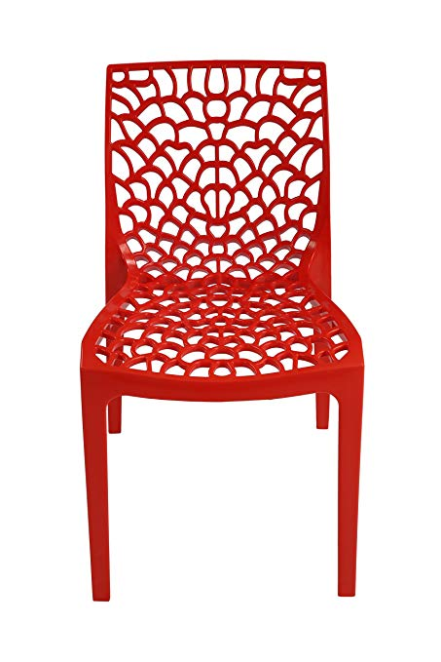
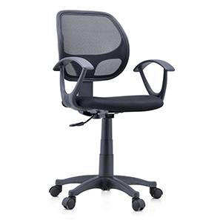
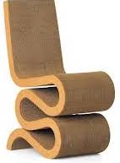

Beyond humans/templates?
Generated
Point cloud
Latent shape representation
MLP
x
y
z

Slide 19
Deform a unit square
Latent shape representation
Generated
3D point
MLP
x
y
Sampled
2D point

Slide 20
Deform a unit square
Latent shape representation
Generated
3D point
MLP
x
y
Sampled
2D point

Slide 21
Deform a unit square
Latent shape representation
MLP
x
y
Sampled
2D point

Slide 22
Deform a unit square
Latent shape representation
MLP
x
y
Sampled
2D point

Slide 23
Deform a unit square
Latent shape representation
MLP
x
y
Sampled
2D point

Slide 24
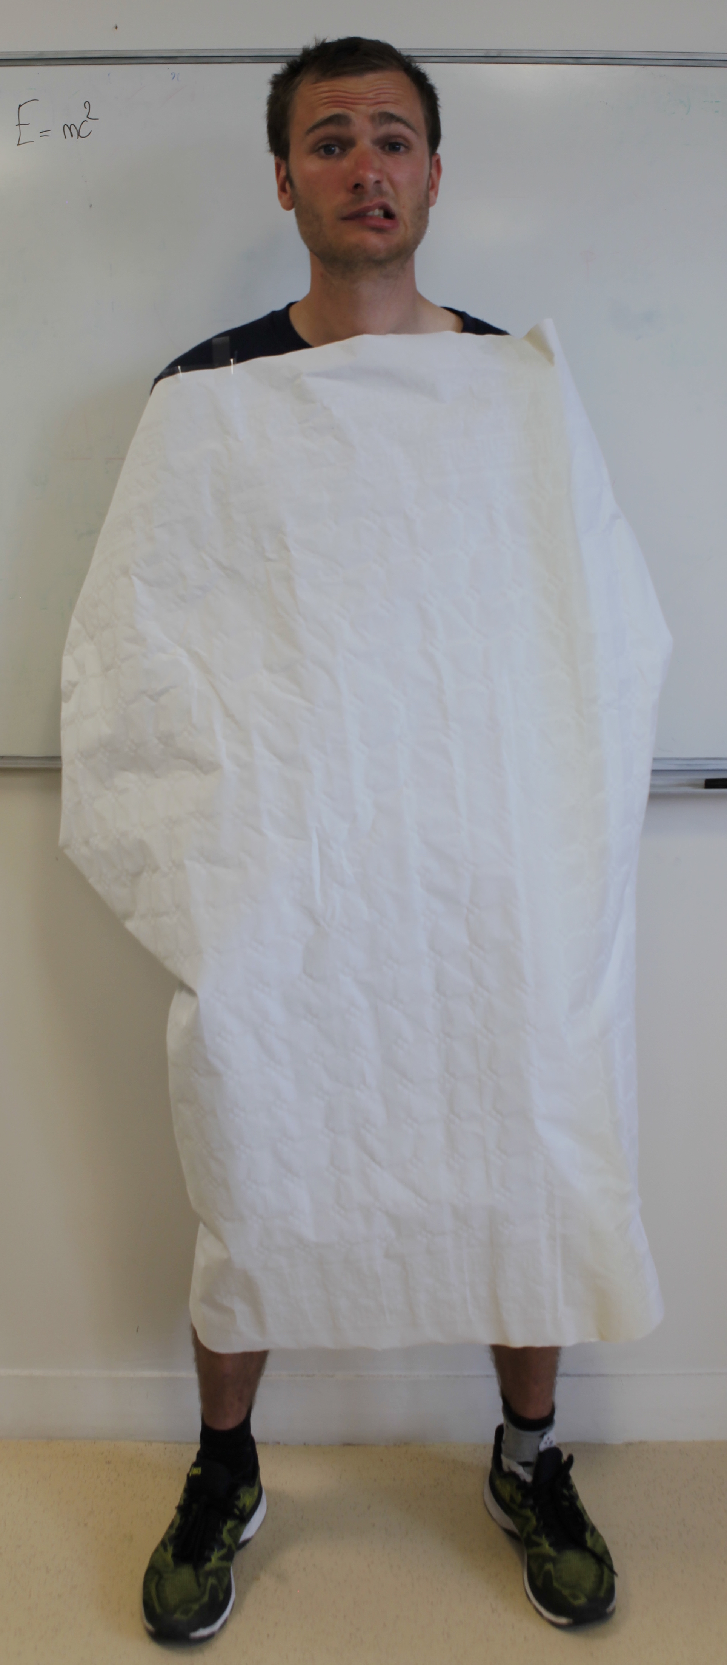
x
Generated
3D point
Latent shape representation
MLP
y
Sampled
2D point

Slide 25
x
Generated
3D point
MLP 1
Latent shape representation
y
Sampled
2D point

Slide 26
x
Generated
3D point
MLP 1
Latent shape representation
MLP 2
y
MLP 3
Sampled
2D point

Slide 27
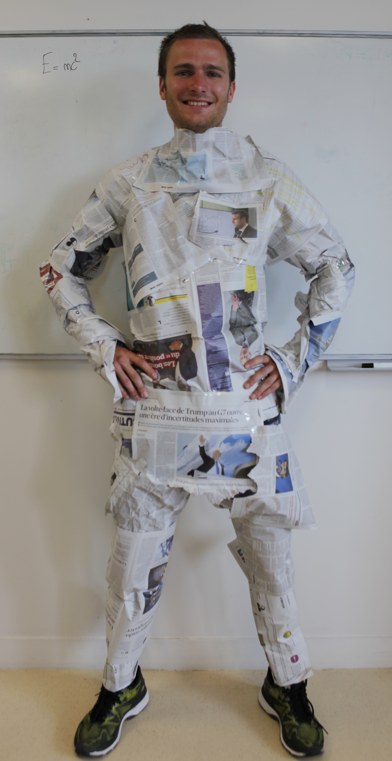
x
Generated
3D point
MLP 1
Latent shape representation
MLP 2
y
MLP 3
Sampled
2D point
Learnt simply by sampling many points and minimizing Chamfer distance

Slide 28
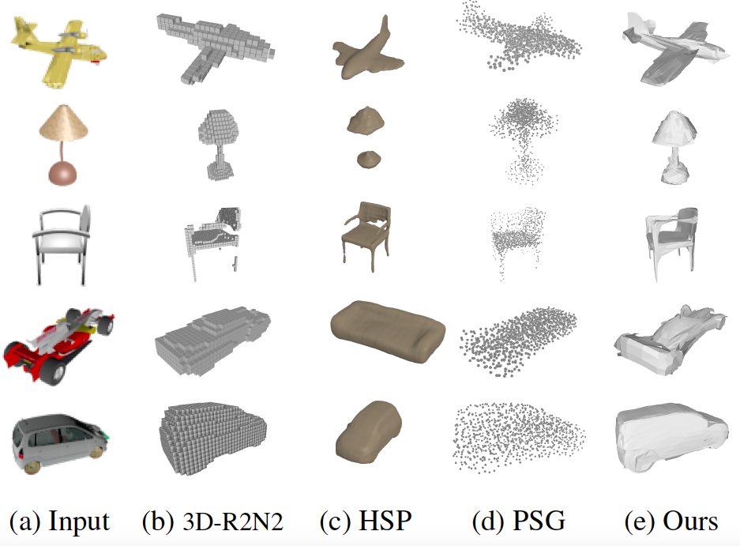
Input
Image
Voxels
3D-R2N2
PointClouds
PSG
Meshes
Ours : AtlasNet

Slide 29
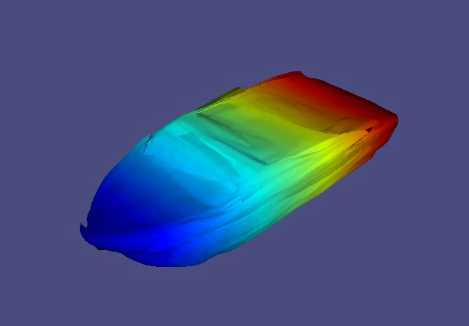
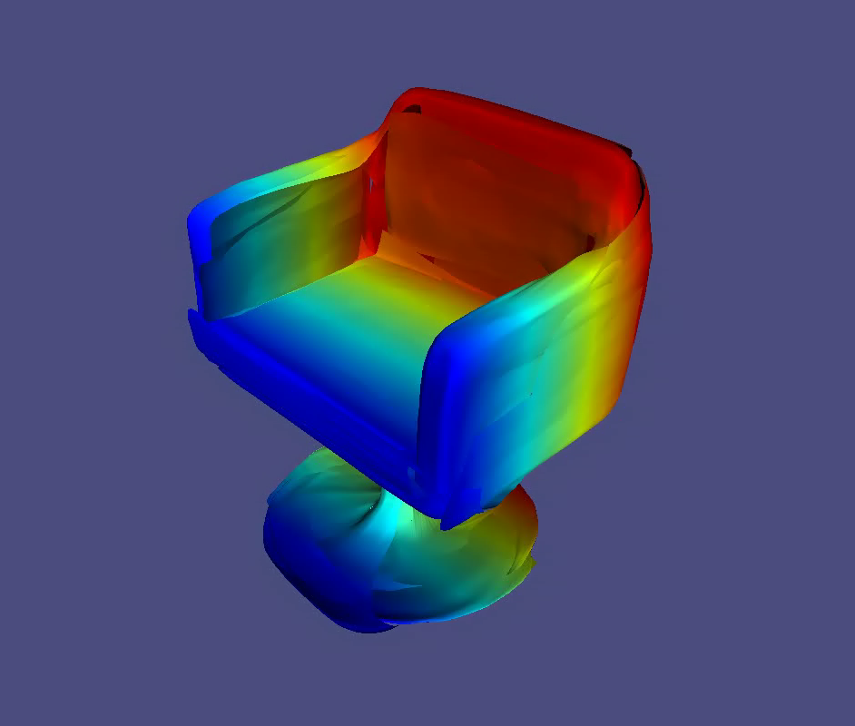
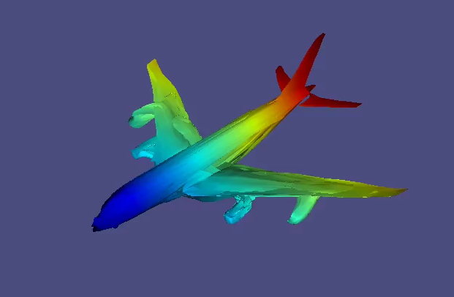
Shape Interpolation
Deformations are a flexible and intuitive way to represent shapes
  Preserve correspondences
  Infinite resolution
  Preserve connectivity - Generate Meshes

Slide 30
Template Available
No Template
Generated
Point cloud
Generated
3D point
Latent shape representation
MLP 1
MLP
Sampled
3D point
x
MLP 2
y
z
x
y
MLP 3
Sampled
2D point
Notes:
And this works much better in practice.
This actually goes back to the topological definition of a surface, as being everywhere similar to a 2D patch (homeomorphic to R2). We show in the paper that in fact the representation we learn is similar to an atlas.
This is our final setup.
We show that this simple representation leads to better shape generation, improved generalization and several free applications.

Slide 31
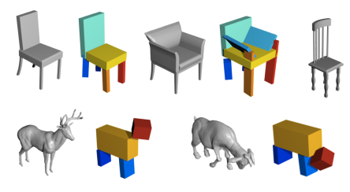
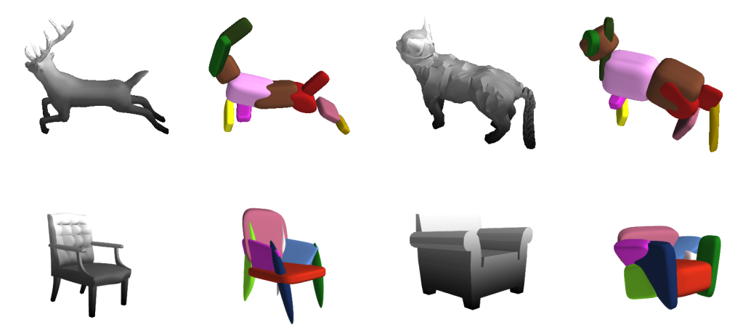
Learning the number of primitives.
Learning Shape Abstractions by Assembling Volumetric Primitives, Shubham Tulsiani , Hao Su, Leonidas J. Guibas, Alexei A. Efros, Jitendra Malik
Superquadrics Revisited: Learning 3D Shape Parsing beyond Cuboids, Despoina Paschalidou, Ali Osman Ulusoy, Andreas Geiger

Slide 32
Optimal elementary structures?
Generated
Point cloud
Latent shape representation
MLP
x
y
z

Slide 33
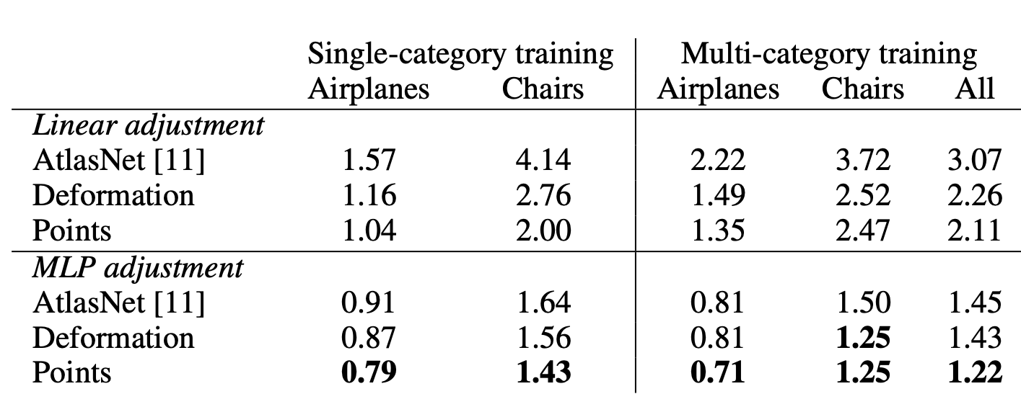
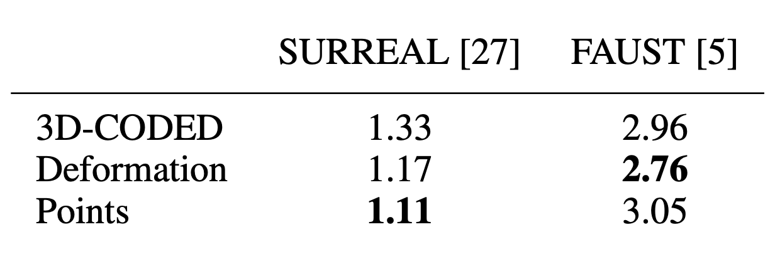
Quantitative Results
3D Surface Reconstruction on Shapenet
Method 1
Lower is Better
Method 2
3D Dense correspondences on FAUST
Method 1
Lower is Better
Method 2

Slide 34
Optimal elementary structures?
Generated
Point cloud
Latent shape representation
MLP
x
y
z

Slide 35
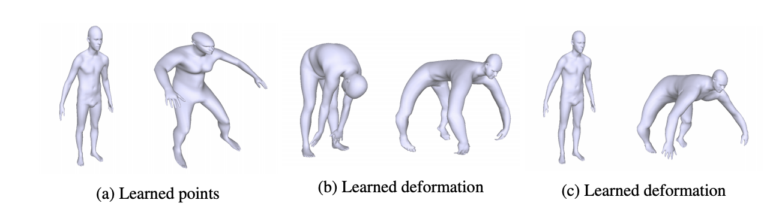
Optimal elementary structures?
Method 1 : Deform a prior towards an optimal template
Generated
Point cloud
Latent shape representation
MLP
x
y
z
x
MLP
y
z

Slide 36
Results
Initial Template
Learned Template

Slide 37
Results
Initial Template
Learned Template

Slide 38
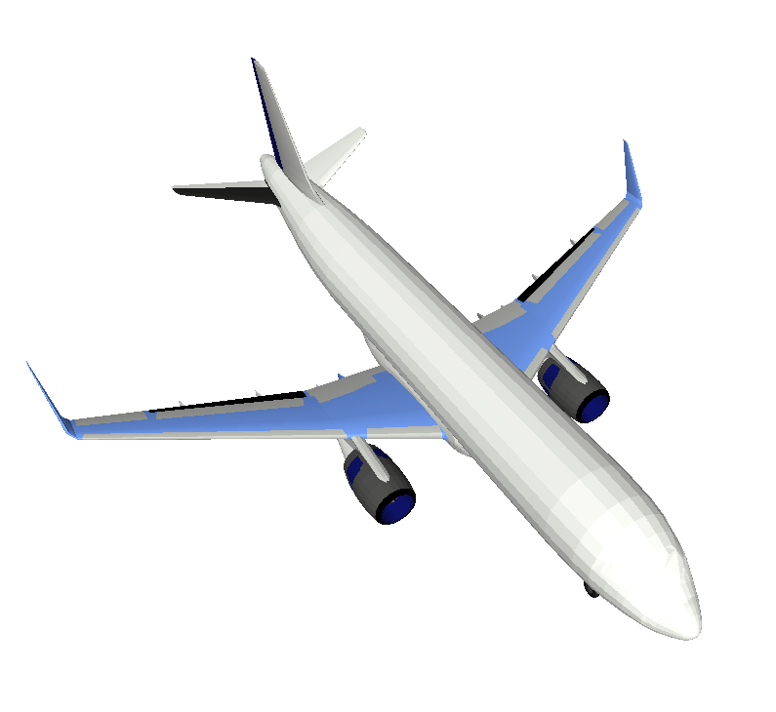
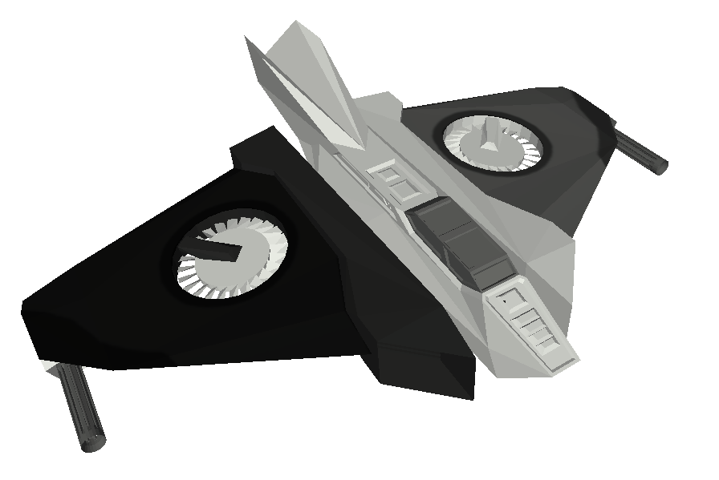
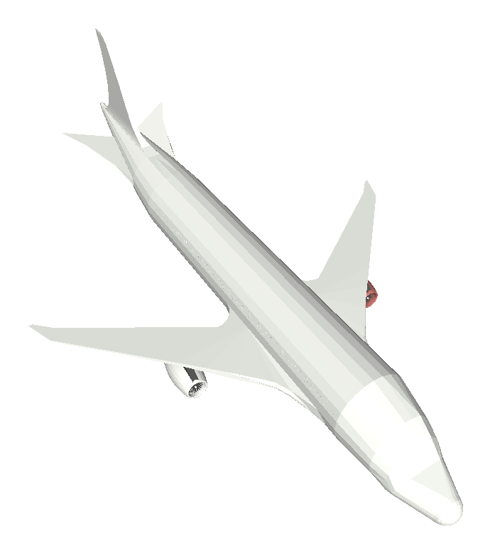
On planes

Slide 39
x
Discovery.
MLP 1
Latent shape representation
MLP 2
y
MLP 3
Notes:
And this works much better in practice. This type of parameterization is in fact called an atlas.
Now using this, we can train on more generic categories, for example we can train on ShapeNet. It's a dataset of about 30 thousand shapes coming from 13 categories, among which the chairs.
To evaluate our proposed parameterization, we evaluate the quality of the autoencoder.

Slide 40
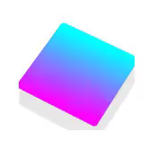
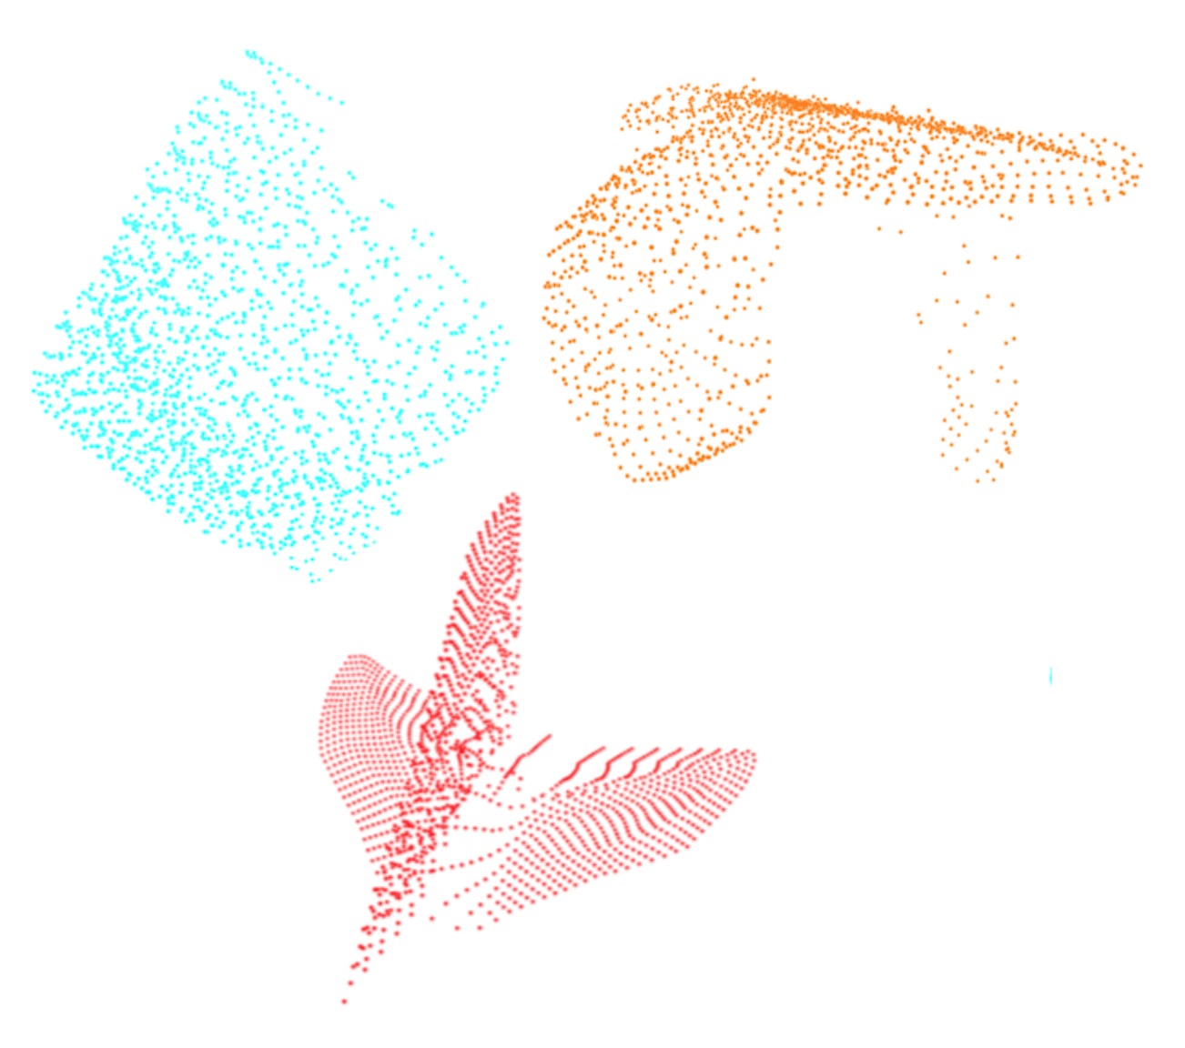
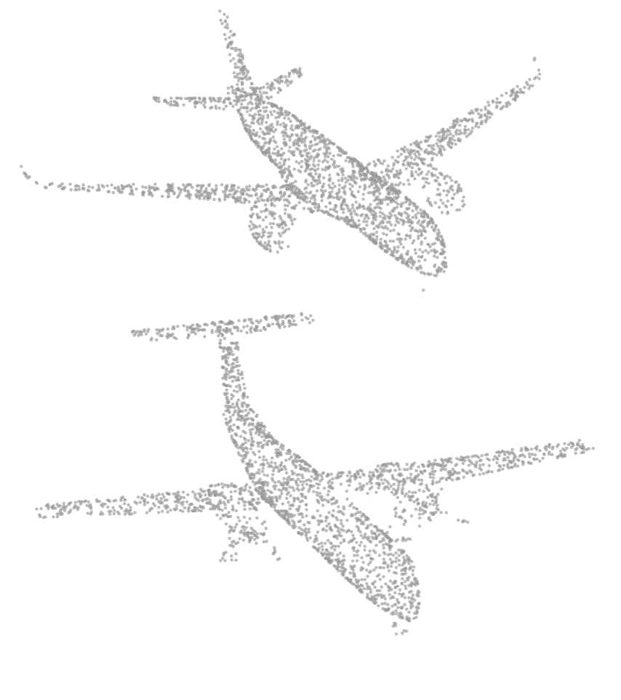
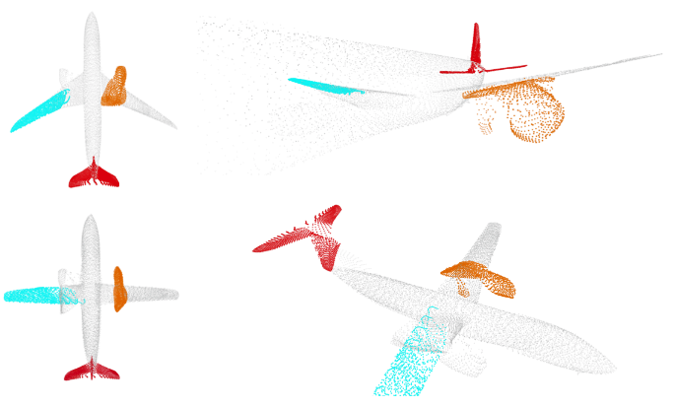
Results Shapenet : Patch Deformation
Learned elementary structures
Input
Reconstructions
Notes:
Notice that different shapes are reconstructed with different sets of cuboids

Slide 41


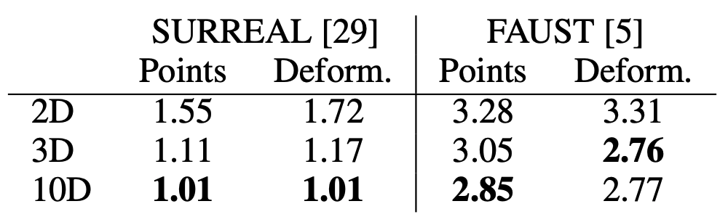
Results Shapenet : Patch Deformation
Properties | Patch Deformation
Mesh templates
Robustness to initialization
Explicit Control over the deformation
Higher Dimensional Templates
Topology Changes
Learned elementary structures
Notes:
Notice that different shapes are reconstructed with different sets of cuboids

Slide 42
Optimal elementary structures?
Method 2 : Make the template points learnable parameters
Generated
Point cloud
Latent shape representation
MLP
x
y
z
Notes:
And this works much better in practice.
This actually goes back to the topological definition of a surface, as being everywhere similar to a 2D patch (homeomorphic to R2). We show in the paper that in fact the representation we learn is similar to an atlas.
This is our final setup.
We show that this simple representation leads to better shape generation, improved generalization and several free applications.

Slide 43
Optimal elementary structures?
Method 2 : Make the template points learnable parameters
Generated
Point cloud
Latent shape representation
MLP
x
y
z
Notes:
And this works much better in practice.
This actually goes back to the topological definition of a surface, as being everywhere similar to a 2D patch (homeomorphic to R2). We show in the paper that in fact the representation we learn is similar to an atlas.
This is our final setup.
We show that this simple representation leads to better shape generation, improved generalization and several free applications.

Slide 44
x
Optimal elementary structures?
MLP 1
Latent shape representation
MLP 2
y
MLP 3
Notes:
And this works much better in practice. This type of parameterization is in fact called an atlas.
Now using this, we can train on more generic categories, for example we can train on ShapeNet. It's a dataset of about 30 thousand shapes coming from 13 categories, among which the chairs.
To evaluate our proposed parameterization, we evaluate the quality of the autoencoder.

Slide 45
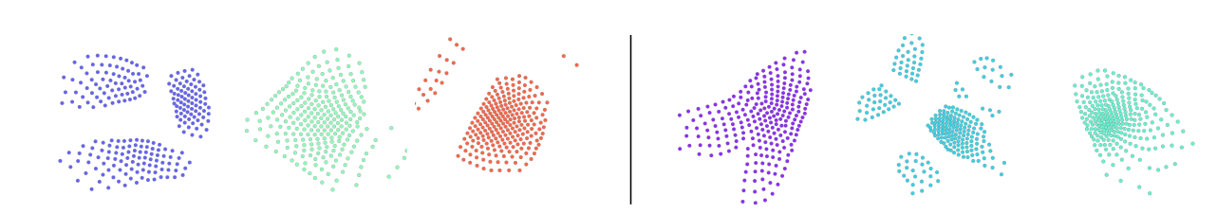
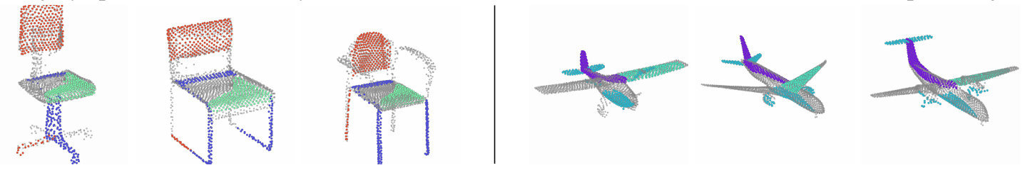
On objects

Slide 46
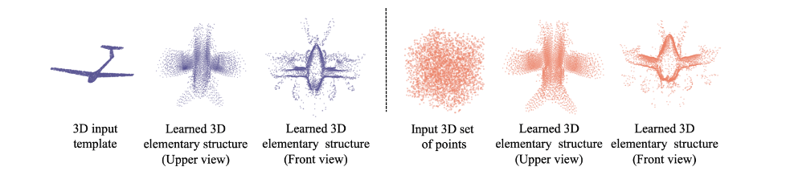
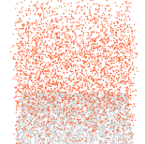
Initial Template
Learned Template

Slide 47
Properties | Patch Deformation | Points Translation
Mesh templates
Robustness to initialization
Explicit Control over the deformation
Higher Dimensional Templates
Topology changes

Slide 48
Deformations are a flexible and intuitive way to represent shapes
  Preserve correspondences
  Infinite resolution
  Preserve connectivity - Generate Meshes
  Suited to learn an optimised set of template(s).

