Slide 1
Unsupervised Layered Image Decomposition into Object Prototypes
International Conference of Computer Vision 2021
Tom Monnier¹ Elliot Vincent^{1,2} Jean Ponce^{2,3} Mathieu Aubry¹
¹LIGM, École des Ponts ²INRIA and DIENS ³Center for Data Science, NYU
Notes:
Hi I am Tom and I am going to present our work on Unsupervised Layered Image Decomposition into Object Prototypes.

Slide 2
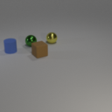
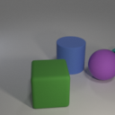
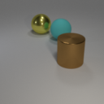
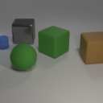
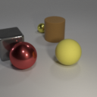
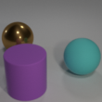
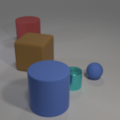
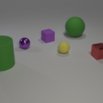
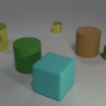
3 shapes
2 materials
Different scales and locations
Different colors
Notes:
Let’s have a look at this small collection of images. As humans, we can quickly identify common characteristics for these objects.
First, we can isolate 3 categories of shapes, and
within a same category, we can identify two types of material.
Then, objects can have different scales and locations in the scene.
Finally, we can identify a limited set of colors that are repeated in the images.
In this work, we introduce

Slide 3
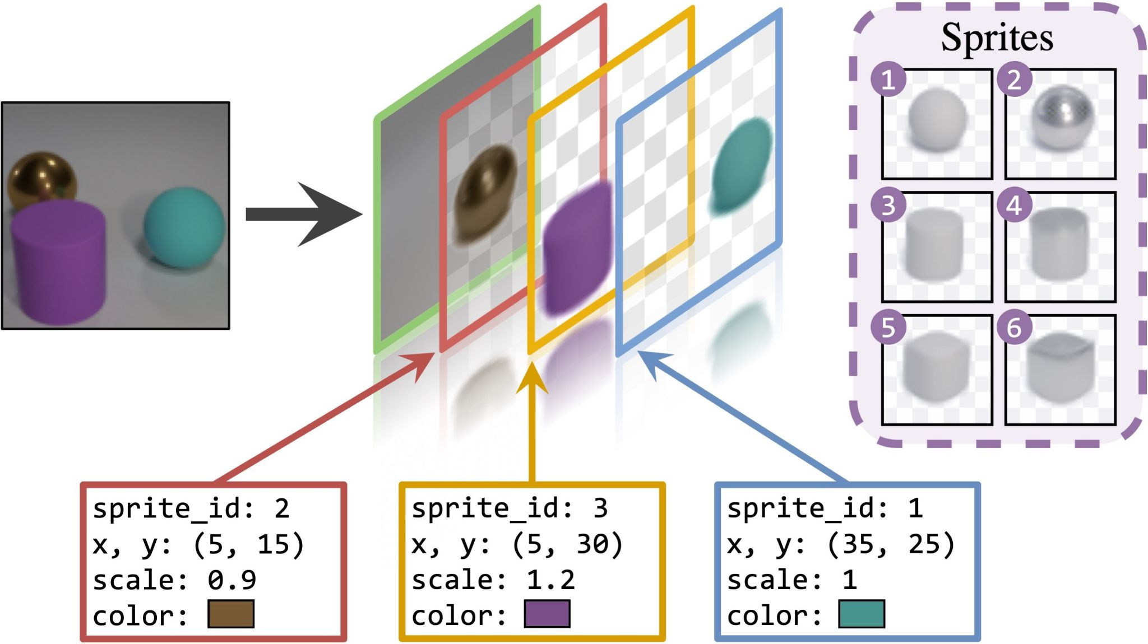
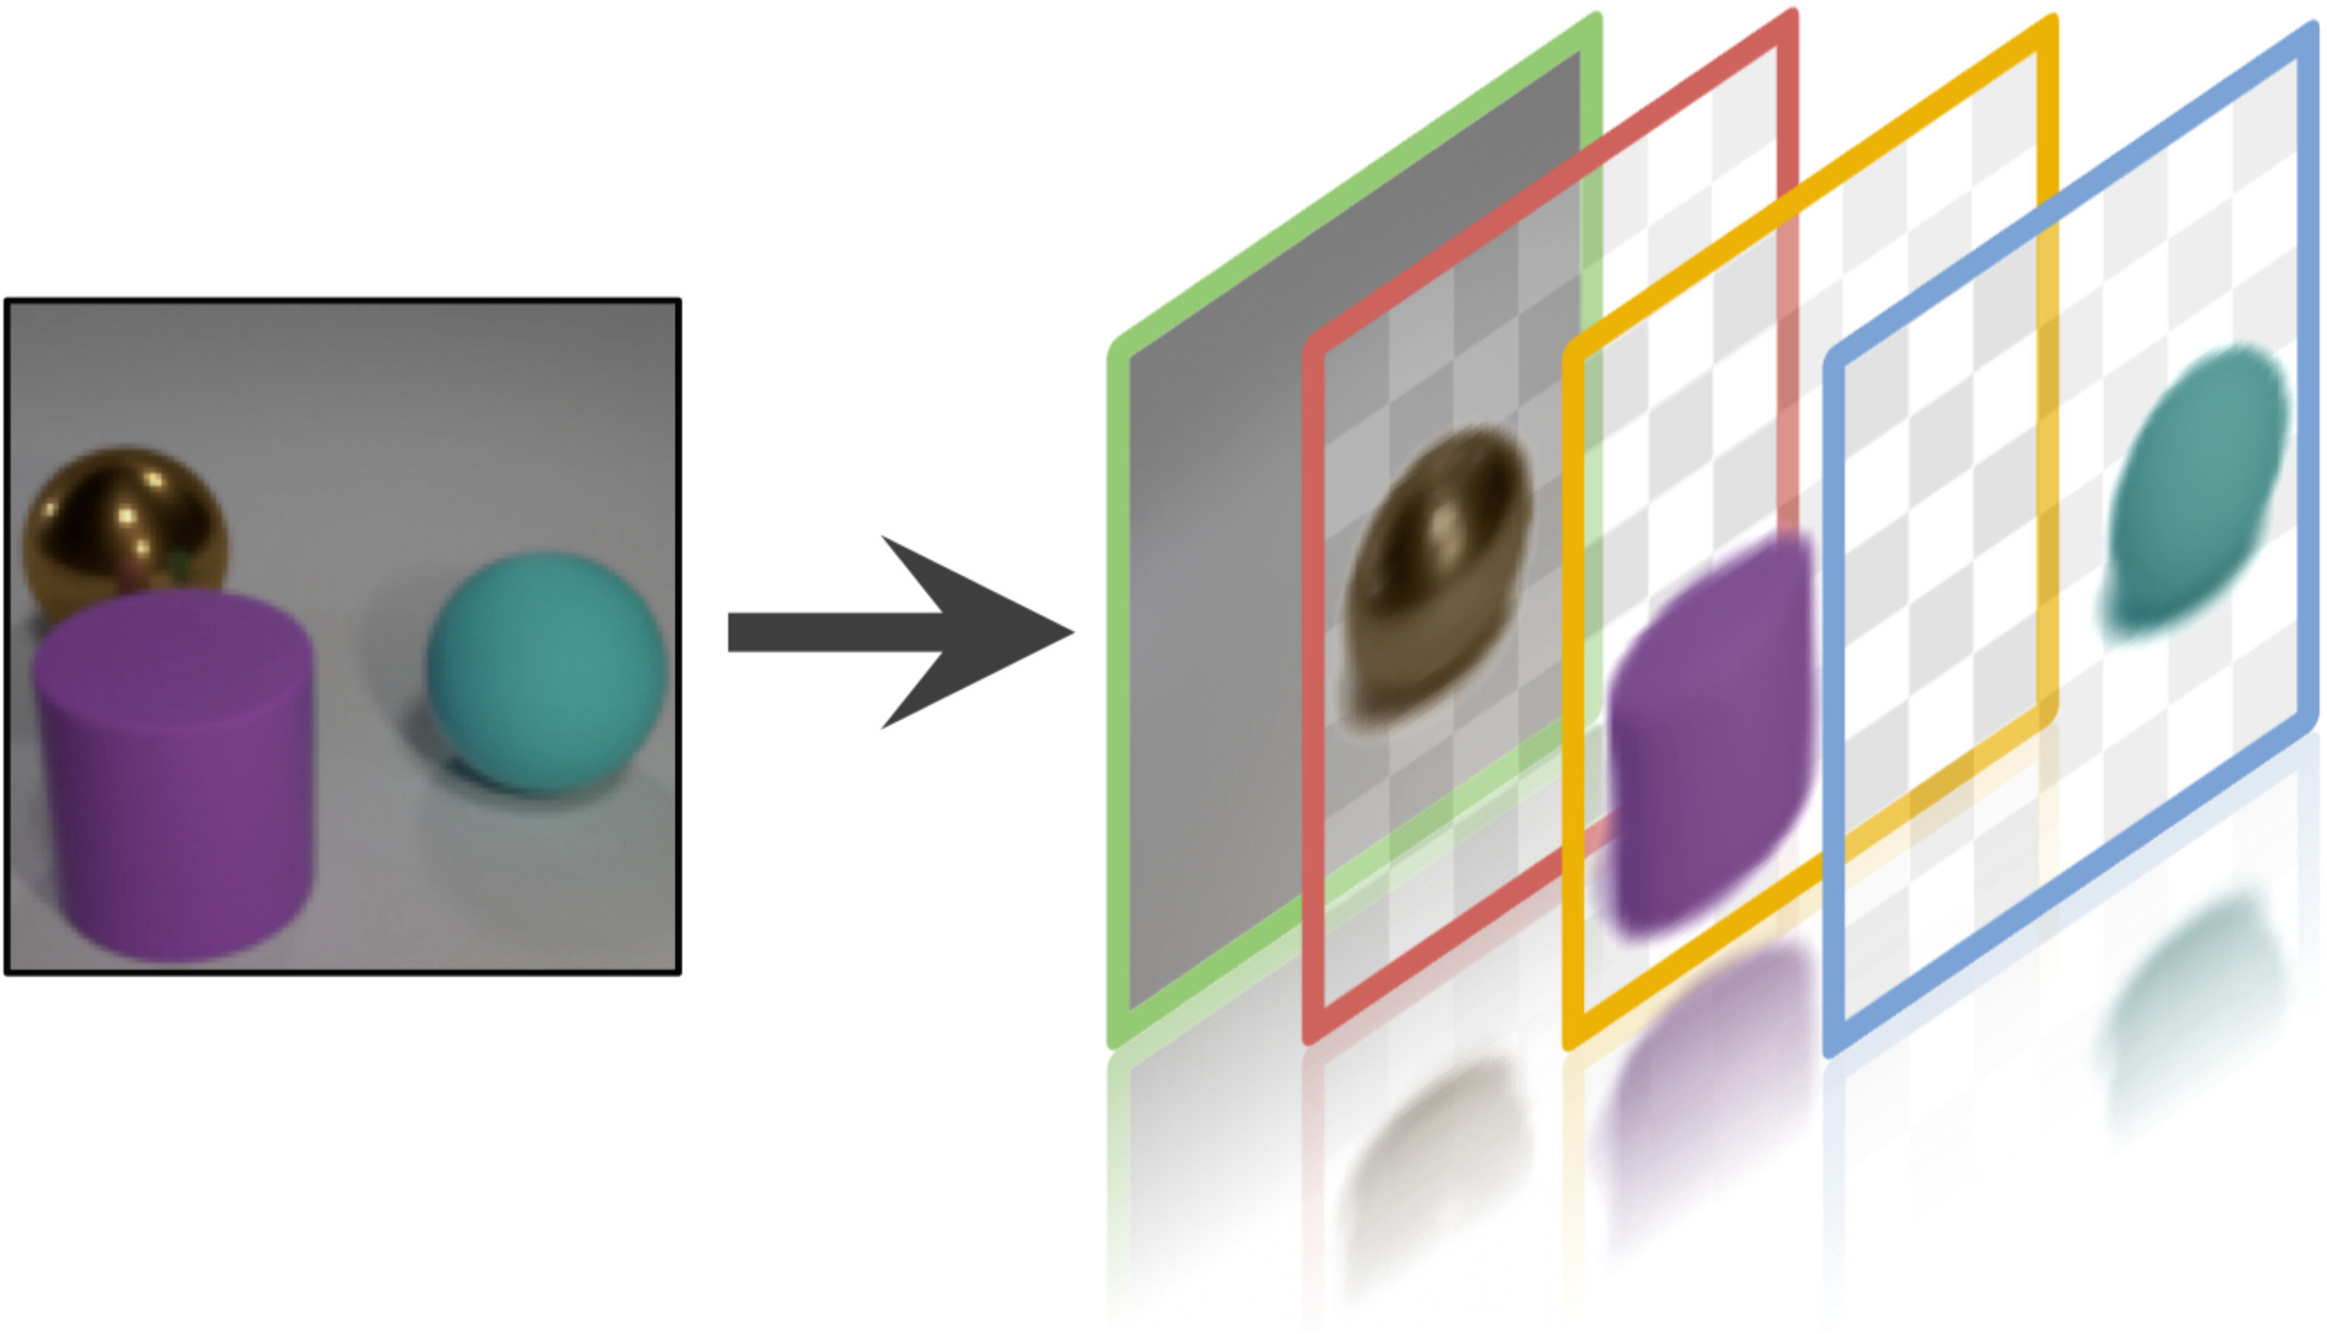
Our work
image = layered composition of transformed 2D prototypes
Notes:
an unsupervised algorithm that learns to decompose an image into object layers. Compared to previous methods which use neural networks to generate layers,
our key insight is to model layers as the explicit transformations of learnable prototypes called sprites. Transformations can notably include positioning the object in the image, changing its scale or even modifying its color.

Slide 4
Why does it matter?
Scene understanding
Environment abstraction
Object-centric image editing
Object discovery
Notes:
Such a layered decomposition algorithm could be beneficial for a wide range of applications such as scene understanding, environment abstraction, object discovery or object-centric image editing.

Slide 5
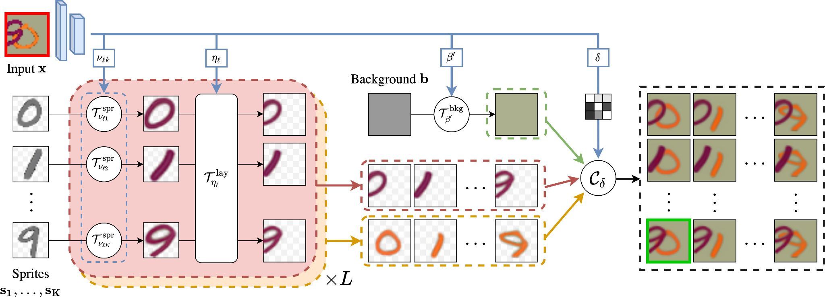
Overview
1
Sprites and background prototypes
Notes:
Our proposed approach has 3 main components.
First, we introduce a small set of object prototypes, called sprites, which take the form of learnable RGB images with a transparency channel.
We propose to learn another set of prototypes when modeling background.

Slide 6
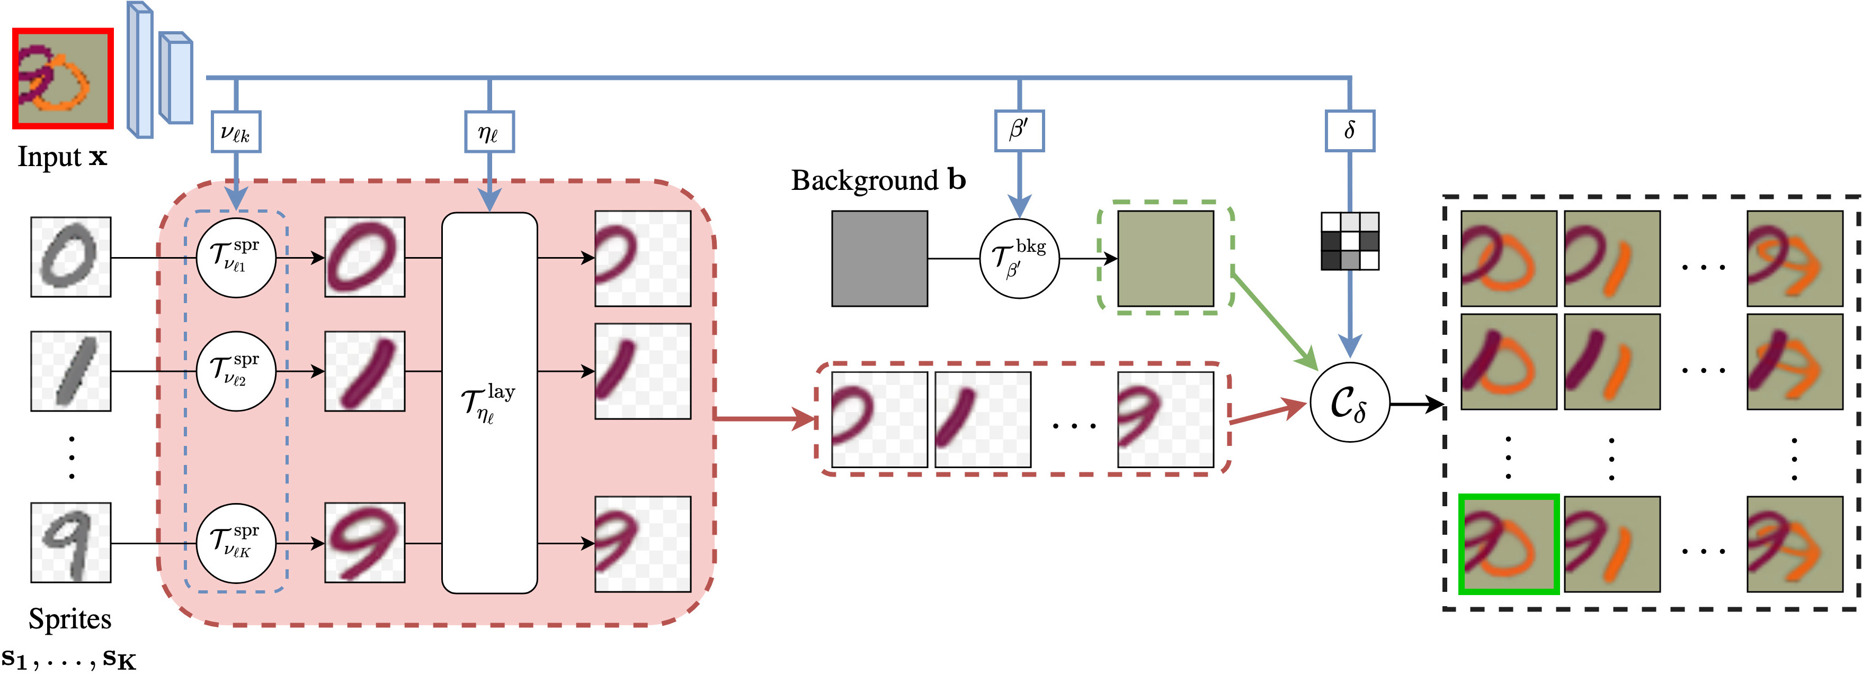
Overview
2
Differentiable transformation predictors
Notes:
Second, given an input image,
we propose to learn differentiable functions that output transformation parameters necessary to instanciate the sprites in a given layer.
We repeat the process several times to obtain candidates for each object layer.
Similarly, transformation parameters are predicted for the background prototype if any.

Slide 7
Overview
Learnable
3
Layered composition process with occlusion
Notes:
Finally, object layer candidates are composited through an adaptation of the classical alpha blending, where the occlusion between objects is learned.
This results in many possible reconstructions and we introduce a greedy algorithm to select the best one here in green.
To summarize, the learnable parts are the sprites, the background prototypes, and predictors for occlusions and transformation parameters. They are learned jointly and end-to-end by minimizing a reconstruction error. Please see the paper for additional details.

Slide 8
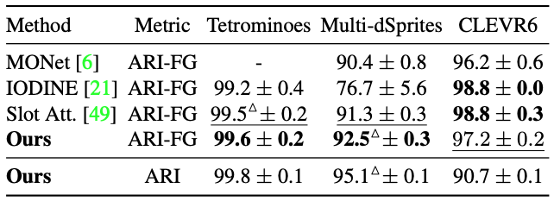
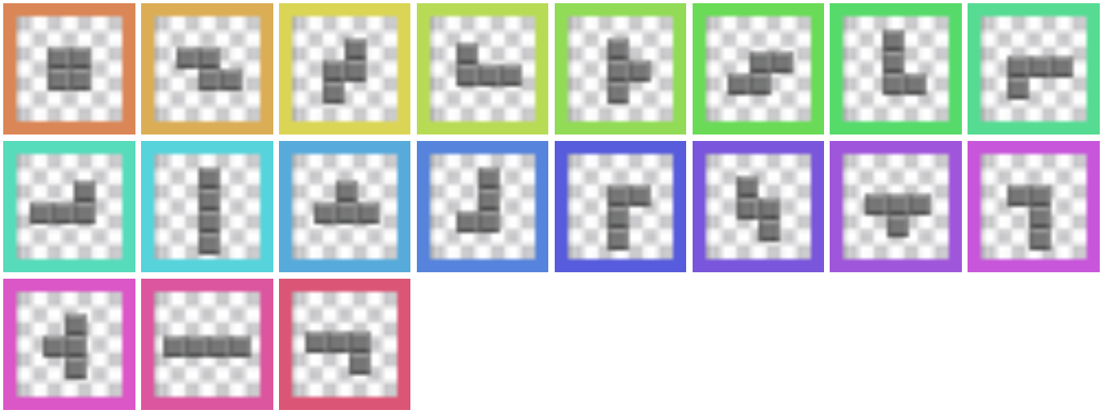
Multi-object discovery results
Discovered sprites
Notes:
We apply our approach on 3 standard multi-object benchmarks.
First, we discover for each dataset different object categories without any supervision whatsoever.
Using transformations of such sprites, our predicted reconstructions match accurately the input images.
By analysis-by-synthesis, we can then infer their semantic segmentation, where each mask is colored with respect to the sprite used,
Additionally, we can predict their instance segmentation, where each color corresponds to a different instance. Resulting image decompositions are shown on the right.
Quantitatively, we compare our approach to the state of the art and demonstrate results on par with the best methods.

Slide 9
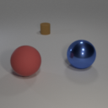
Object-centric image manipulation
Object swapping
2D position
Scale
Color
Notes:
Because we explicitly model the image formation, our framework enables controllable object-centric image manipulations. Given an input image, we can
Swap objects with other prototypes,
Change their 2D positions,
Scale them into small or large objects,
And modify their colors. Note that we are able to render out of distribution instances, like the pink sphere or the gigantic cylinder.

Slide 10
Image clustering
GTSRB-8
SVHN
Notes:
We further demonstrate our approach robustness by applying our 2-layer model to real images. When applied to image clustering benchmarks,
our method accurately discovers one prototype per category. We provide quantitative results for these benchmarks in the paper and show that we outperform previous approaches.

Slide 11
Co-segmentation
Weizmann horse database
Notes:
We evaluated the quality of our learned sprite (on the left alongwith its mask) when applied to a dataset of horse images (on the right). Even in this case, the discovered sprite is meaninful and its spatial extent accurate.
Using our explicit image formation process, we can reconstruct a given input and decompose it in order to extract the foreground.

Slide 12
Object discovery on Instagram
Notes:
Finally, we apply our framework on raw instagram collections associated to different hashtags. While most images are noise,
our unsupervised approach is still able to learn meaninful sprites.

Slide 13
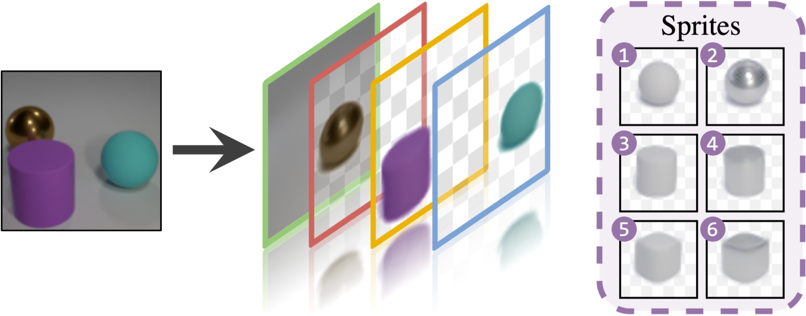
Unsupervised Layered Image Decomposition into Object Prototypes
Tom Monnier¹ Elliot Vincent^{1,2} Jean Ponce^{2,3} Mathieu Aubry¹
¹LIGM, École des Ponts ²INRIA and DIENS ³Center for Data Science, NYU
Project webpage
http://imagine.enpc.fr/~monniert/DTI-Sprites/
Code
https://github.com/monniert/dti-sprites
Notes:
More details are available on our project webpage, thanks for watching!

Slide 14
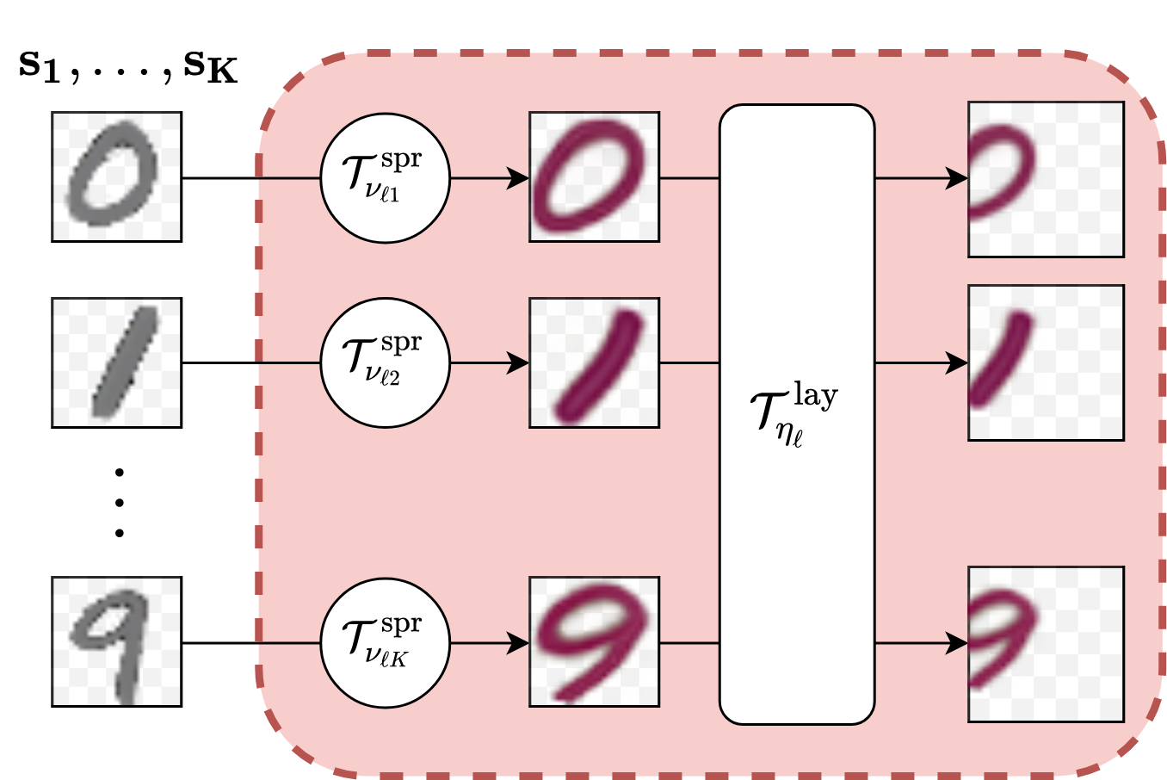
Approach formalization
object layers
sprites
Notes:
More

