Slide 1




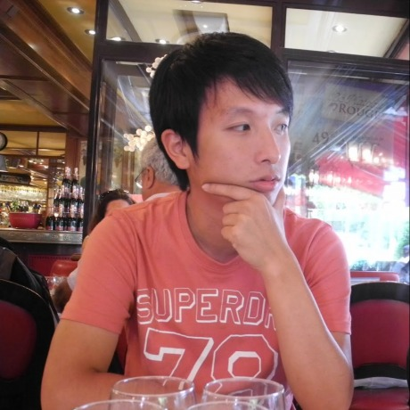


Re-ranking for image retrieval and
transductive few-shot classification
Xi Shen¹
Yang Xiao¹
Shell Xu Hu²
Othman Sbai^{1, 3}
Mathieu Aubry¹
1. Ecole des Ponts, ParisTech 2. Samsung AI Center, Cambridge 3. Facebook AI Research
Notes:
Hi, I am Xi Shen. I present our work re-ranking for image retrieval and transductive few-shot classification.

Slide 2


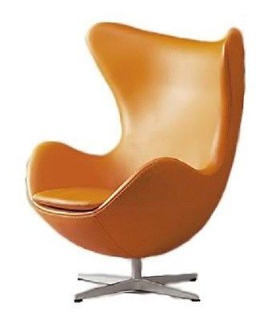

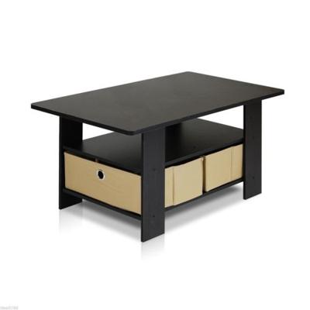

Image retrieval and re-ranking
Retrieval

Slide 3
Image retrieval and re-ranking
Retrieval
Re-ranking

Slide 4
Image retrieval and re-ranking
Retrieval
First order neighbors :
AQE [Ondrei et al. 2007]
AQEwD [Gordo et al. 2017]
…
Re-ranking

Slide 5
Image retrieval and re-ranking
Retrieval
First order neighbors :
AQE [Ondrei et al. 2007]
AQEwD [Gordo et al. 2017]
…
High order neighbors:
k-reciprocal [Zhong et al. 2017]
Region diffusion [Iscen et al. 2017]
…
Re-ranking

Slide 6
Contributions
A deep learning approach to update similarity graph
A unified solution to both image retrieval and transductive few-shot classification
Our method can be seen as revisiting and complementing classical approaches to re-ranking with deep learning techniques.

Slide 7
Main idea
SSR
Notes:
Our key insight is to an improved similarity graph.

Slide 8
Main idea
SSR
Notes:
Our key insight is to an improved similarity graph.

Slide 9
Main idea
SSR
Notes:
Our key insight is to an improved similarity graph.

Slide 10
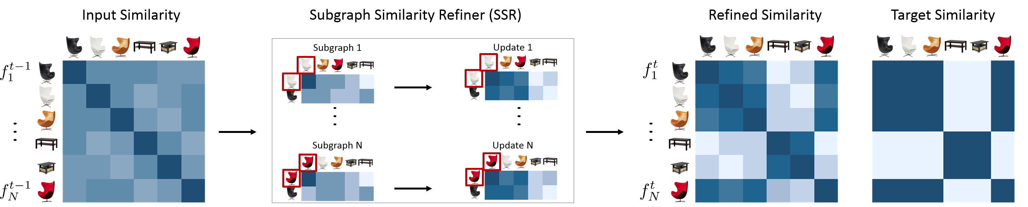
Our approach: SSR
Notes:
Our key insight is to an improved similarity graph.

Slide 11
Our approach: SSR
Updating similarities
Notes:
Our key insight is to an improved similarity graph.

Slide 12
Our approach: SSR
Updating features
Notes:
Our key insight is to an improved similarity graph.

Slide 13
Our approach: SSR
Loss
Notes:
Our key insight is to an improved similarity graph.

Slide 14


SSR for image retrieval
Nearest Neighbors
Nearest Neighbors
Sample
Query
Notes:
Our key insight is to an improved similarity graph.

Slide 15
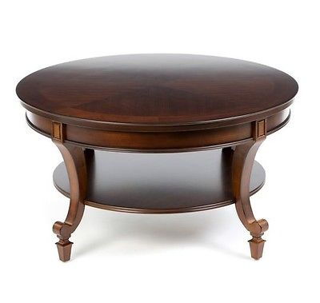








SSR for transductive few-shot classification
Sample
Notes:
Our key insight is to an improved similarity graph.

Slide 16
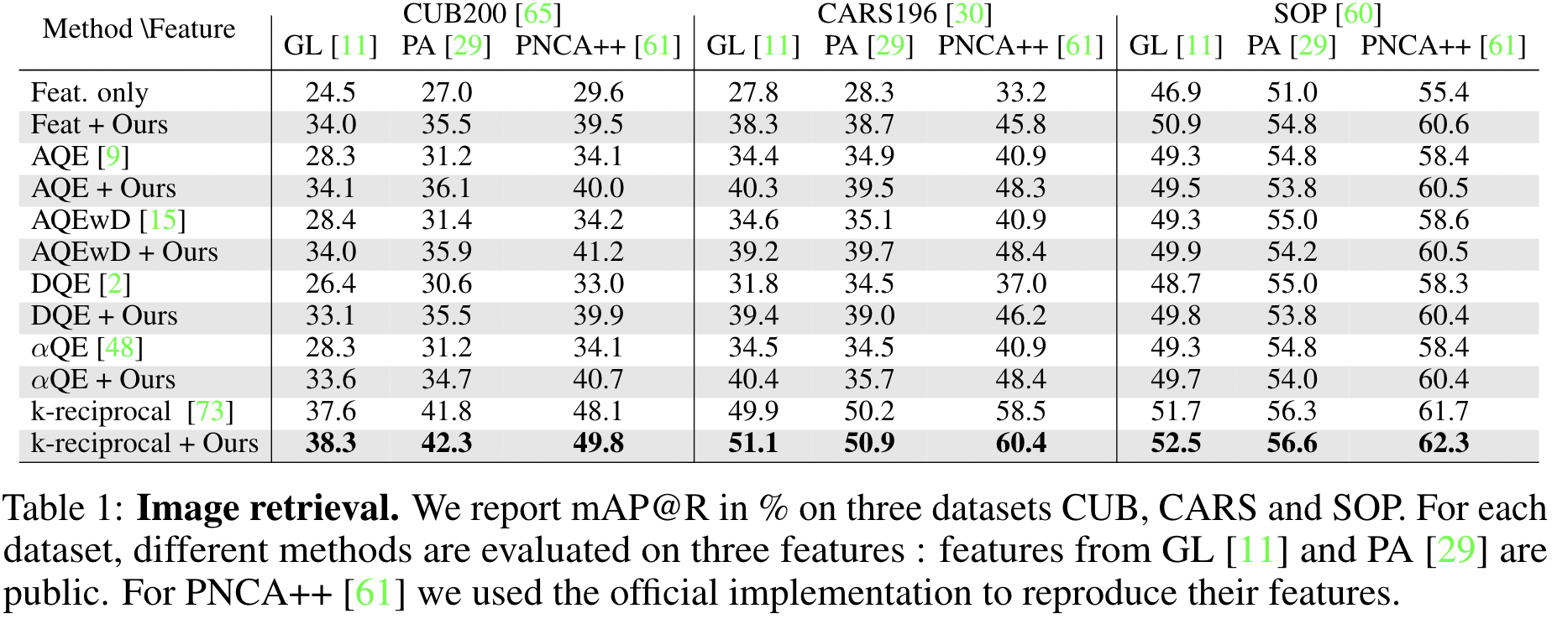
Image retrieval results on CUB, CARS and SOP
Notes:
Our key insight is to an improved similarity graph.

Slide 17
Image retrieval results on CUB, CARS and SOP
Notes:
Our key insight is to an improved similarity graph.

Slide 18
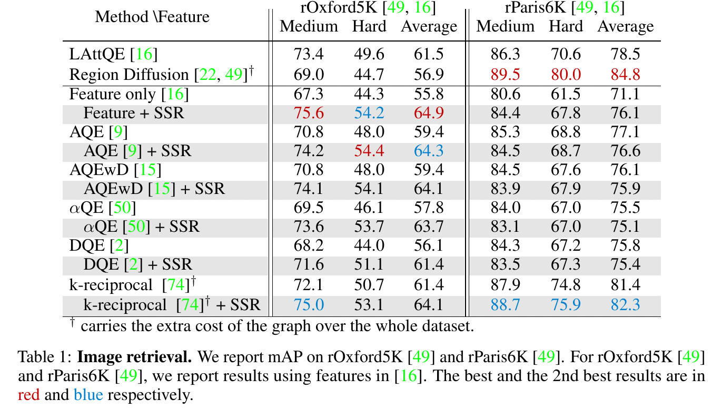
Image retrieval results on rOxford5K and rParis6K
Notes:
Our key insight is to an improved similarity graph.

Slide 19
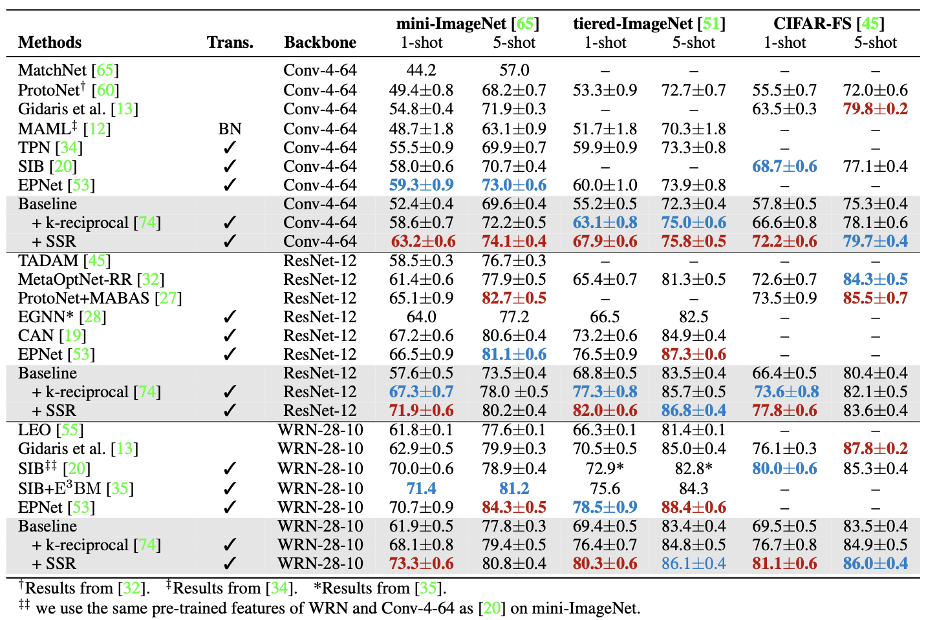
Transductive few-shot classification on mini-ImageNet, tiered-ImageNet and CIFAR-FS
Notes:
Our key insight is to an improved similarity graph.

Slide 20
Transductive few-shot classification on mini-ImageNet, tiered-ImageNet and CIFAR-FS
Notes:
Our key insight is to an improved similarity graph.

Slide 21
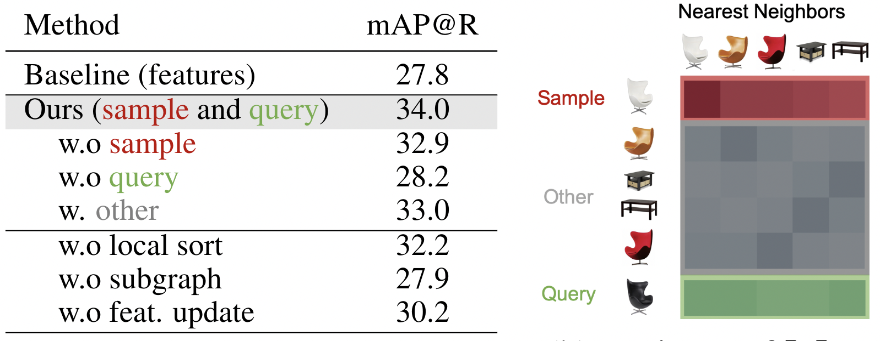
Ablation study on image retrieval
Notes:
Our key insight is to an improved similarity graph.

Slide 22
Ablation study on image retrieval
Notes:
Our key insight is to an improved similarity graph.

Slide 23
Ablation study on image retrieval
Notes:
Our key insight is to an improved similarity graph.

Slide 24
Ablation study on image retrieval
Notes:
Our key insight is to an improved similarity graph.

Slide 25
Ablation study on image retrieval
Notes:
Our key insight is to an improved similarity graph.

Slide 26

Conclusion
SSR module learn from the similarity graph
Validation on two tasks: image retrieval and transductive few-shot classification
Project page & Code
https://imagine.enpc.fr/~shenx/SSR/

